Slide 1
2
What is Faith?

Slide 2
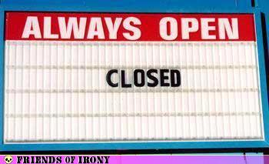

Slide 3
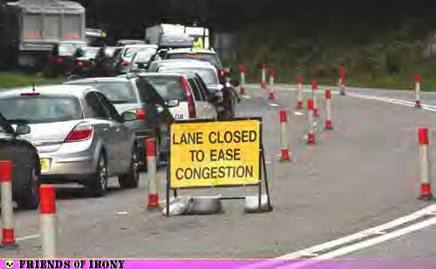

Slide 4
What is Faith?
The judgment that something stated is the truth.

Slide 5
What is Faith?
The judgment that something stated is the truth.
Belief which causes you to do what you do.

Slide 6
What is Faith?
The judgment that something stated is the truth.
Belief which causes you to do what you do.
To put your full weight down upon a cause.

Slide 7
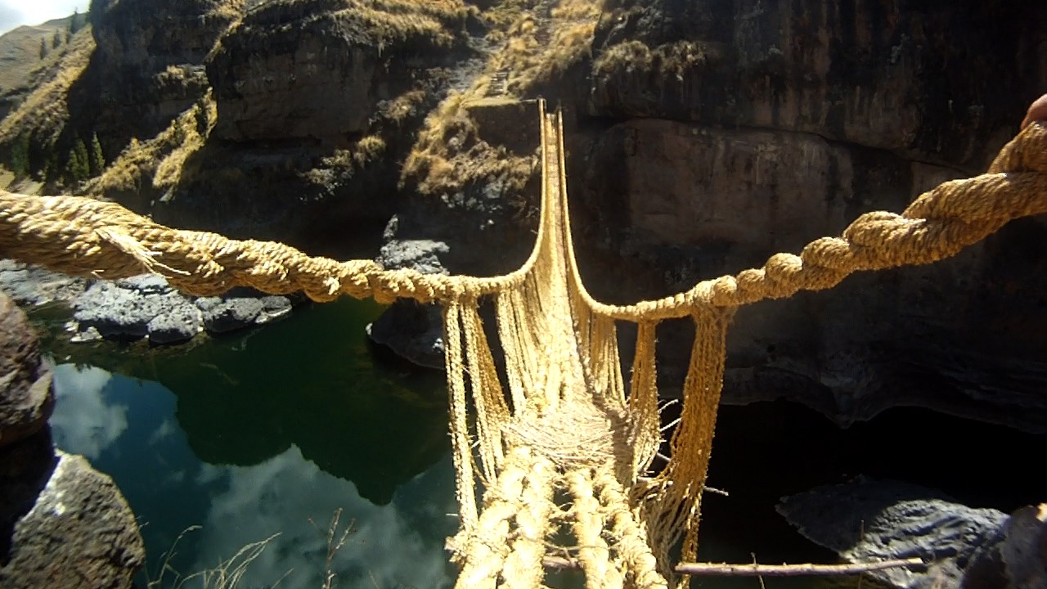
Grass Woven Suspension Bridge

Slide 8
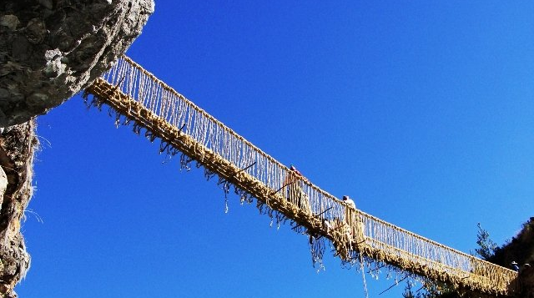

Slide 9
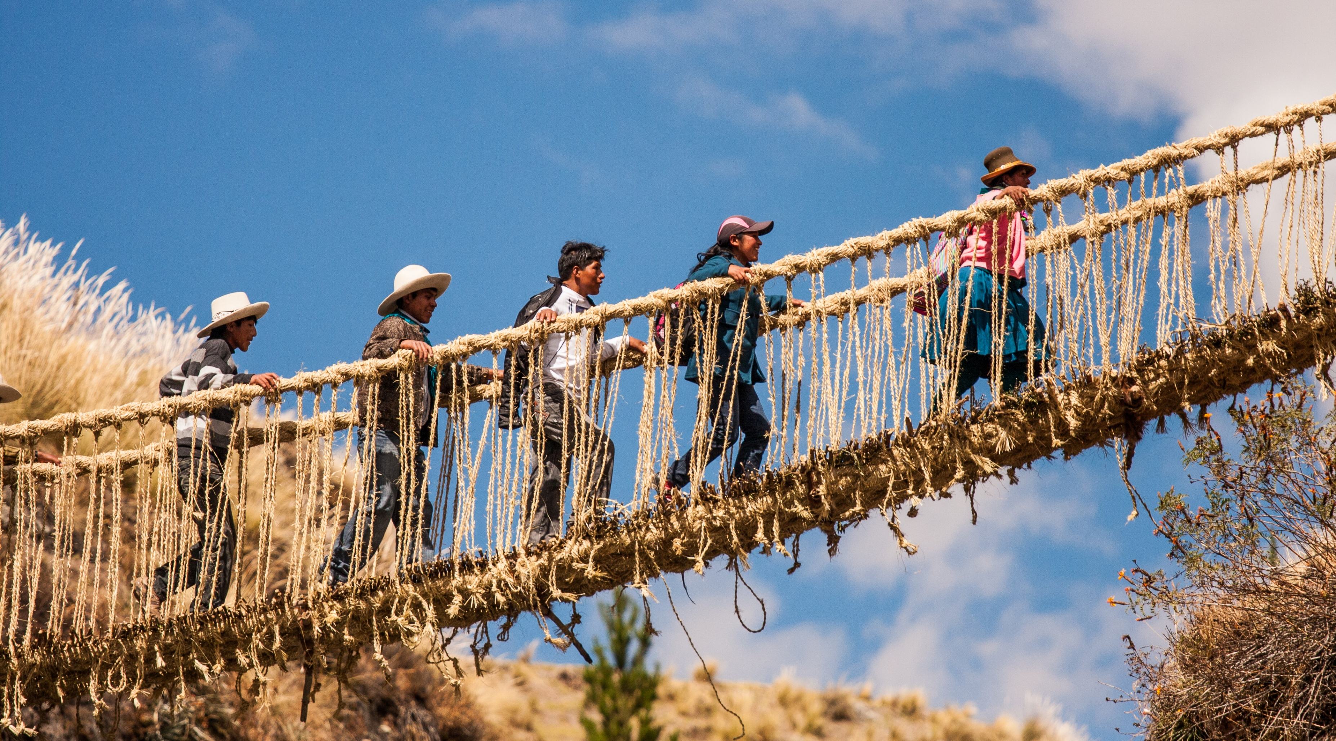

Slide 10
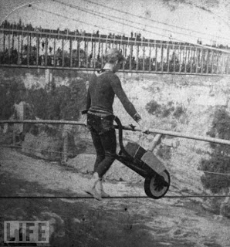
Charles Blondin
1824-1897

Slide 11
What is Faith?
The judgment that something stated is the truth.
Belief which causes you to do what you do.
To put your full weight down upon a cause.
The assent of the mind to a conviction of biblical truth.

Slide 12
What is Faith?
The judgment that something stated is the truth.
Belief which causes you to do what you do.
To put your full weight down upon a cause.
The assent of the mind to a conviction of biblical truth.
Confidence to rely on Christ in making moral choices.

Slide 13
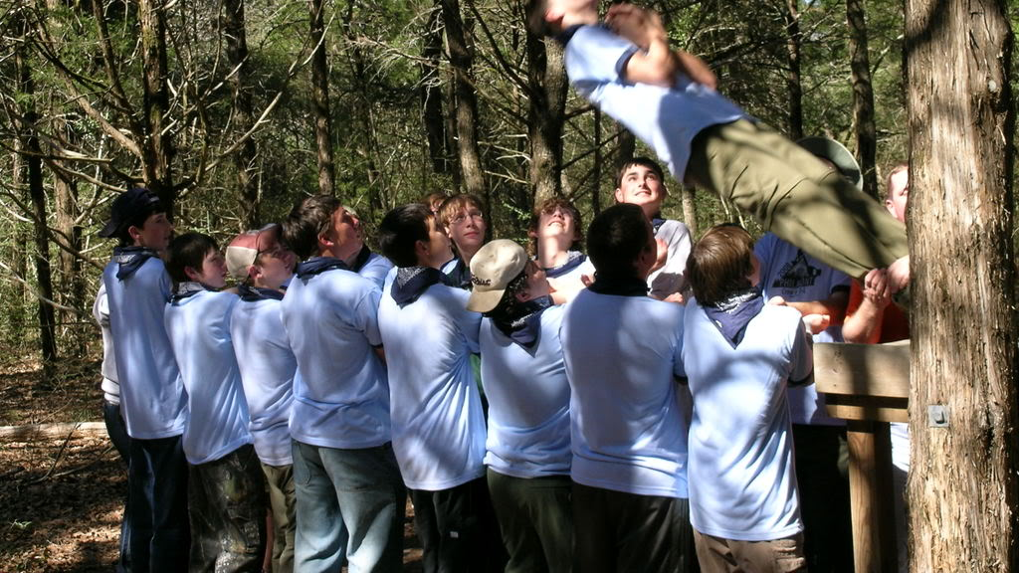

Slide 14
Now faith is the assurance of things hoped for, the conviction of things not seen.
- Hebrews 11:1

Slide 15
The assurance of things hoped for.
Sure that God can change me and you.
1 Corinthians 6:9-11
Philippians 1:3-6

Slide 16
⁹ Or do you not know that the unrighteous will not inherit the kingdom of God? Do not be deceived; neither fornicators, nor idolaters, nor adulterers, nor effeminate, nor homosexuals, ¹⁰ nor thieves, nor the covetous, nor drunkards, nor revilers, nor swindlers, will inherit the kingdom of God.
- 1 Corinthians 6:9-10

Slide 17
Such were some of you; but you were washed, but you were sanctified, but you were justified in the name of the Lord Jesus Christ and in the Spirit of our God.
- 1 Corinthians 6:11

Slide 18
³ I thank my God in all my remembrance of you, ⁴ always offering prayer with joy in my every prayer for you all,
- Philippians 1:3-4

Slide 19
⁵ in view of your participation in the gospel from the first day until now. ⁶ For I am confident of this very thing, that He who began a good work in you will perfect it until the day of Christ Jesus.
- Philippians 1:5-6

Slide 20
The assurance of things hoped for.
Sure that I will be in heaven with God.
Hebrews 11:8-10, 13-16, 24-26

Slide 21
By faith Abraham, when he was called, obeyed by going out to a place which he was to receive for an inheritance; and he went out, not knowing where he was going.
- Hebrews 11:8

Slide 22
⁹ By faith he lived as an alien in the land of promise, as in a foreign land, dwelling in tents with Isaac and Jacob, fellow heirs of the same promise; ¹⁰ for he was looking for the city which has foundations, whose architect and builder is God.
- Hebrews 11:9-10

Slide 23
¹³ All these died in faith, without receiving the promises, but having seen them and having welcomed them from a distance, and having confessed that they were strangers and exiles on the earth. ¹⁴ For those who say such things make it clear that they are seeking a country of their own.
- Hebrews 11:13-14

Slide 24
¹⁵ And indeed if they had been thinking of that country from which they went out, they would have had opportunity to return. ¹⁶ But as it is, they desire a better country, that is, a heavenly one. Therefore God is not ashamed to be called their God; for He has prepared a city for them.
- Hebrews 11:15-16

Slide 25
²⁴ By faith Moses, when he had grown up, refused to be called the son of Pharaoh’s daughter, ²⁵ choosing rather to endure ill-treatment with the people of God than to enjoy the passing pleasures of sin, ²⁶ considering the reproach of Christ greater riches than the treasures of Egypt; for he was looking to the reward.
- Hebrews 11:24-26

Slide 26
The conviction of things not seen.
Convicted there is a heaven, there is a Devil, there is a Mighty God.

