Slide 1
12
The Covenant Between God and Israel
God Gives Moses the Plans for the Tabernacle - Part 2

Slide 2
Review of Plans for the Tabernacle
Ark of the Covenant
Table of Showbread
Golden Lampstand
Curtains, boards, sockets, veil and screens
Bronze Altar
Court of Tabernacle
Oil for the Golden Lampstand (Menorah)

Slide 3
¹ “Then bring near to yourself Aaron your brother, and his sons with him, from among the sons of Israel, to minister as priest to Me—Aaron, Nadab and Abihu, Eleazar and Ithamar, Aaron’s sons. ² You shall make holy garments for Aaron your brother, for glory and for beauty.
- Exodus 28:1-2

Slide 4
³ You shall speak to all the skillful persons whom I have endowed with the spirit of wisdom, that they make Aaron’s garments to consecrate him, that he may minister as priest to Me. ⁴ These are the garments which they shall make: a breastpiece and an ephod and a robe and a tunic of checkered work, a turban and a sash, and they shall make holy garments for Aaron your brother and his sons, that he may minister as priest to Me. ⁵ They shall take the gold and the blue and the purple and the scarlet material and the fine linen.
- Exodus 28:3-5

Slide 5
Family heads offered sacrifice for their families
{
Noah
Abraham Jacob

Slide 6
Chosen priests offered sacrifice for God’s people
{
Aaron +
Sons

Slide 7
© Sweet Publishing

Slide 8
© Sweet Publishing

Slide 9
Aaron’s Sons
Nadab
Abihu
Ithamar
Eleazar
}
Killed for offering “strange” fire
Eli (Samuel) descendant
Succeeds Aaron as High Priest
Zadok descendent

Slide 10
Men belonging to the tribe of “Levi” were appointed by God to help the priests in the work of the Tabernacle.

Slide 11
¹ “Now this is what you shall do to them to consecrate them to minister as priests to Me: take one young bull and two rams without blemish, ² and unleavened bread and unleavened cakes mixed with oil, and unleavened wafers spread with oil; you shall make them of fine wheat flour.
- Exodus 29:1-2

Slide 12
³ You shall put them in one basket, and present them in the basket along with the bull and the two rams. ⁴ Then you shall bring Aaron and his sons to the doorway of the tent of meeting and wash them with water.
- Exodus 29:3-4

Slide 13
⁵ You shall take the garments, and put on Aaron the tunic and the robe of the ephod and the ephod and the breastpiece, and gird him with the skillfully woven band of the ephod; ⁶ and you shall set the turban on his head and put the holy crown on the turban.
- Exodus 29:5-6

Slide 14
⁷ Then you shall take the anointing oil and pour it on his head and anoint him. ⁸ You shall bring his sons and put tunics on them. ⁹ You shall gird them with sashes, Aaron and his sons, and bind caps on them, and they shall have the priesthood by a perpetual statute. So you shall ordain Aaron and his sons.
- Exodus 29:7-9

Slide 15
© Sweet Publishing

Slide 16
© Sweet Publishing

Slide 17
Consecration Ceremony (Exodus 29:1-46)
Presentation of offerings – 29:1-3
Water cleansing – 29:4
Dressing Aaron – 29:5-6
Anointing Aaron – 29:7
Dressing Aaron’s Sons – 29:8-9

Slide 18
Consecration Ceremony Continued
Offering and Consumption of Sacrifice
Bull is sacrificed – 29:10-14
First ram sacrificed – 29:15-18
Second ram sacrificed – 29:19-34
Sacrifices and consumption repeated for 7 days – 29:35-37

Slide 19
Types of Sacrifices
Sin or guilt offering – Lev. 4-6
Burnt offering – Lev. 1
Grain or meal offering – Lev. 2
Fellowship or peace offering – Lev. 2; 7:11-12
Wave or heave offering – Lev. 7
Daily offerings – Ex. 29:38-42

Slide 20
⁴³ I will meet there with the sons of Israel, and it shall be consecrated by My glory. ⁴⁴ I will consecrate the tent of meeting and the altar; I will also consecrate Aaron and his sons to minister as priests to Me. ⁴⁵ I will dwell among the sons of Israel and will be their God. ⁴⁶ They shall know that I am the Lord their God who brought them out of the land of Egypt, that I might dwell among them; I am the Lord their God.
- Exodus 29:43-46

Slide 22
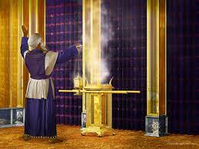

Slide 23
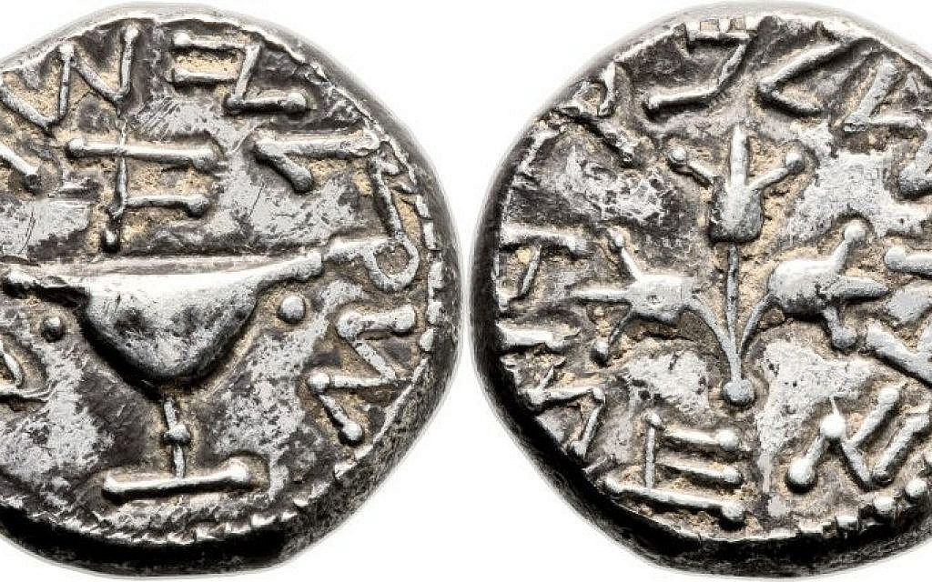

Slide 24
¹⁷ The Lord spoke to Moses, saying, ¹⁸ “You shall also make a laver of bronze, with its base of bronze, for washing; and you shall put it between the tent of meeting and the altar, and you shall put water in it. ¹⁹ Aaron and his sons shall wash their hands and their feet from it;
- Exodus 30:17-19

Slide 25
²⁰ when they enter the tent of meeting, they shall wash with water, so that they will not die; or when they approach the altar to minister, by offering up in smoke a fire sacrifice to the Lord. ²¹ So they shall wash their hands and their feet, so that they will not die; and it shall be a perpetual statute for them, for Aaron and his descendants throughout their generations.”
- Exodus 30:20-21

Slide 27
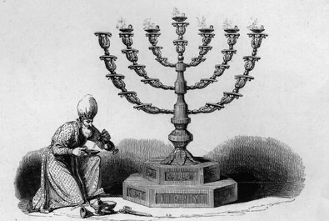

Slide 28
Incense – Exodus 30:34-38
Special recipe
Rare and expensive ingredients
Regarded as holy
Not for personal use
Punishable by death

Slide 29
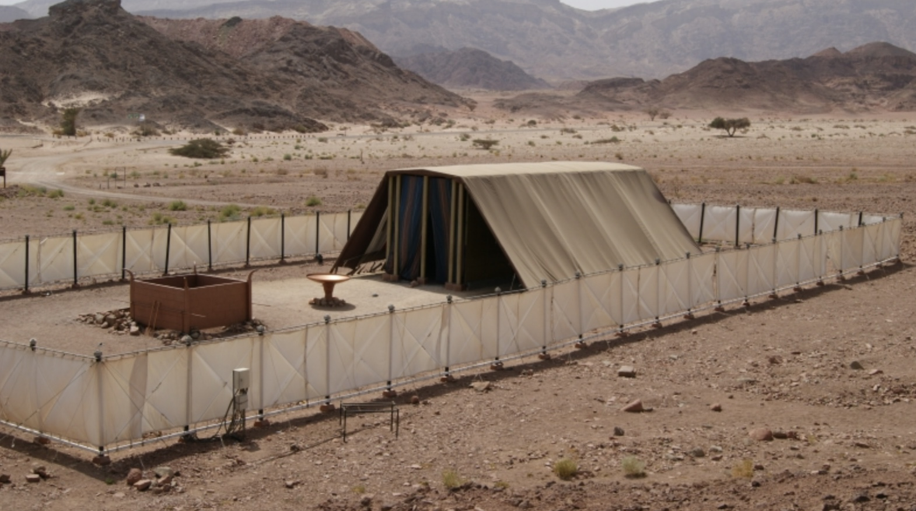

Slide 30
The priests and Tabernacle were in service to keeping the Sabbath.

Slide 31
Lesson
Christians must distinguish between what is holy and what is not.

Slide 32
Practicing this cultivates the virtue of piety.

