Slide 1
13
Rewinding the Clock!

Slide 2
Hold firmly to Scripture; loosely to theories

Slide 3
Calculating the age of the universe
No scientific test to measure the age of the universe – must be calculated
Like all age calculations, there are assumptions involved

Slide 4
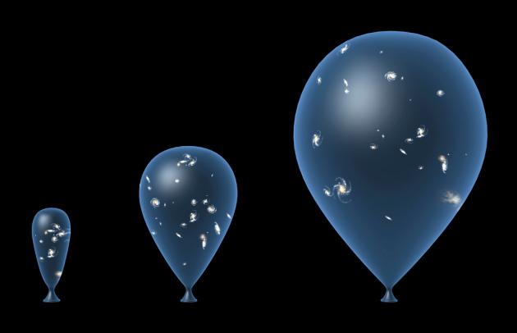
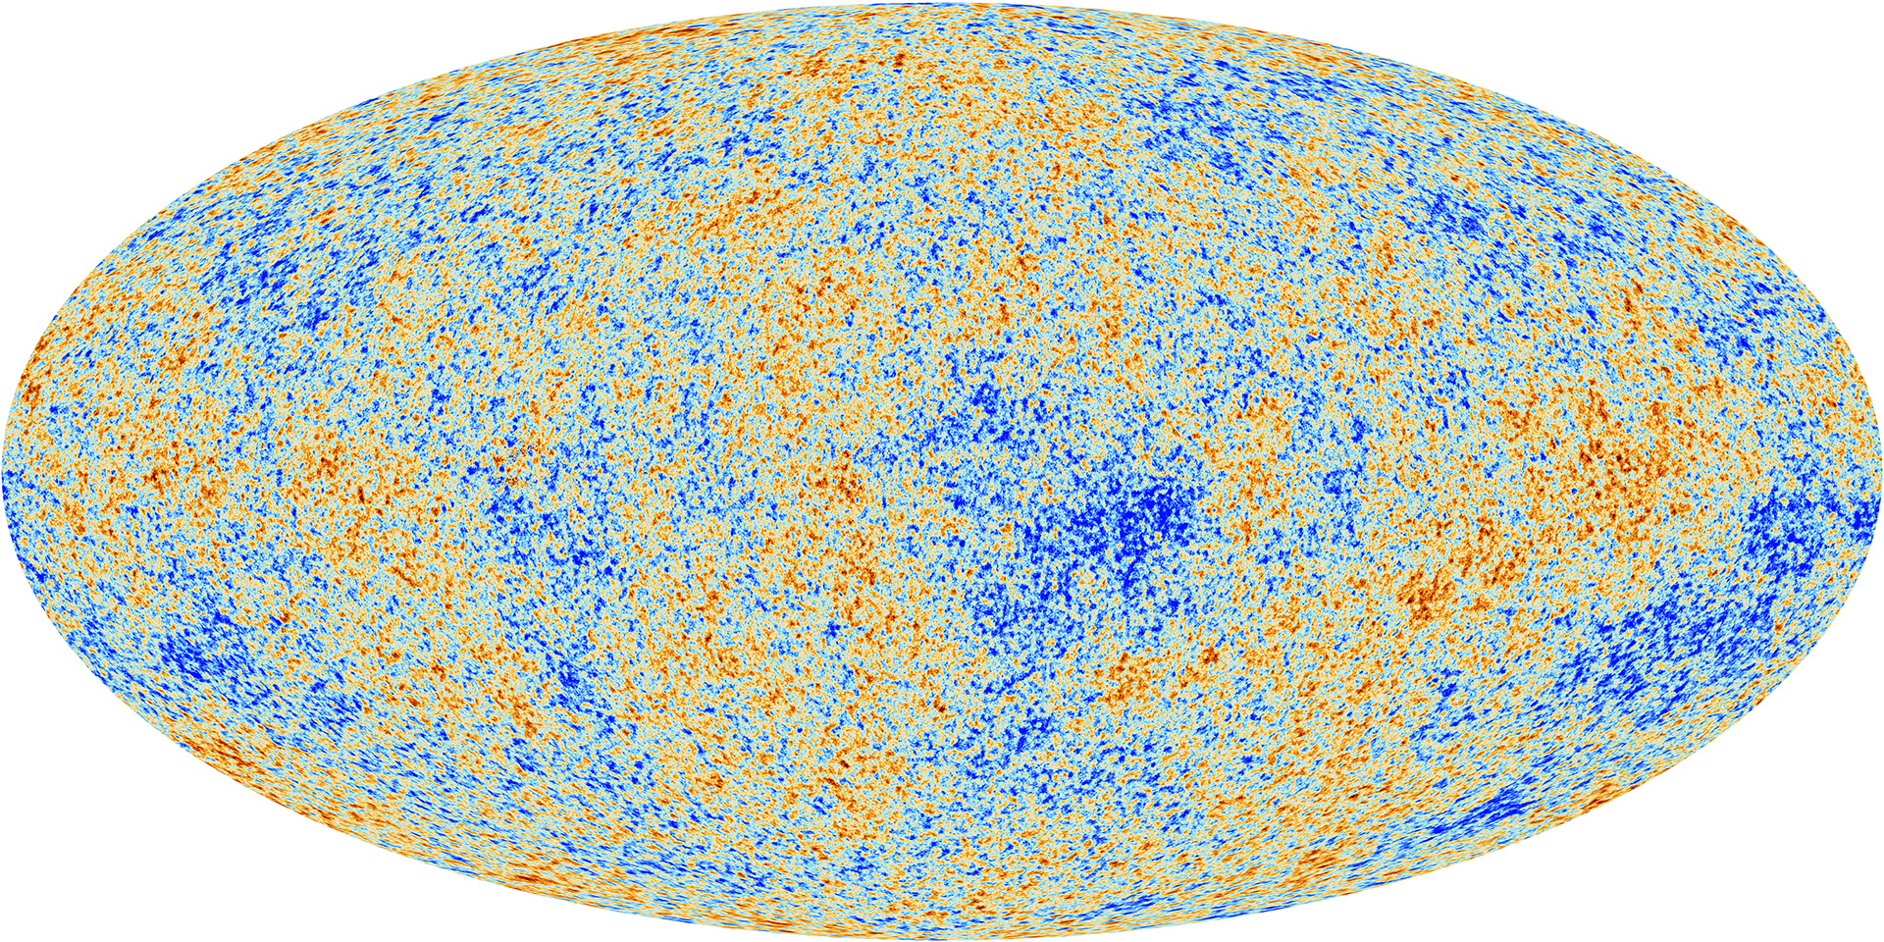
Calculating the age of the universe
H
CMB

Slide 5
Is the universe old?

Slide 6
Who alone stretches out the heavens, And walks on the waves of the sea;
- Job 9:8

Slide 7
Rewinding the clock!
If something is stretched out over time:
You can measure the current rate of stretching
Then calculate backwards the time it took to get to its present position

Slide 8
Rewinding the clock!
Time

Slide 9
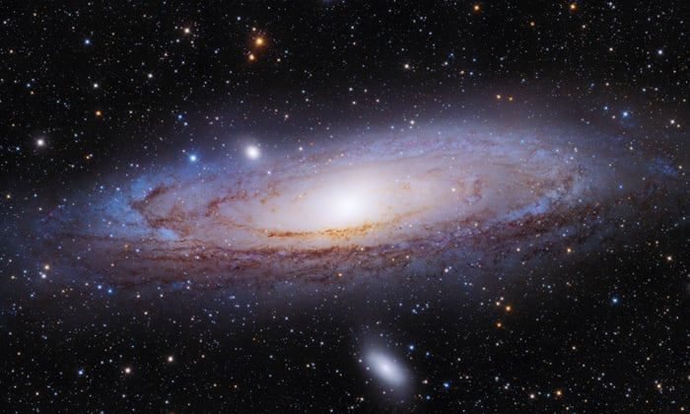
Old Universe?
We are here

Slide 10
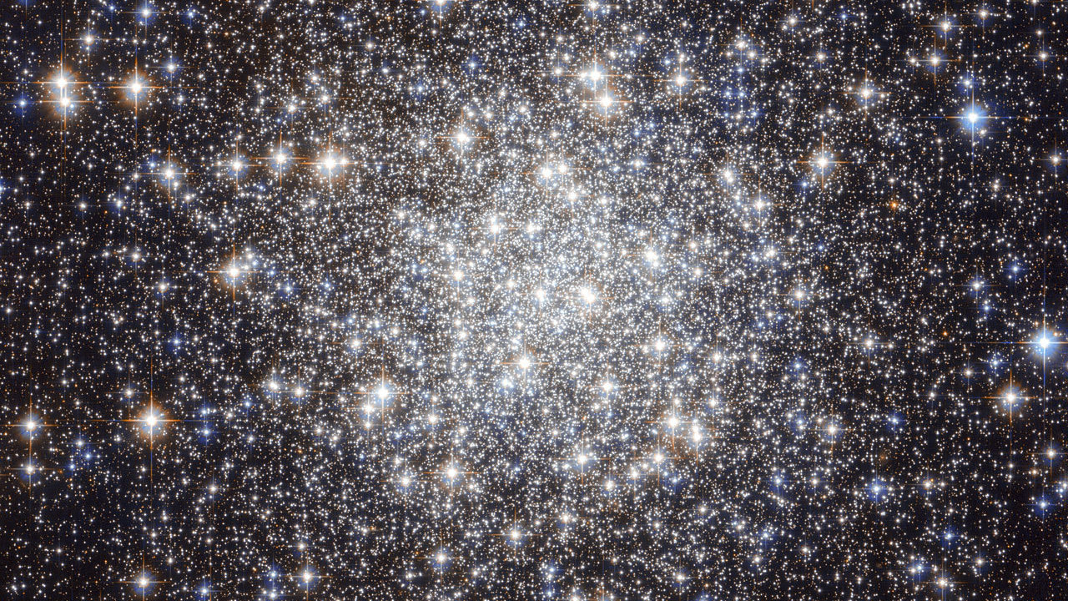
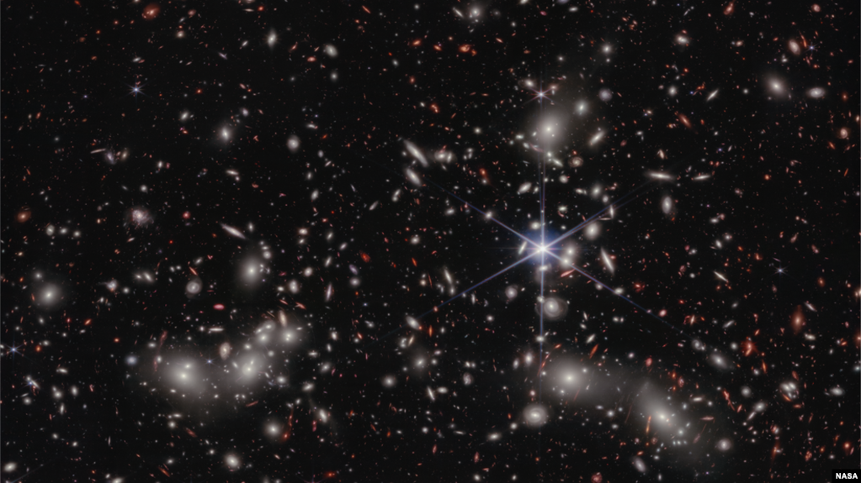
Old Universe?
“Raise your eyes on high And see who has created these stars, The One who brings out their multitude by number, He calls them all by name; Because of the greatness of His might and the strength of His power, Not one of them is missing”
Isaiah 40:26

Slide 11
Rewinding the clock!
12 – 14 billion years

Slide 12
Rewinding the clock!
Cosmic Microwave Background
-454.7632 F
-/- 5 F

Slide 13
Old Universe?
Hubble & CMB Unknowns
History of the expansion rate is constant
Current density of the universe
Composition of the universe
Cosmological constant (Hubble)

Slide 14
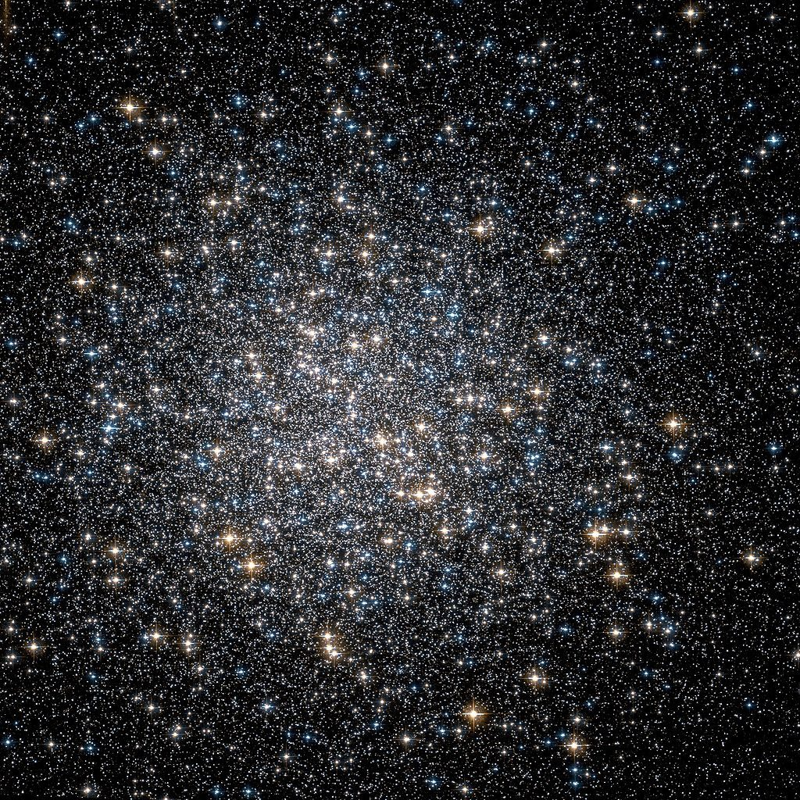
Globular clusters
M13 Hercules Globular Cluster

Slide 15
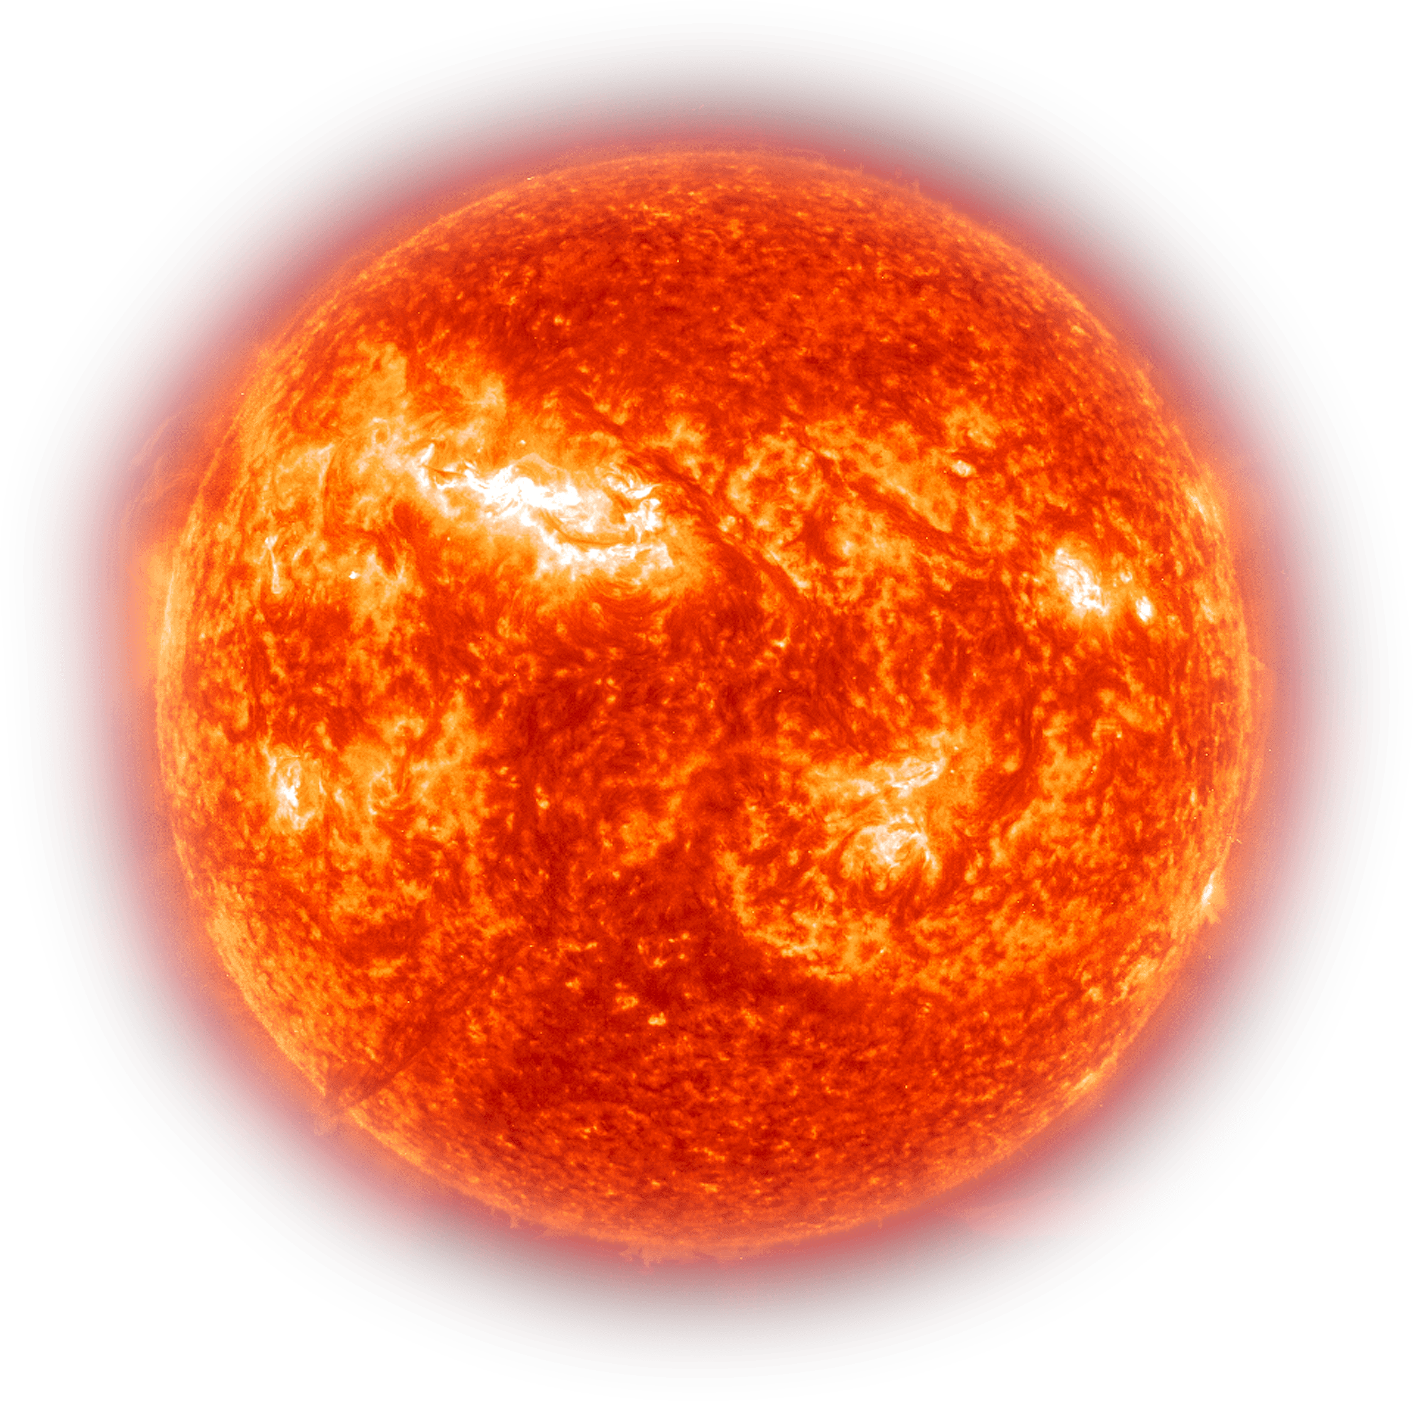
Dating globular clusters
2x sun
Our sun
½ sun
800 million years
to burn out
9 billion years
to burn out
20 billion years
to burn out

Slide 16
Old Universe?
Globular Cluster Unknowns
History of the burnout rate
The exact distance to the cluster
Ignorance of stellar evolution details

Slide 17
Is the universe young?

Slide 18
Young universe?
Scientific Evidences for youth
Galaxies wind themselves up too fast
Too few super nova remnant
Comets disintegrate too quickly
New light from binary stars
Matter in the universe is too clumpy
Too many blue giants (stars)
Lack of green pea galaxies at the edge of the universe
Biological material decays too fast
Fossil radioactivity
Too much helium in minerals
Too much C14 in deep geological strata that should not be there
Not enough stone age skeletons
Agriculture is too recent
Homo Sapiens history is too short

Slide 19
Young universe?
Adam
Abraham
Jesus
Today
~2000 years
~2000 years
~2000 years
~6,000 years total
Why is this not an exact figure?

Slide 20
Young universe?
Gen 5:3 “When Adam had lived 130 years, he fathered a son in his own likeness, according to his image, and named him Seth.”
Is this an exact age?

Slide 21
Young universe?
Adam to Shem
Shem to Abraham
Abraham to Jacob
Exodus of Israel
Gen 5
Gen 11
Gen 21;25;47
Ex 12
Birth of Christ
Exile
Judges
1 Kings 6
Exile to Christ 580 years +/- 50 years
Judges to Exile 345 years
Solomon +/- 25 years
Today
What about the days in Genesis?

Slide 22
… probably, so far as I know, there is no professor of Hebrew or Old Testament at any world-class university who does not believe that the writer(s) of Genesis 1–11 intended to convey to their readers the ideas that: … the figures contained in the Genesis genealogies provided by simple addition a chronology from the beginning of the world up to later stages in the biblical story.
Barr, J., Letter to David C.C. Watson, 1984

Slide 23
Young universe?
Why go through so much effort to force ‘time’ into the Genesis text?

Slide 24
For in six days the LORD made the heavens and the earth, the sea and everything that is in them, and He rested on the seventh day…
- Exodus 20:11

Slide 25
Why is the age of the universe important?

Slide 26
For the weapons of our warfare are not of the flesh, but divinely powerful for the destruction of fortresses
- II Corinthians 10:4

Slide 27
We are destroying arguments and all arrogance raised against the knowledge of God, and we are taking every thought captive to the obedience of Christ
- II Corinthians 10:5

Slide 28
Time is in fact the hero of the plot...What we regard as the impossible on the basis of human experience is meaningless here. Given so much time, the "impossible" becomes possible, the possible probable, and the probable virtually certain. One only has to wait: time itself performs the miracles
George Wald, "The Origin of Life", Scientific American, August 1954, p. 48.

Slide 29
But from the beginning of creation, God CREATED THEM MALE AND FEMALE
- Mark 10:6

Slide 30
Is the age of the universe important?
Death enters as the result of sin
AD 30 when Jesus spoke
Today
~6,000 years
Creation 6 days
People here
Earth
4.5 BY
People
3 MY
Today
~14 billion years
Death
Creation (“big bang”)
3 Billion Years

Slide 31
For since by a man death came, by a man also came the resurrection of the dead.
For as in Adam all die, so also in Christ all will be made alive.
- I Corinthians 15:21-22

Slide 32
Is the age of the universe important?
What does death before sin do for the gospel?
Earth
4.5 BY
People
3 MY
Today
~14 billion years
Death
Creation (“big bang”)
3 Billion Years

Slide 33
But each in his own order: Christ the first fruits, after that those who are Christ’s at His coming, then comes the end, when He hands over the kingdom to our God and Father, when He has abolished all rule and all authority and power.
- I Corinthians 15:23-24

Slide 34
Earth
4.5 BY
People
3 MY
For He must reign until He has put all His enemies under His feet.
The last enemy that will be abolished is death.
Today
~14 billion years
Death
Creation (“big bang”)
3 Billion Years
- I Corinthians 15:25-26

Slide 35
It is a difficult scientific question

Slide 36
It is a difficult scientific question
Edwin Hubble
3 BY
Walter Baade 3.6 BY
Allen Sandage 5.5 BY
Allen Sandage 7-13 BY
Allen Sandage 15-20 BY
1929
1943
1952
1958
1975
Globular Clusters
13.5 BY
Planck 13.10 BY
Planck 13.7 BY
NSF 12.7 BY
Meth. Planet 16->12 BY
Close galaxies 11.4 BY
1998
2010
2013
2019
2000-2021
2019

Slide 37
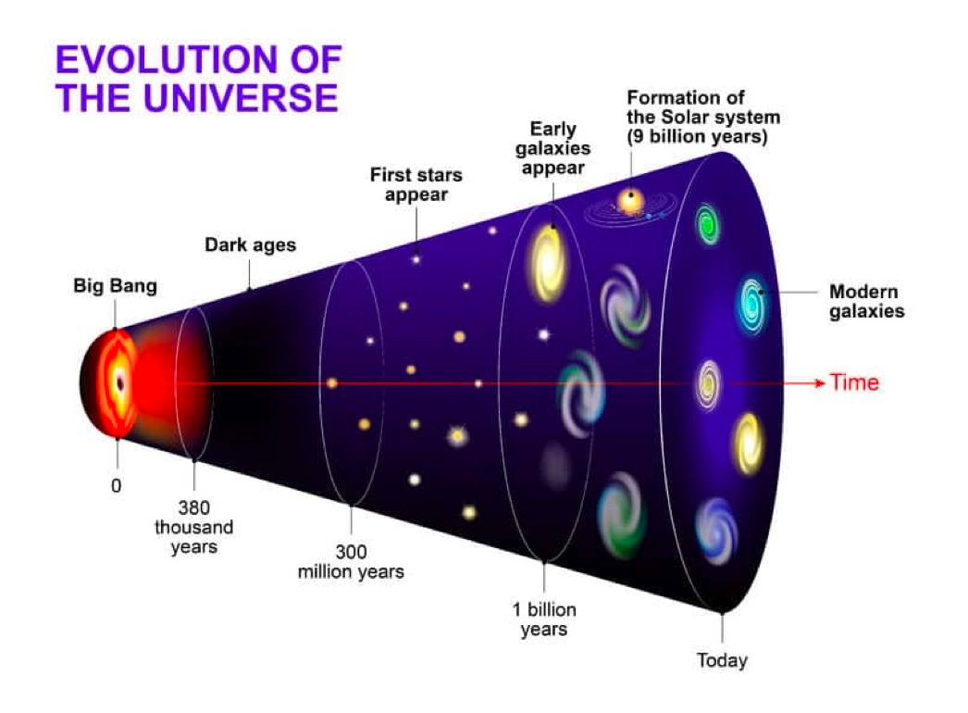
It is a difficult scientific question

Slide 38
It is a difficult scientific question
History of scientific ages
2013 Hercules-Corona Borealis was discovered
10 billion light years across (10% of the diameter of the observable Universe!)
Too large to have formed in just 3.7 BY

Slide 39
Cosmology may look like science but it isn’t a science. A basic tenet of science is that you can do repeatable experiments, and you can’t do that in cosmology.
James Gunn – Eugene Higgins Professor of Astronomy at Princeton University – Science 317:1848-1850, p. 1850, 2007

Slide 40
It is a difficult scientific question
Walk into a room, see a candle burning – how long has it been burning (length of time / age)?

Slide 41
It is a difficult scientific question
Knowing the age of something is not always easy
Assumptions are required without actually being there when it came into existence

Slide 42
The universe is mature

Slide 43
Then God said, “Let the earth sprout vegetation, plants yielding seed, and fruit trees on the earth bearing fruit according to their kind with seed in them”; and it was so.
- Genesis 1:11

Slide 44
The universe is mature
What day did God create the plants and trees - including fruit trees?
What did Adam eat on day 6?
Did God act supernaturally?

Slide 45
So God created man in His own image, in the image of God He created him; male and female He created them.
- Genesis 1:27

Slide 46
The universe is mature
What did Adam look like – a baby, toddler, teenager, or adult?
God spoke to Adam
Adam was to reproduce
Adam was to rule over the animals
Did God do something supernaturally?

Slide 47
Then God said, “Let there be lights in the expanse of the heavens to separate the day from the night, and they shall serve as signs and for seasons, and for days and years;”
- Genesis 1:14

Slide 48
He made the stars also.
- Gen 1:16b

Slide 49
The universe is mature
How did light from objects far away reach earth without taking billions of years?
Did God do something supernaturally?

Slide 50
Then God said, “Let the waters below the heavens be gathered into one place, and let the dry land appear”; and it was so.
- Genesis 1:9

Slide 51
The universe is mature
How long did it take earth to cool from a molten state before the dry land was ready for life?
Trick question! The earth was created in vs 1, had water, and dry land was ready on day 3 for life!
Did God do something supernaturally?

Slide 52
The universe is mature
Adam
Supernatural
No dating method will be accurate that does not take this into account!
Plants & Trees
Supernatural
Rocks
Supernatural
Stars/Starlight
Supernatural

Slide 53
The universe is mature
You are from another universe.
You travel to earth on day 7 of creation.

Slide 54
The universe is mature
Billions of years?
Would be wrong!
Billions of years old?
Would be wrong!
Twenties?
Would be wrong!

Slide 55
Then God said, “Let the earth sprout vegetation, plants yielding seed, and fruit trees on the earth bearing fruit according to their kind with seed in them”; and it was so.
- Genesis 1:11

Slide 56
Then God said, “Let the earth sprout vegetation, plants yielding seed, and fruit trees on the earth bearing fruit according to their kind with seed in them”; and it was so.
- Genesis 1:11

Slide 57
The universe is mature
“To Sprout, to Bring Forth!”

Slide 58
The universe is mature
https://www.youtube.com/watch?v=cadNZJvfl7s

Slide 59
It is He who sits above the circle of the earth, And its inhabitants are like grasshoppers, Who stretches out the heavens like a curtain And spreads them out like a tent to live in.
- Isaiah 40:22

Slide 60
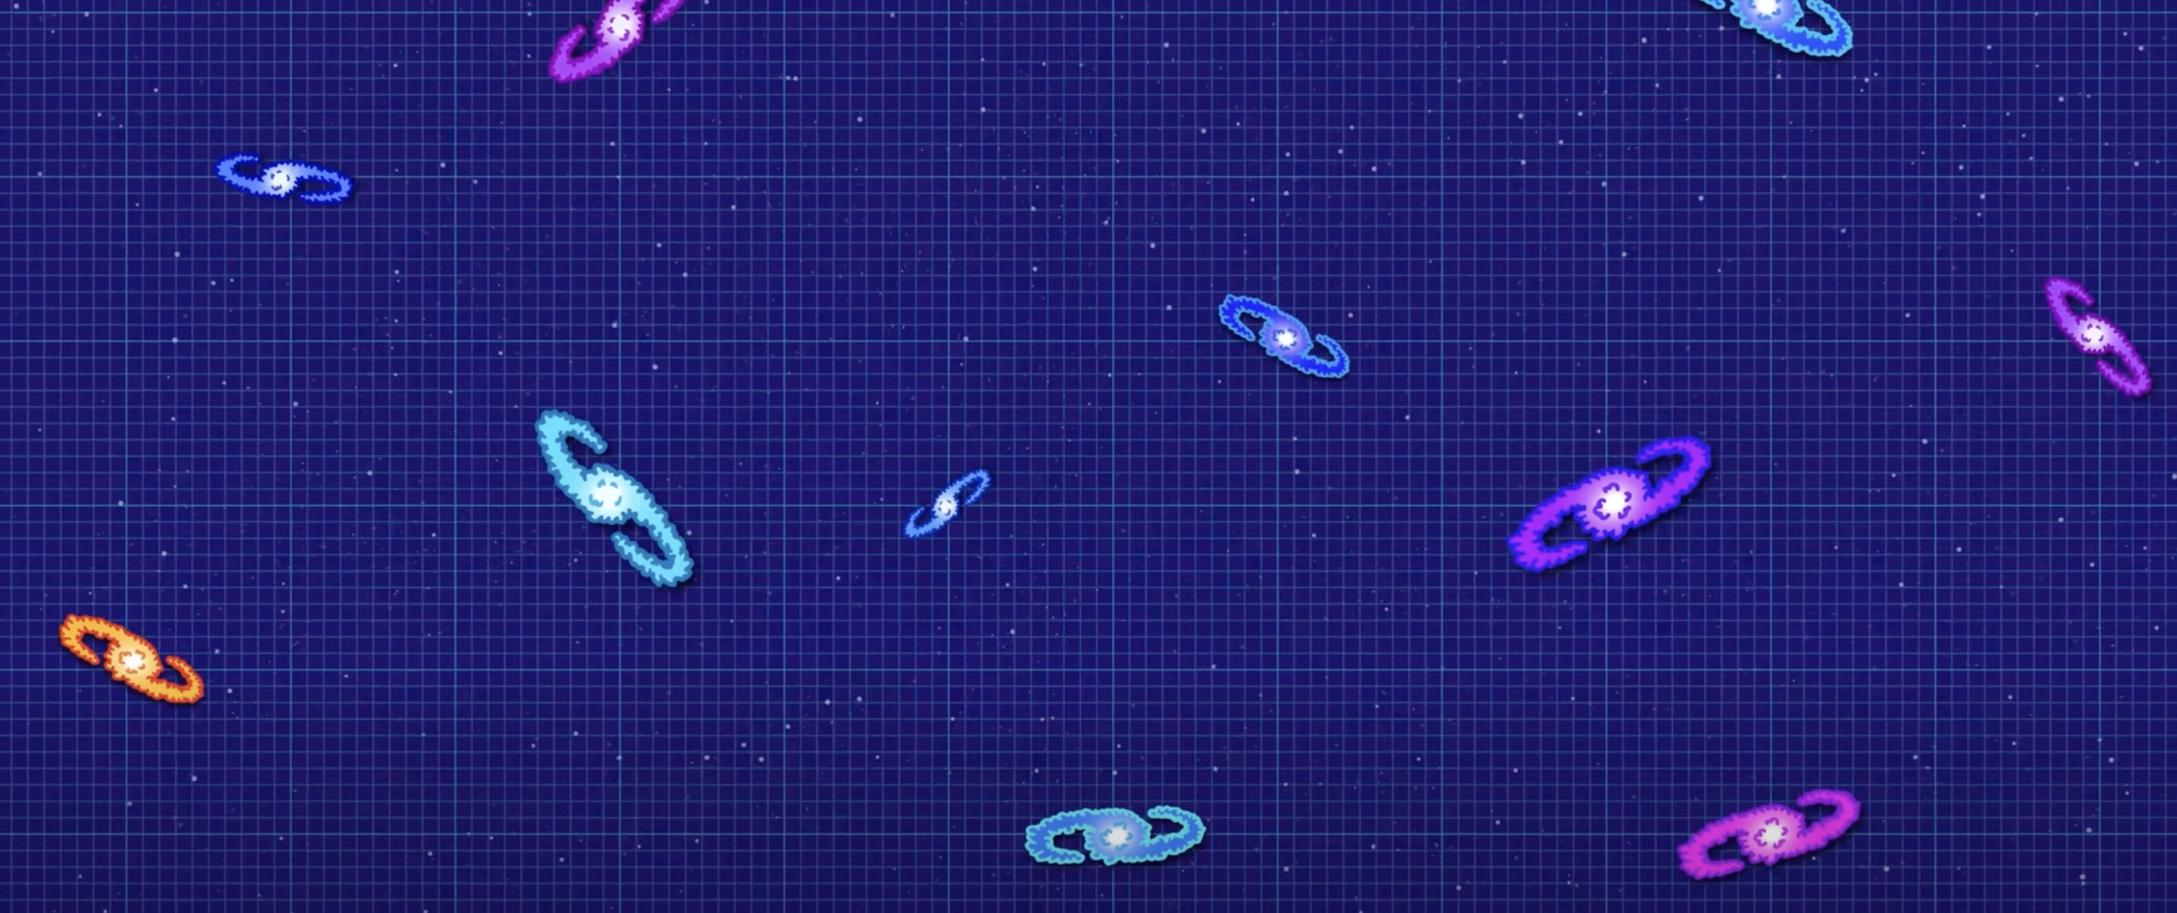
The universe is mature

Slide 61
The universe is mature
Why would God tell us in His Word over and over again that He had stretched/stretches the heavens unless He also provided some evidence that He had stretched or is continuing to stretch the heavens?

Slide 62
He is the image of the invisible God, the firstborn of all creation: for by Him all things were created, both in the heavens and on the earth, visible and invisible, whether thrones, or dominions, or rulers, or authorities -
- Colossians 1:15-17

Slide 63
All things have been created through Him and for Him. He is before all things, and in Him all things hold together.
- Colossians 1:15-17

Slide 64
Conclusion

Slide 65
Cosmology may look like science but it isn’t a science. A basic tenet of science is that you can do repeatable experiments, and you can’t do that in cosmology.
James Gunn – Eugene Higgins Professor of Astronomy at Princeton University – Science 317:1848-1850, p. 1850, 2007

Slide 66
Conclusion
The universe appears old
The universe appears young
The universe was created mature
Must consider when using scientific dating methods
Death before sin undermines the reason for Christ’s death

