Slide 1
6
Pro-Life or Pro Death
Part 1

Slide 2
Roe vs. Wade
January 22, 1973

Slide 3
Abortion: Legal Reasoning
Laws preventing abortion violated the Constitution's 14th Amendment
14th Amendment – right to privacy

Slide 4
Abortion: Moral Reasoning
Only the woman had the right to choose if she would have the baby or not.

Slide 5
Abortion: Medical Reasoning
Lowered unnecessary injury or death
Encouraged research on pregnancy

Slide 6
Pro- Life
Pro- Choice
VS

Slide 7
Abortion = Latin “Abortus”
(To die)

Slide 8
Abortion Methods
Suction
10 weeks
Vacuum removes child

Slide 9
Abortion Methods
Suction
D+C
12 weeks
Dilation and Curettage
Doctor uses scalpel to cut and scrape baby out of mother’s body

Slide 10
Abortion Methods
Suction
D+C
Salt Poisoning
4-5 months
Saline solution injected into the mother killing the baby which is then removed

Slide 11
Abortion Methods
Suction
D+C
Salt Poisoning
D+E
20-32 weeks
Dilation and Extraction
Partial birth method

Slide 12
Abortion Methods
Suction
D+C
Salt Poisoning
D+E
R.U. 486
Abortion Pill
Causes miscarriage

Slide 13
Pro-Choice Arguments
The fetus is not human

Slide 14
Development of Fetus
Heart forms – Day 18
Eyes form – Day 19
Pulse detected – Day 24
10,000x growth rate – Day 30
Brain waves – Day 43
Response to touch (pain) – Day 70
Completely formed – Day 100

Slide 15
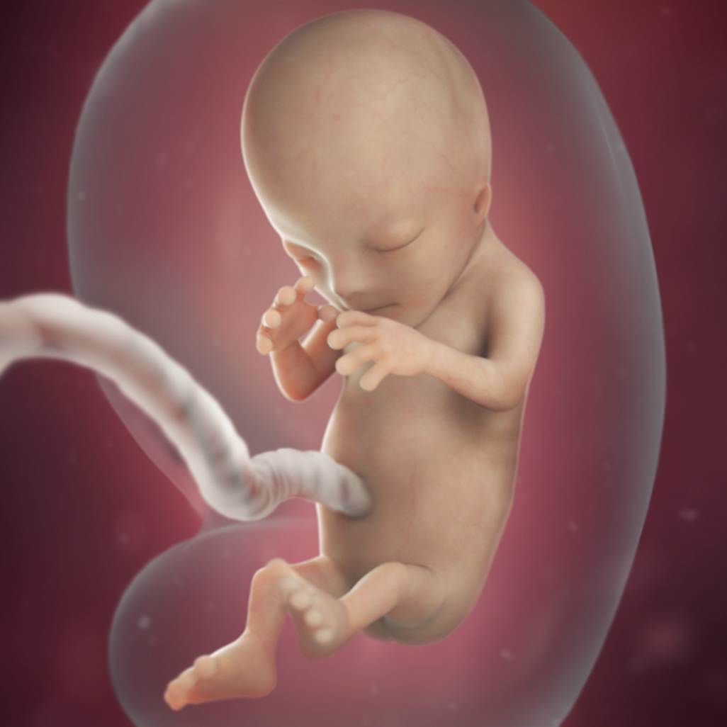
© babycenter.com

Slide 16
Conception
Delivery
Human Being
Human Being
100%

Slide 17
Pro-Choice Arguments
The fetus is not human
Choice

Slide 18
The false part of this argument is thinking that the baby is part of the woman’s body. The baby has its own body completely different from its mother’s body.

Slide 19
Pro-Choice Arguments
The fetus is not human
Choice
The well being of the mother versus the well being of the child

Slide 20
Most abortions in the United States are performed out of convenience not concern.

Slide 21
Every human life in the image of God is equally valuable.

Slide 22
1. Pro/Con Arguments 2. What the Bible teaches

