Slide 1
13
Practicing Holiness

Slide 2
Outline #3 – Training for Holiness
Attaining Holiness (Lev. 1-16)
Through offerings
Through a consecrated priesthood
By distinguishing between the clean and the unclean
By observing the Day of Atonement
Practicing Holiness (Lev. 17-27)
Individual responsibility to keep God’s moral and ritual Laws
Priestly responsibilities
The Nation’s responsibility to promote holiness
Reasons for practicing holiness: blessings and curses
Evidence of holiness: vows and valuations

Slide 3
Priestly Responsibilities
Mourning the dead – 21:1-6

Slide 4
Priestly Responsibilities
Mourning the dead – 21:1-6
Marriage - 21:7-9

Slide 5
Priestly Responsibilities
Mourning the dead - 21:1-6
Marriage - 21:7-9
Rules for High Priest – 21:10-15

Slide 6
Priestly Responsibilities
Mourning the dead - 21:1-6
Marriage - 21:7-9
Rules for High Priest - 21:10-15
Defects that disqualified – 21:16-24

Slide 7
Priestly Responsibilities
Mourning the dead - 21:1-6
Marriage - 21:7-9
Rules for High Priest - 21:10-15
Defects that disqualified - 21:16-24
Requirements to eat priest’s portion - 22:1-16

Slide 8
Priestly Responsibilities
Mourning the dead - 21:1-6
Marriage - 21:7-9
Rules for High Priest - 21:10-15
Defects that disqualified - 21:16-24
Requirements to eat priest’s portion - 22:1-16
Requirements for sacrificial animals - 22:17-25

Slide 9
Priestly Responsibilities
Mourning the dead - 21:1-6
Marriage - 21:7-9
Rules for High Priest - 21:10-15
Defects that disqualified - 21:16-24
Requirements to eat priest’s portion - 22:1-16
Requirements for sacrificial animals - 22:17-25
Additional requirements: sacrifices - 22:26-33

Slide 10
National Responsibilities – Leviticus 23:1-25:55
7 convocations given with each having:
A gathering for worship
Offering of sacrifice
Day of rest

Slide 11
7 Appointed Days
The Sabbath day – 23:3

Slide 12
Number of Months |  | Hebrew Name | Modern Equivalent | Feasts | Agriculture
Sacred sequence 1 | Civil sequence 7 | Abib (Nisan) | March – April | Passover, Unleavened Bread, First Fruits | Spring (later) rains; barley and flax harvest begins
2 | 8 | Ziv (Iyyar) | April – May |  | Barley harvest; dry season begins
3 | 9 | Sivan | May – June | Weeks (Pentecost) | Wheat harvest
4 | 10 | Tammuz | June – July |  | Tending vines
5 | 11 | Ab | July – August |  | Ripening of grapes, figs and olives
6 | 12 | Elul | August – Sept. |  | Processing grapes, figs and olives
7 | 1 | Ethanim (Tishri) | Sept. – Oct. | Trumpets, Day of Atonement Tabernacles (Booths) | Autumn (early) rains begin; plowing
8 | 2 | Bul (Marcheshvan) | October – Nov. |  | Sowing of wheat and barley
9 | 3 | Kislev | Nov. – Dec. | Hanukkah (Dedication) | Winter rains begin; snow in some areas
10 | 4 | Tebeth | Dec. – Jan.
11 | 5 | Shebat | Jan. – Feb.
12 | 6 | Adar | Feb – Mar. | Purim | Almond trees bloom; citrus fruit harvest
 |  | Second Adar (Adar Sheni) | Month added every three years so that the lunar calendar corresponds to the solar years.

Slide 13
7 Appointed Days
The Sabbath day – 23:3
Passover / Feast of Unleavened Bread – 23:4-8

Slide 14
Number of Months |  | Hebrew Name | Modern Equivalent | Feasts | Agriculture
Sacred sequence 1 | Civil sequence 7 | Abib (Nisan) | March – April | Passover, Unleavened Bread, First Fruits | Spring (later) rains; barley and flax harvest begins
2 | 8 | Ziv (Iyyar) | April – May |  | Barley harvest; dry season begins
3 | 9 | Sivan | May – June | Weeks (Pentecost) | Wheat harvest
4 | 10 | Tammuz | June – July |  | Tending vines
5 | 11 | Ab | July – August |  | Ripening of grapes, figs and olives
6 | 12 | Elul | August – Sept. |  | Processing grapes, figs and olives
7 | 1 | Ethanim (Tishri) | Sept. – Oct. | Trumpets, Day of Atonement Tabernacles (Booths) | Autumn (early) rains begin; plowing
8 | 2 | Bul (Marcheshvan) | October – Nov. |  | Sowing of wheat and barley
9 | 3 | Kislev | Nov. – Dec. | Hanukkah (Dedication) | Winter rains begin; snow in some areas
10 | 4 | Tebeth | Dec. – Jan.
11 | 5 | Shebat | Jan. – Feb.
12 | 6 | Adar | Feb – Mar. | Purim | Almond trees bloom; citrus fruit harvest
 |  | Second Adar (Adar Sheni) | Month added every three years so that the lunar calendar corresponds to the solar years.

Slide 15
Unleavened Bread
No leavened bread – 7 days
Rest on the 1st and 7th day
Worship assembly on 1st and 7th day
Offer sacrifice on each of the 7 days

Slide 16
7 Appointed Days
The Sabbath day – 23:3
Passover / Feast of Unleavened Bread – 23:4-8
First Fruits – 23:9-14

Slide 17
Number of Months |  | Hebrew Name | Modern Equivalent | Feasts | Agriculture
Sacred sequence 1 | Civil sequence 7 | Abib (Nisan) | March – April | Passover, Unleavened Bread, First Fruits | Spring (later) rains; barley and flax harvest begins
2 | 8 | Ziv (Iyyar) | April – May |  | Barley harvest; dry season begins
3 | 9 | Sivan | May – June | Weeks (Pentecost) | Wheat harvest
4 | 10 | Tammuz | June – July |  | Tending vines
5 | 11 | Ab | July – August |  | Ripening of grapes, figs and olives
6 | 12 | Elul | August – Sept. |  | Processing grapes, figs and olives
7 | 1 | Ethanim (Tishri) | Sept. – Oct. | Trumpets, Day of Atonement Tabernacles (Booths) | Autumn (early) rains begin; plowing
8 | 2 | Bul (Marcheshvan) | October – Nov. |  | Sowing of wheat and barley
9 | 3 | Kislev | Nov. – Dec. | Hanukkah (Dedication) | Winter rains begin; snow in some areas
10 | 4 | Tebeth | Dec. – Jan.
11 | 5 | Shebat | Jan. – Feb.
12 | 6 | Adar | Feb – Mar. | Purim | Almond trees bloom; citrus fruit harvest
 |  | Second Adar (Adar Sheni) | Month added every three years so that the lunar calendar corresponds to the solar years.

Slide 18
7 Appointed Days
The Sabbath day – 23:3
Passover / Feast of Unleavened Bread – 23:4-8
First Fruits – 23:9-14
Feast of Weeks – 23:15-22

Slide 19
Number of Months |  | Hebrew Name | Modern Equivalent | Feasts | Agriculture
Sacred sequence 1 | Civil sequence 7 | Abib (Nisan) | March – April | Passover, Unleavened Bread, First Fruits | Spring (later) rains; barley and flax harvest begins
2 | 8 | Ziv (Iyyar) | April – May |  | Barley harvest; dry season begins
3 | 9 | Sivan | May – June | Weeks (Pentecost) | Wheat harvest
4 | 10 | Tammuz | June – July |  | Tending vines
5 | 11 | Ab | July – August |  | Ripening of grapes, figs and olives
6 | 12 | Elul | August – Sept. |  | Processing grapes, figs and olives
7 | 1 | Ethanim (Tishri) | Sept. – Oct. | Trumpets, Day of Atonement Tabernacles (Booths) | Autumn (early) rains begin; plowing
8 | 2 | Bul (Marcheshvan) | October – Nov. |  | Sowing of wheat and barley
9 | 3 | Kislev | Nov. – Dec. | Hanukkah (Dedication) | Winter rains begin; snow in some areas
10 | 4 | Tebeth | Dec. – Jan.
11 | 5 | Shebat | Jan. – Feb.
12 | 6 | Adar | Feb – Mar. | Purim | Almond trees bloom; citrus fruit harvest
 |  | Second Adar (Adar Sheni) | Month added every three years so that the lunar calendar corresponds to the solar years.

Slide 20
Various Names
Feast of Weeks - Exodus 34:22
Feast of Harvest - Exodus 23:16
Day of First Fruits - Numbers 28:26
Day of Pentecost - Acts 2:1 (Greek = 50)

Slide 21
‘When you reap the harvest of your land, moreover, you shall not reap to the very corners of your field nor gather the gleaning of your harvest; you are to leave them for the needy and the alien. I am the Lord your God.’”
- Leviticus 23:22

Slide 22
7 Appointed Days
The Sabbath day – 23:3
Passover / Feast of Unleavened Bread – 23:4-8
First Fruits – 23:9-14
Feast of Weeks – 23:15-22
Feast of Trumpets - 23:23-25

Slide 23
Number of Months |  | Hebrew Name | Modern Equivalent | Feasts | Agriculture
Sacred sequence 1 | Civil sequence 7 | Abib (Nisan) | March – April | Passover, Unleavened Bread, First Fruits | Spring (later) rains; barley and flax harvest begins
2 | 8 | Ziv (Iyyar) | April – May |  | Barley harvest; dry season begins
3 | 9 | Sivan | May – June | Weeks (Pentecost) | Wheat harvest
4 | 10 | Tammuz | June – July |  | Tending vines
5 | 11 | Ab | July – August |  | Ripening of grapes, figs and olives
6 | 12 | Elul | August – Sept. |  | Processing grapes, figs and olives
7 | 1 | Ethanim (Tishri) | Sept. – Oct. | Trumpets, Day of Atonement Tabernacles (Booths) | Autumn (early) rains begin; plowing
8 | 2 | Bul (Marcheshvan) | October – Nov. |  | Sowing of wheat and barley
9 | 3 | Kislev | Nov. – Dec. | Hanukkah (Dedication) | Winter rains begin; snow in some areas
10 | 4 | Tebeth | Dec. – Jan.
11 | 5 | Shebat | Jan. – Feb.
12 | 6 | Adar | Feb – Mar. | Purim | Almond trees bloom; citrus fruit harvest
 |  | Second Adar (Adar Sheni) | Month added every three years so that the lunar calendar corresponds to the solar years.

Slide 24
7 Appointed Days
The Sabbath day – 23:3
Passover / Feast of Unleavened Bread – 23:4-8
First Fruits – 23:9-14
Feast of Weeks – 23:15-22
Feast of Trumpets – 23:23-25
Day of Atonement - 23:26-32

Slide 25
Number of Months |  | Hebrew Name | Modern Equivalent | Feasts | Agriculture
Sacred sequence 1 | Civil sequence 7 | Abib (Nisan) | March – April | Passover, Unleavened Bread, First Fruits | Spring (later) rains; barley and flax harvest begins
2 | 8 | Ziv (Iyyar) | April – May |  | Barley harvest; dry season begins
3 | 9 | Sivan | May – June | Weeks (Pentecost) | Wheat harvest
4 | 10 | Tammuz | June – July |  | Tending vines
5 | 11 | Ab | July – August |  | Ripening of grapes, figs and olives
6 | 12 | Elul | August – Sept. |  | Processing grapes, figs and olives
7 | 1 | Ethanim (Tishri) | Sept. – Oct. | Trumpets, Day of Atonement Tabernacles (Booths) | Autumn (early) rains begin; plowing
8 | 2 | Bul (Marcheshvan) | October – Nov. |  | Sowing of wheat and barley
9 | 3 | Kislev | Nov. – Dec. | Hanukkah (Dedication) | Winter rains begin; snow in some areas
10 | 4 | Tebeth | Dec. – Jan.
11 | 5 | Shebat | Jan. – Feb.
12 | 6 | Adar | Feb – Mar. | Purim | Almond trees bloom; citrus fruit harvest
 |  | Second Adar (Adar Sheni) | Month added every three years so that the lunar calendar corresponds to the solar years.

Slide 26
7 Appointed Days
The Sabbath day – 23:3
Passover / Feast of Unleavened Bread – 23:4-8
First Fruits – 23:9-14
Feast of Weeks – 23:15-22
Feast of Trumpets – 23:23-25
Day of Atonement – 23:26-32
Feast of Booths (Tabernacles) – 23:33-44

Slide 27
Number of Months |  | Hebrew Name | Modern Equivalent | Feasts | Agriculture
Sacred sequence 1 | Civil sequence 7 | Abib (Nisan) | March – April | Passover, Unleavened Bread, First Fruits | Spring (later) rains; barley and flax harvest begins
2 | 8 | Ziv (Iyyar) | April – May |  | Barley harvest; dry season begins
3 | 9 | Sivan | May – June | Weeks (Pentecost) | Wheat harvest
4 | 10 | Tammuz | June – July |  | Tending vines
5 | 11 | Ab | July – August |  | Ripening of grapes, figs and olives
6 | 12 | Elul | August – Sept. |  | Processing grapes, figs and olives
7 | 1 | Ethanim (Tishri) | Sept. – Oct. | Trumpets, Day of Atonement Tabernacles (Booths) | Autumn (early) rains begin; plowing
8 | 2 | Bul (Marcheshvan) | October – Nov. |  | Sowing of wheat and barley
9 | 3 | Kislev | Nov. – Dec. | Hanukkah (Dedication) | Winter rains begin; snow in some areas
10 | 4 | Tebeth | Dec. – Jan.
11 | 5 | Shebat | Jan. – Feb.
12 | 6 | Adar | Feb – Mar. | Purim | Almond trees bloom; citrus fruit harvest
 |  | Second Adar (Adar Sheni) | Month added every three years so that the lunar calendar corresponds to the solar years.

Slide 28
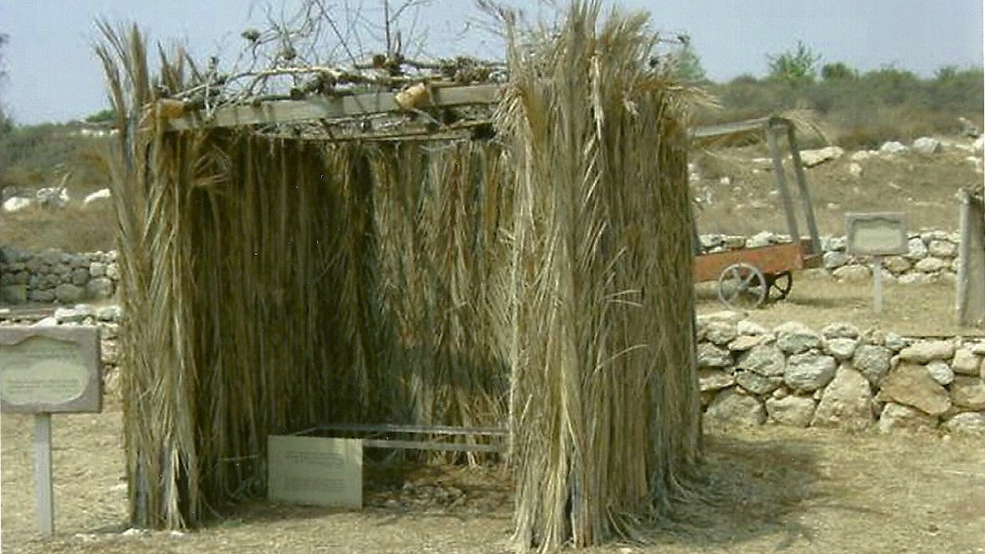

Slide 29
7 Lessons on Worship
About community
About remembering and learning
About praise and thanksgiving
About giving
About forgiveness
About commitment to God
About rejoicing

Slide 30
Responsibilities: Priests – Leviticus 24:1-23 Miscellaneous Things
Care of lampstand – 24:1-4
Maintenance of the Bread of Presence – 24:5-9
Instructions concerning blasphemy / Sabbath observance – 24:10-16
Instructions concerning other punishments – 24:17-24

Slide 31
National Responsibilities – continued Leviticus 25:1-55
Sabbatical year - 25:1-7

Slide 32
National Responsibilities – continued Leviticus 25:1-55
Sabbatical year - 25:1-7
Year of Jubilee - 25:8-55
2 Objectives
Return land to original owner
Release Israeli slaves

Slide 33
John P. Pratt

Slide 34
Reasons for Practicing Holiness – Leviticus 26:1-46
Blessings and Curses

Slide 35
Reasons for Practicing Holiness – Leviticus 26:1-46
Blessings
Abundant crops - 26:3-5
Peace - 26:6-8
Growing population - 26:9-10
God’s presence - 26:11-13

Slide 36
Reasons for Practicing Holiness – Leviticus 26:1-46
Blessings
Curses
Disease - 26:14-17
Drought - 26:18-20
Plagues - 26:21-22
War, pestilence, hunger - 26:23-26
Destruction, deportation - 26:27-33
Captivity - 26:34-39

Slide 37
Reasons for Practicing Holiness – Leviticus 26:1-46
Blessings
Curses
Repentance - 26:40-43
Confess
Humble
Accept

Slide 38
Reasons for Practicing Holiness – Leviticus 26:1-46
Blessings
Curses
Repentance
God’s Promise

Slide 39
⁴⁴ Yet in spite of this, when they are in the land of their enemies, I will not reject them, nor will I so abhor them as to destroy them, breaking My covenant with them; for I am the Lord their God. ⁴⁵ But I will remember for them the covenant with their ancestors, whom I brought out of the land of Egypt in the sight of the nations, that I might be their God. I am the Lord.’”
- Leviticus 26:44-45

Slide 40
Reasons for Practicing Holiness – Leviticus 26:1-46
Blessings
Curses
Repentance
God’s Promise
Summary - 26:46

Slide 41
Evidence of Holiness : Vows and Valuations Leviticus 27:1-34

Slide 42
Valuations
Persons dedicated to God – 27:1-8
Male
20-60 years - 50 shekels
5-20 years - 20 shekels
1 mo.-5 - 5 shekels
60+ - 15 shekels
Female
20-60 years - 30 shekels
5-20 years - 10 shekels
1 mo.-5 - 3 shekels
60+ - 10 shekels

Slide 43
Valuations
Persons dedicated to God – 27:1-8
Animals – 27:9-13

Slide 44
Valuations
Persons dedicated to God – 27:1-8
Animals – 27:9-13
Property – 27:14-25

Slide 45
Valuations
Persons dedicated to God – 27:1-8
Animals – 27:9-13
Property – 27:14-25
Unvowed gifts – 27:26-33

Slide 46
These are the commandments which the Lord commanded Moses for the sons of Israel at Mount Sinai.
- Leviticus 27:34

Slide 47
Leviticus 27:34
Moses wrote Leviticus at Sinai
They are God’s commandments to the Jews
Obedience or pain and death
We (Christians) are under a New Covenant

Slide 48
²³ But before faith came, we were kept in custody under the law, being shut up to the faith which was later to be revealed.
²⁴ Therefore the Law has become our tutor to lead us to Christ, so that we may be justified by faith. ²⁵ But now that faith has come, we are no longer under a tutor. ²⁶ For you are all sons of God through faith in Christ Jesus.
- Galatians 3:23-25

Slide 49
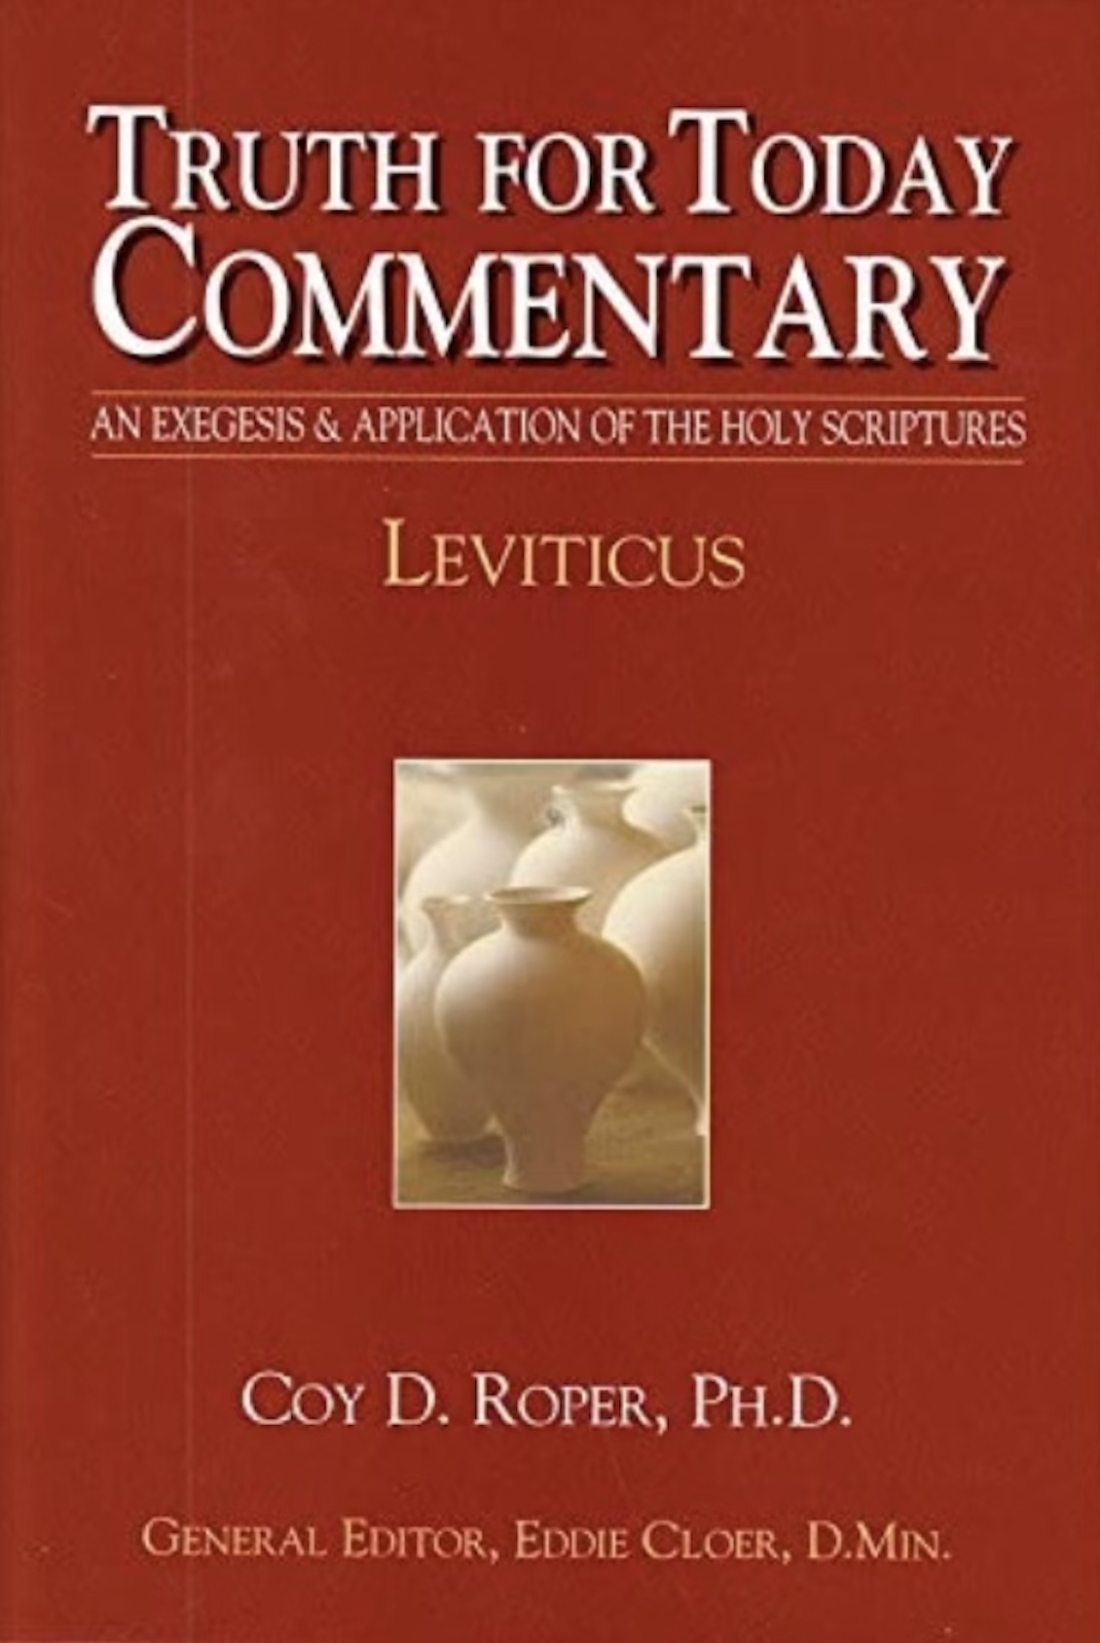
This outline is from Leviticus by Coy D. Roper,
Truth for Today Commentary by Resource Publications,
2205 Benton, Searcy, AR 72143
Copyright © 2017
To purchase, visit resourcepublications.net
501-305-1472

Slide 50
Thank you! Mike Mazzalongo BibleTalk.tv

