Slide 1
12
Extreme Extinction Event!
Part 4 - Noah’s Ark

Slide 2
Noah’s Ark

Slide 3
Of the birds according to their kind, and of the animals according to their kind, of every crawling thing of the ground according to its kind, two of every kind will come to you to keep them alive.
- Genesis 6:20

Slide 4
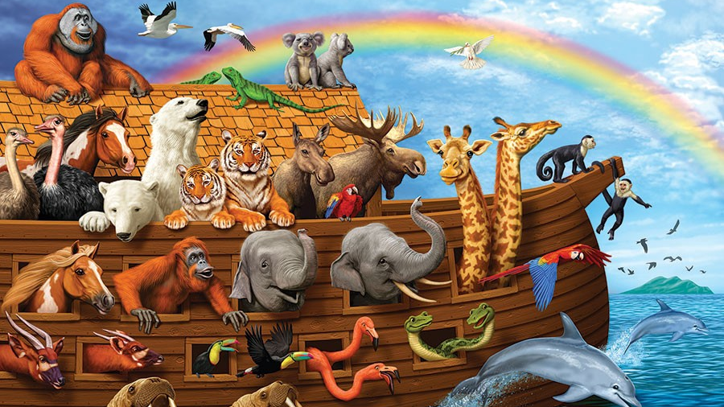
How did the animals fit on the Ark?

Slide 5
How? The answer depends
Number of animals
Size of the ark

Slide 6
“So they went into the ark to Noah, by twos of all flesh in which there was the breath of life.”
- Genesis 7:15

Slide 7
“of all that was on the dry land, all in whose nostrils was the breath of the spirit of life, died.”
- Genesis 7:22

Slide 8
Number of animals
2
2
2

Slide 9
“…you shall bring two of every kind into the ark…Of the birds according to their kind, and of the animals according to their kind…two of every kind will come to you to keep them alive.”
- Genesis 6:19-20

Slide 10
Number of animals
2 of the dog “kinds”
Genesis chapter 1
2
2 of the cat “kinds”
Genesis chapter 1
2

Slide 11
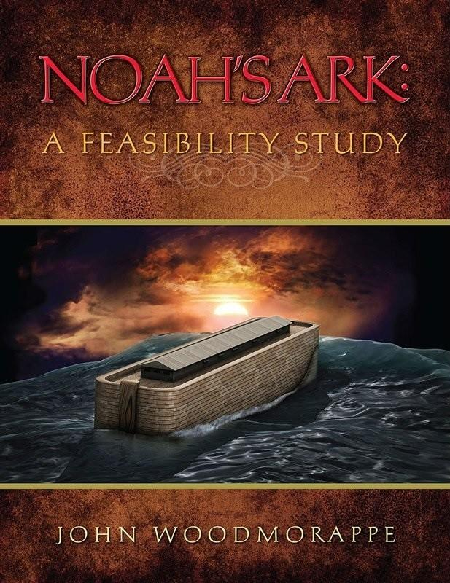
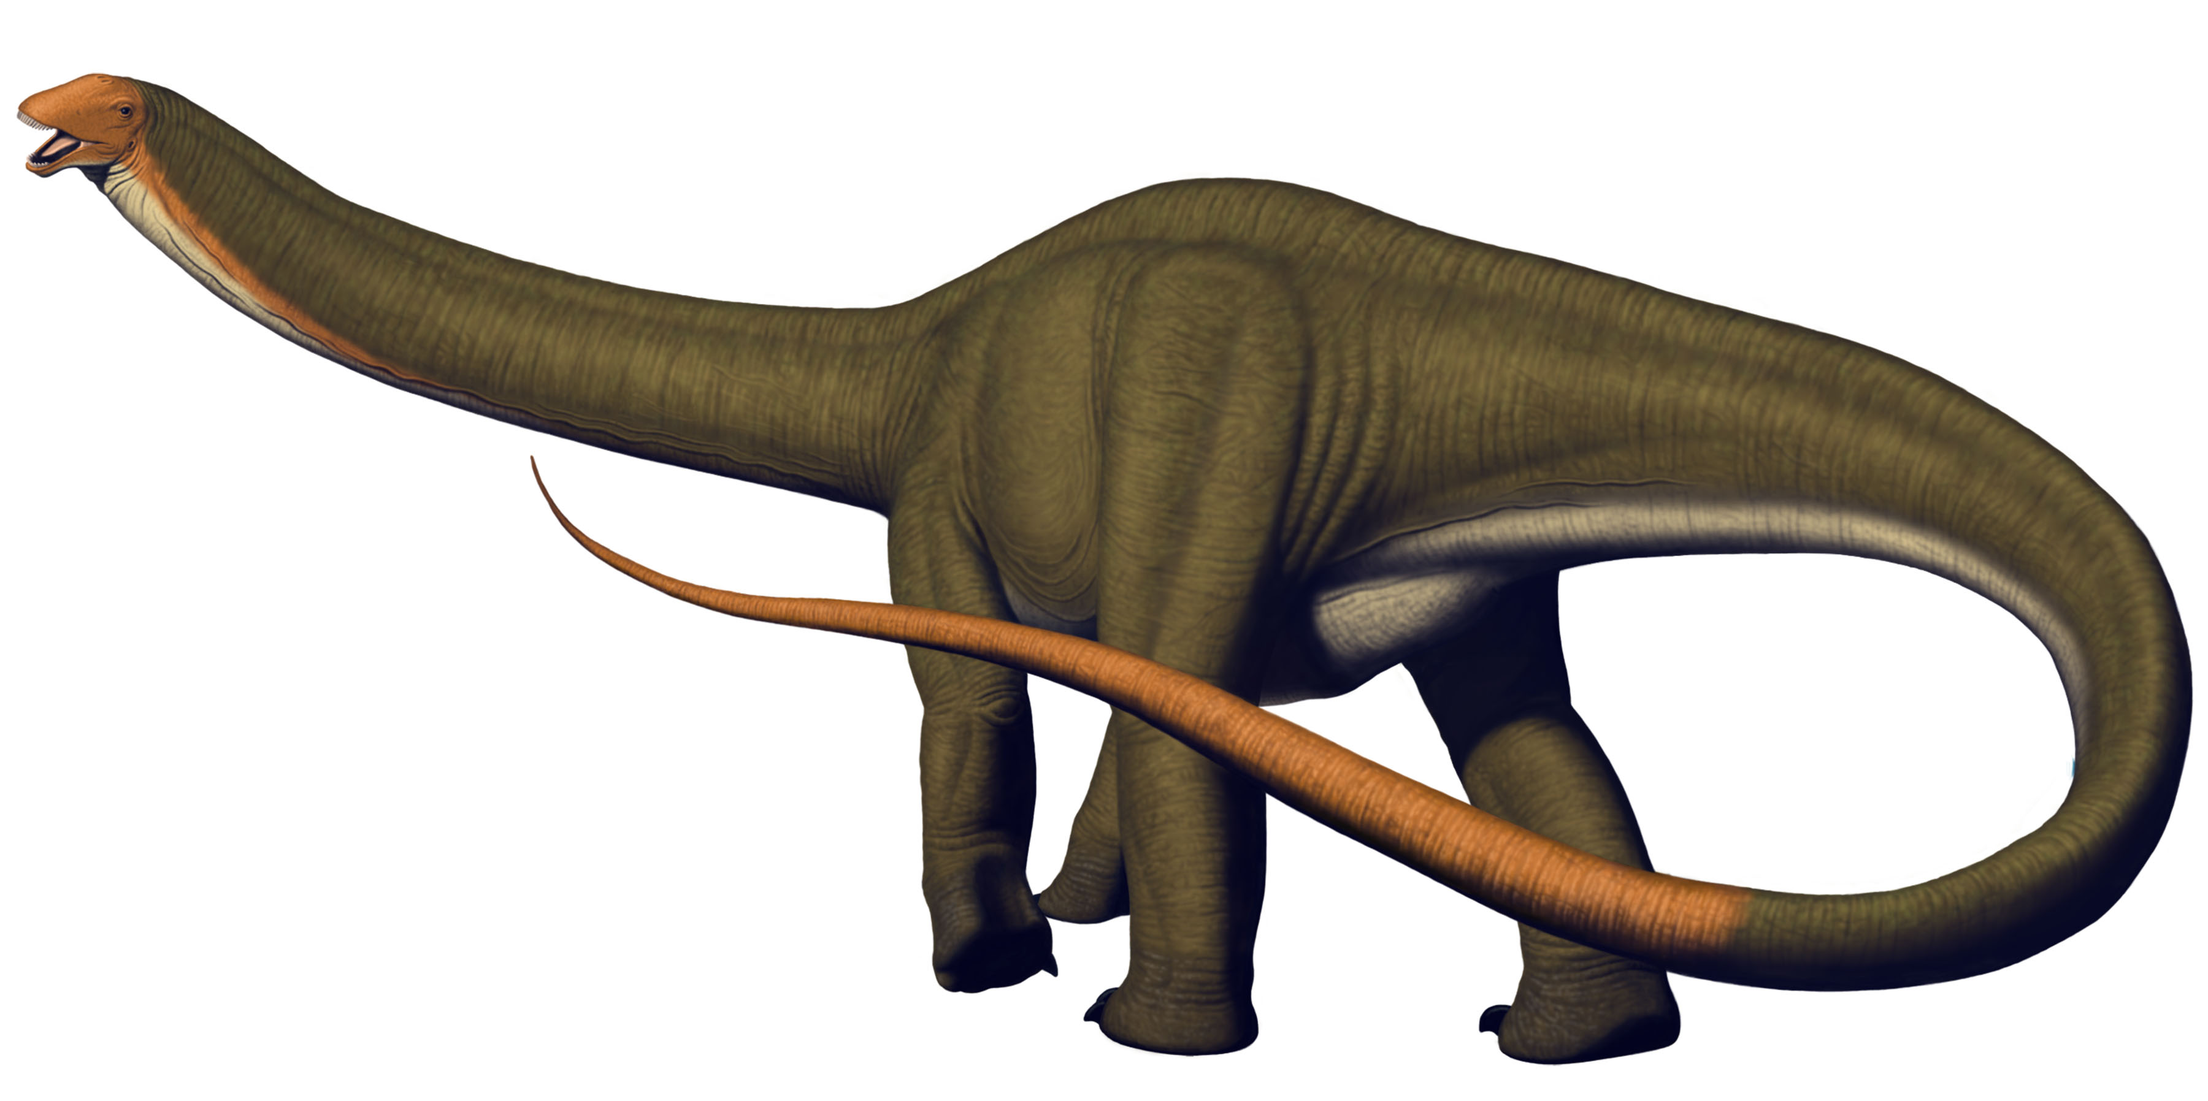
Number of animals
~16,000 animals if kind = genus
~2,000 animals if kind = family
Probably somewhere in between and would include dinosaur families
Average size = rabbit/dog
Take juveniles vs adults

Slide 12
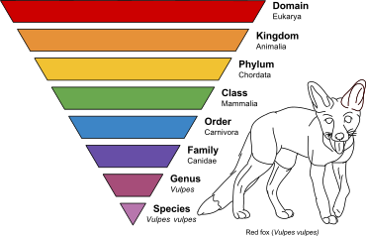
Number of animals
“Kinds” in Gen 1

Slide 13
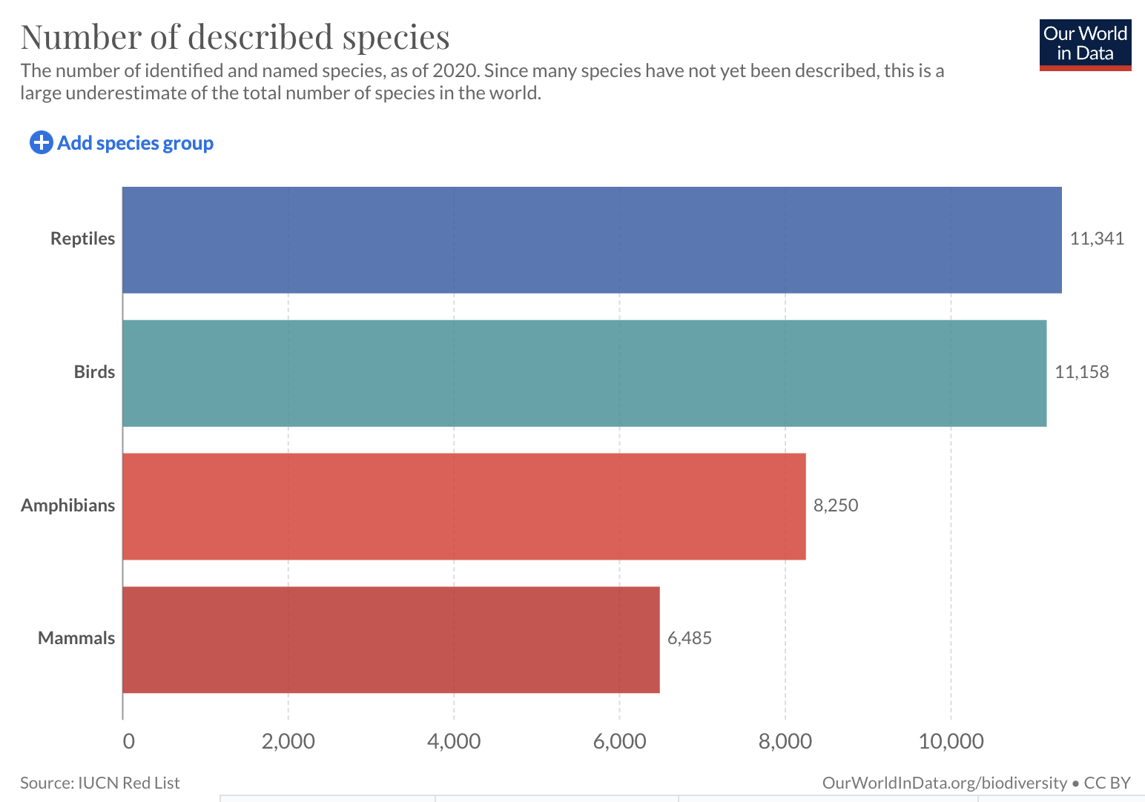
Species – 2020 data
Current classified number of modern species is 32,234

Slide 14
“This is how you shall make it: the length of the ark shall be three hundred cubits, its width fifty cubits, and its height thirty cubits.”
- Genesis 6:15

Slide 15
Ark dimensions
Length: 450ft
Width: 75ft
Height: 45ft

Slide 16
Size of the Ark

Slide 17
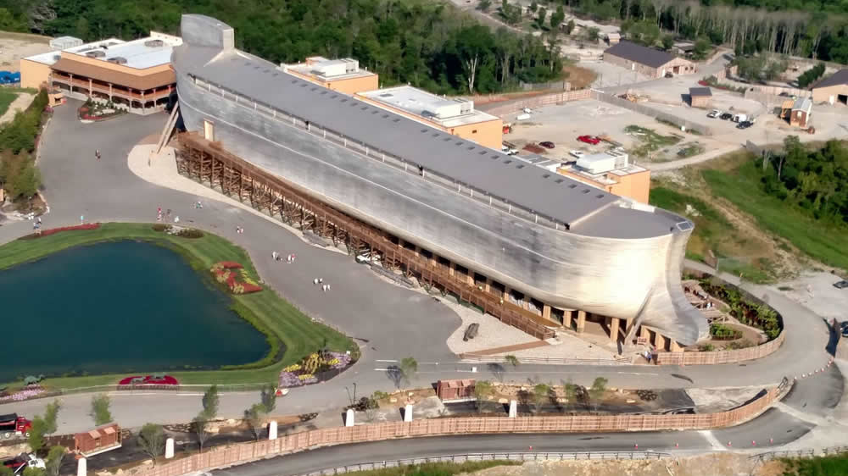
Ark replica at https://arkencounter.com

Slide 18
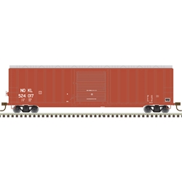
Could hold a minimum of 522 railroad boxcars
Enough room to carry 120,000 sheep-sized animals
Only needed to carry 16,000 at most

Slide 19
More than enough room
Number of animals
Less than 16,000
The size of the Ark
Enough to hold 120,000

Slide 20
What happened to the dinosaurs?

Slide 21
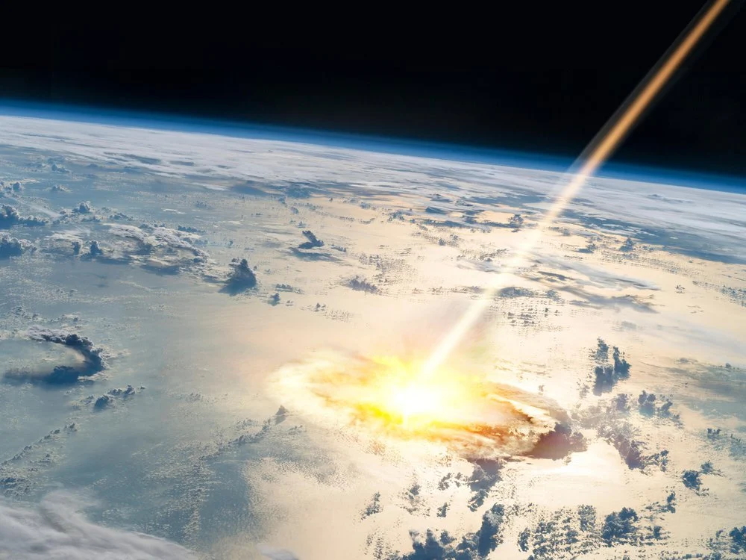
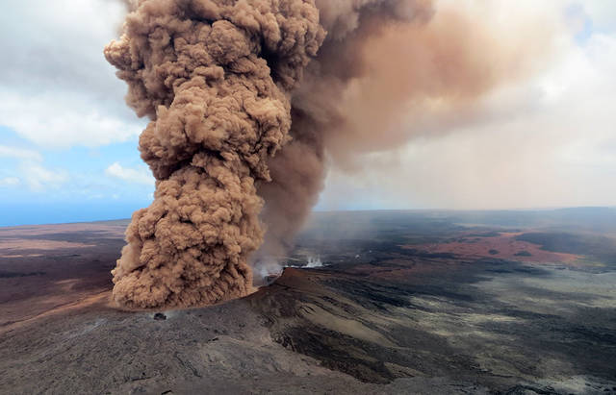
Top theories
Meteorite impact
Food shortage
Toxic volcanic gases and dust

Slide 22
Weird theories
Egg theory – ate themselves into extinction
Thin eggs – too thick or too thin
Self destruction – became too dumb
Self destruction – became too slow
Too many males – could not find any wives
Caterpillars – ate all of the vegetation
Cataracts – bad eyesight
Supernova – radiation reducing temperatures

Slide 23
Traditional dinosaur theory is full of short circuits. Like the antiquated wiring in an old house, the details sputter and burn out when specific parts are tested.
Robert T. Bakker - The Dinosaur Heresies (1986), 27

Slide 24
Why so many theories?
Over 160 theories!
1,000 species have become extinct in the last 100 years alone (IUCN).

Slide 25
?

Slide 26
“Then the Lord saw that the wickedness of mankind was great upon the earth,”
- Genesis 6:5

Slide 27
“and that every intent of the thoughts of their hearts was only evil continually.”
- Genesis 6:5

Slide 28
“Then the Lord said, ‘I will wipe out mankind whom I have created from the face of the land’”
- Genesis 6:7a

Slide 29
Don’t miss the point
God judges the wicked and saves those who follow Him.

