Slide 1
The Gold in the Golden Years

Slide 2
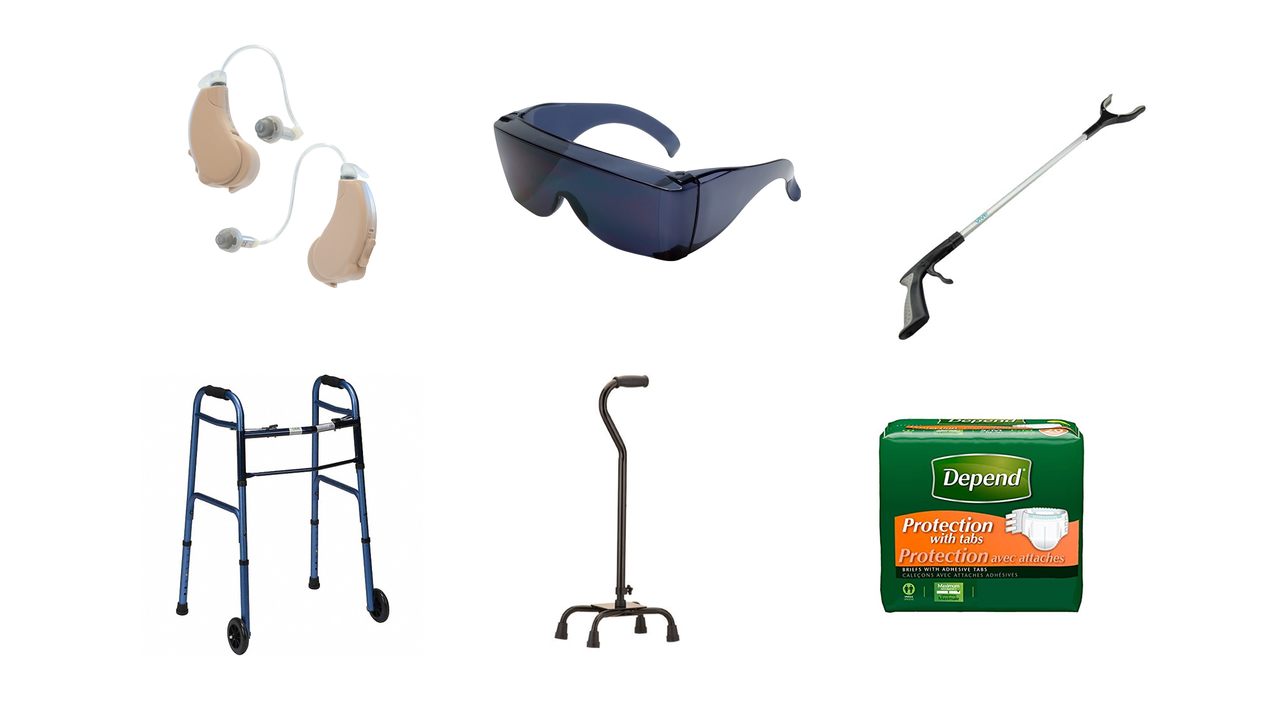

Slide 3
BOOMER GENERATION 1946 - 1964

Slide 5
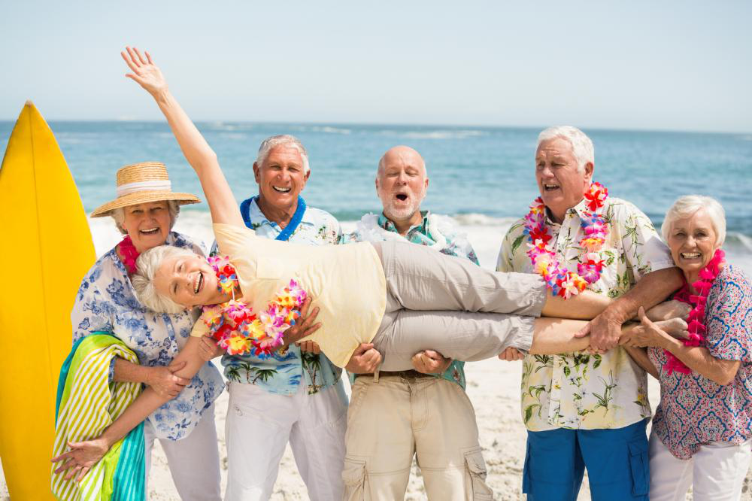

Slide 7
The “Golden Years” should be special and can be, if we are searching for what is truly precious.

Slide 8
Psalm 71
Written by an older person
He is suffering from a serious illness
He is threatened by his enemies while in this weakened state

Slide 9
3 Golden Blessings
Blessing #1 - Security

Slide 10
¹ In You, O Lord, I have taken refuge; Let me never be ashamed. ² In Your righteousness deliver me and rescue me; Incline Your ear to me and save me. ³ Be to me a rock of habitation to which I may continually come; You have given commandment to save me, For You are my rock and my fortress.
– Psalm 71:1-3

Slide 11
⁴ Rescue me, O my God, out of the hand of the wicked, Out of the grasp of the wrongdoer and ruthless man, ⁵ For You are my hope; O Lord God, You are my confidence from my youth.
- Psalm 71:4-5

Slide 12
⁶ By You I have been sustained from my birth; You are He who took me from my mother’s womb; My praise is continually of You. ⁷ I have become a marvel to many, For You are my strong refuge. ⁸ My mouth is filled with Your praise And with Your glory all day long.
- Psalm 71:6-8

Slide 13
⁹ Do not cast me off in the time of old age; Do not forsake me when my strength fails. ¹⁰ For my enemies have spoken against me; And those who watch for my life have consulted together, ¹¹ Saying, “God has forsaken him; Pursue and seize him, for there is no one to deliver.”
- Psalm 71:9-11

Slide 14
{
Refuge
Rescuer
Dwelling place
SAFETY IN GOD

Slide 15
{
Fortress on a rock
Savior
Hope
SAFETY IN GOD

Slide 16
{
Confidence
Sustainer
Protector and Deliverer
SAFETY IN GOD

Slide 17
Only the Lord can make us feel safe!

Slide 18
The elderly can feel safe with God.

Slide 19
3 Golden Blessings
Blessing #1 – Security
Blessing #2 - Witness

Slide 20
¹² O God, do not be far from me; O my God, hasten to my help! ¹³ Let those who are adversaries of my soul be ashamed and consumed; Let them be covered with reproach and dishonor, who seek to injure me.
- Psalm 71:12-13

Slide 21
¹⁴ But as for me, I will hope continually, And will praise You yet more and more. ¹⁵ My mouth shall tell of Your righteousness And of Your salvation all day long; For I do not know the sum of them. ¹⁶ I will come with the mighty deeds of the Lord God; I will make mention of Your righteousness, Yours alone.
- Psalm 71:14-16

Slide 22
¹⁷ O God, You have taught me from my youth, And I still declare Your wondrous deeds. ¹⁸ And even when I am old and gray, O God, do not forsake me, Until I declare Your strength to this generation, Your power to all who are to come. ¹⁹ For Your righteousness, O God, reaches to the heavens, You who have done great things; O God, who is like You?
- Psalm 71:17-19

Slide 23
Nothing can stop the senior saint from declaring the faithfulness, goodness and power of God, not even death.

Slide 24
3 Golden Blessings
Blessing #1 – Security
Blessing #2 – Witness
Blessing #3 – Confidence

Slide 25
²⁰ You who have shown me many troubles and distresses Will revive me again, And will bring me up again from the depths of the earth. ²¹ May You increase my greatness And turn to comfort me.
- Psalm 71:20-21

Slide 26
²² I will also praise You with a harp, Even Your truth, O my God; To You I will sing praises with the lyre, O Holy One of Israel. ²³ My lips will shout for joy when I sing praises to You; And my soul, which You have redeemed.
- Psalm 71:22-23

Slide 27
My tongue also will utter Your righteousness all day long; For they are ashamed, for they are humiliated who seek my hurt.
- Psalm 71:24

Slide 28
It takes great confidence to just let go of this life.

Slide 29
Confidence before death = A gift from God

Slide 30
The blessings of old age don’t come from things we’ve amassed, but from the One we’ve spent a lifetime knowing.

Slide 31
{
Feel safe
Are full of praise
Face death with confidence
ELDERLY SAINTS

Slide 32
Do I want these blessings for myself?

Slide 33
Florence Chadwick
Swimmer

Slide 34
Jesus is waiting to receive us on the other shore.

