Slide 1
11
Extreme Extinction Event!
Part 3 – Water Everywhere

Slide 2
Water Everywhere

Slide 3
Why does it matter?
Genesis reads as historical narrative. What does this mean for Christians?
Chapters 1-11 are history and meant to be taken as such.
There really was a global flood.
The entire universe is ~6,000 years old.
~2,000 years from Adam to Abraham.
~2,000 years from Abraham to Jesus.
~2,000 years from Jesus to the present.
The rock layers cannot represent millions of years of macro-evolution and slow and gradual sedimentation.
The global flood better explains the continental sediments.

Slide 4
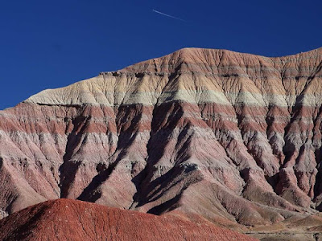
Sedimentary Rock Layers

Slide 5
…on that day all the fountains of the great deep burst open, and the floodgates of the sky were opened.
- Genesis 7:11b

Slide 6
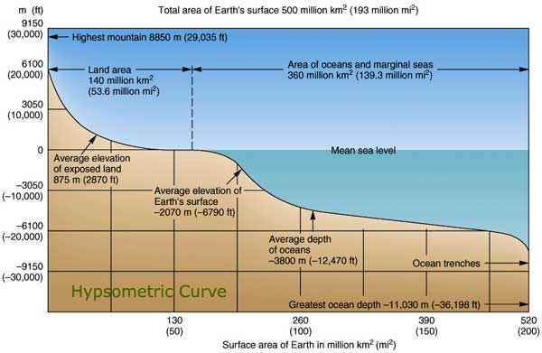
Where did the water come from?
Average elevation of exposed land:
2,870 ft
Average depth of oceans:
12,470 ft

Slide 7
Where did the water come from?
Exposed land volume:
124 million km³
Volume of oceans:
1.3 billion km³

Slide 8
Now it came about after the seven days, that the waters of the flood came upon the earth.
- Genesis 7:10

Slide 9
In the six hundredth year of Noah’s life, in the second month, on the seventeenth day of the month,…
- Genesis 7:11a

Slide 10
…on that day all the fountains of the great deep burst open, and the floodgates of the sky were opened.
- Genesis 7:11b

Slide 11
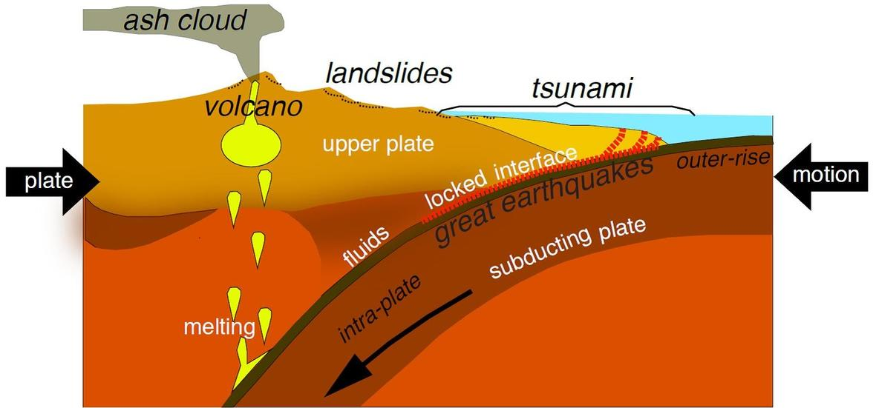
Where did the water come from?
SLOW!!

Slide 12
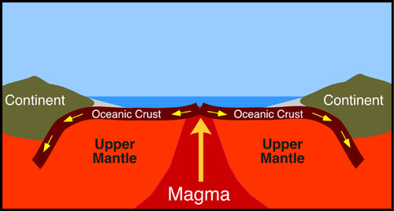
Where did the water come from?

Slide 13
Evidence of rapid subduction?
Entire ocean floor is relatively ‘young’
Previous ocean floor is still cooler than the surrounding rock in the mantle

Slide 14
You covered it with the deep sea as with a garment; The waters were standing above the mountains.
- Psalm 104:6-8

Slide 15
They fled from Your rebuke. At the sound of Your thunder they hurried away.
- Psalm 104:6-8

Slide 16
The mountains rose; the valleys sank down to the place which You established for them.
- Psalm 104:6-8

Slide 17
Where did the water go?
Rapid subduction would have built high mountains at palatial boundaries – “mountains rose”
Cooling sea floor would have lowered ocean levels – “valleys sank down”

Slide 18
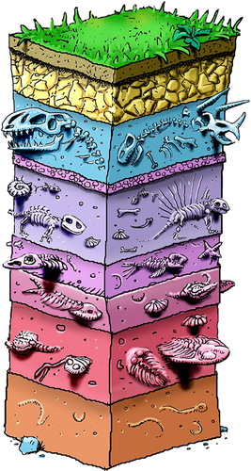
Geologic Column
Exit 65 MYA
Fossils “enter” and “exit” the fossil layers with stasis
Enter 230 MYA
100 MY
An “exit” is supposed to equal extinction
25 MY
25 MY
Once extinct, we do not expect to see them again (alive or as fossils)
100 MY
100 MY
550 MYA

Slide 19
Critical thinking
~550 MY of earth’s history is supposed to be represented in the layers.
Geologists calculate that at today’s erosion rates, it would take ~20 MY to erode the continents to base rock.
Obviously, the continents and fossils are still here. What other evidence do we see to indicate the layers were rapidly deposited?

Slide 20
Fining Upward Sequences
One event caused by decreasing water energy
Erosional surface
Carbonate
Shale
Sandstone
A fining upward sequence
Conglomerate
Erosional surface

Slide 21
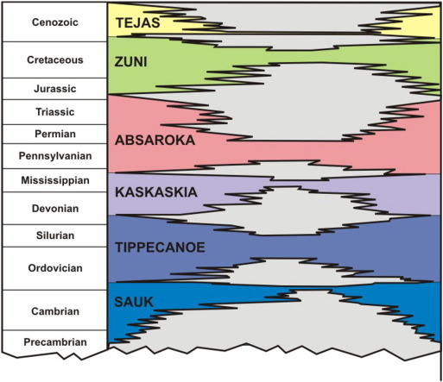
Megasequences
Rapid deposition vs. the “slow and gradual” story of shallow seas across the continents better matches the evidence!

Slide 22
The notion is still widely held that slow-moving currents or still water are a prerequisite for substantial mud deposition…
John Southard, Juergen Schieber, Accretion of mudstone beds from migrating floccule ripples, Science 318(5857):1760, 2007

Slide 23
Our observations do not support the notion that muds can only be deposited in quiet environments with only intermittent weak currents.
John Southard, Juergen Schieber, Accretion of mudstone beds from migrating floccule ripples, Science 318(5857):1760, 2007

Slide 24
Instead bedload transport of flocculated mud and deposition occurs at current velocities that would also transport and deposit sand.
John Southard, Juergen Schieber, Accretion of mudstone beds from migrating floccule ripples, Science 318(5857):1760, 2007

Slide 25
Summary
Oceans contain more than enough water to flood the continents – and still have oceans.
Sedimentary layers appear to have been deposited rapidly – not over millions of years.
The entire ocean sea floor is relatively ‘young’.
The previous ocean floor is still cooler than surrounding mantle rock – indicates recent rapid plate tectonics.
Fining upward sequencing in massive, continent-wide rock layers are better explained by rapid deposition.
Fits the historical narrative of Genesis 6-8.
Rapid tectonics is a theory, to which we should hold loosely!

Slide 26
Know this first of all, that in the last days mockers will come with their mocking, following after their own lusts,
- 2 Peter 3:3

Slide 27
And saying, “Where is the promise of His coming? For ever since the fathers fell asleep, all things continue just as they were from the beginning of creation”.
- 2 Peter 3:4

Slide 28
For when they maintain this, it escapes their notice that by the word of God the heavens existed long ago and the earth was formed out of water and by water,
- 2 Peter 3:5

Slide 29
through which the world at that time was destroyed by being flooded with water.
- 2 Peter 3:6

