Slide 1
7
Evolution’s Extinction Engine
Part 5

Slide 2
“for he was looking for the city which has foundations, whose architect and builder is God.”
- Hebrews 11:10

Slide 3
Building a city

Slide 4
What does an underwater city need?
Blueprints
Roads
Factories
DNA
Microtubules
Ribosomes
Waste Management
Lysosomes
Post Office
Golgi Apparatus
Energy
Mitochondria
Delivery Vehicles
Vesicles / Kinesin
Messaging
Nerve Cells
Steel Girders
Cytoskeleton
City Hall
Cell Nucleus
Medicine Clinics
T-Lymphocytes
Inter-City Comms
Hormones

Slide 5
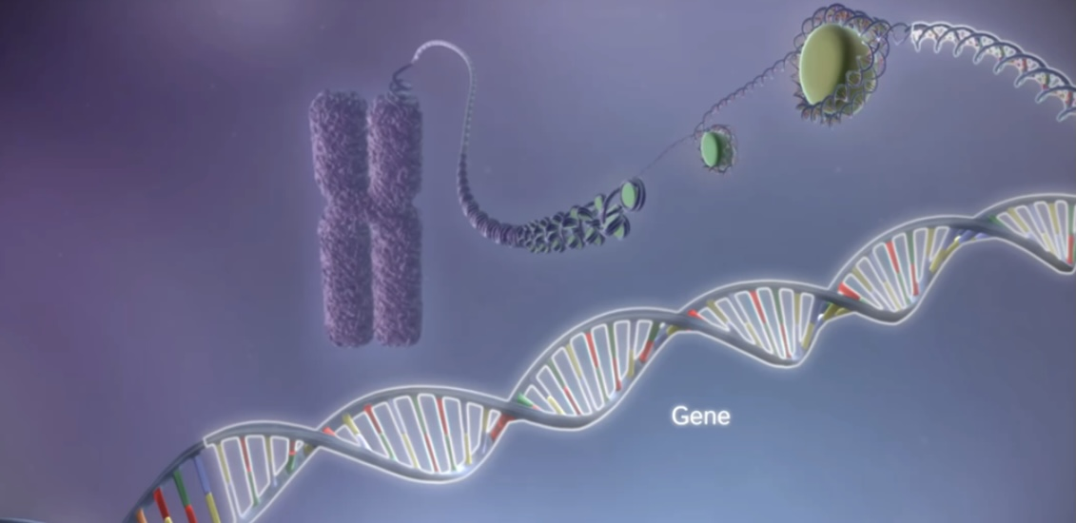
Is the cell really like a city? (blueprints - DNA)
https://www.youtube.com/watch?v=gG7uCskUOrA&t=13s

Slide 6
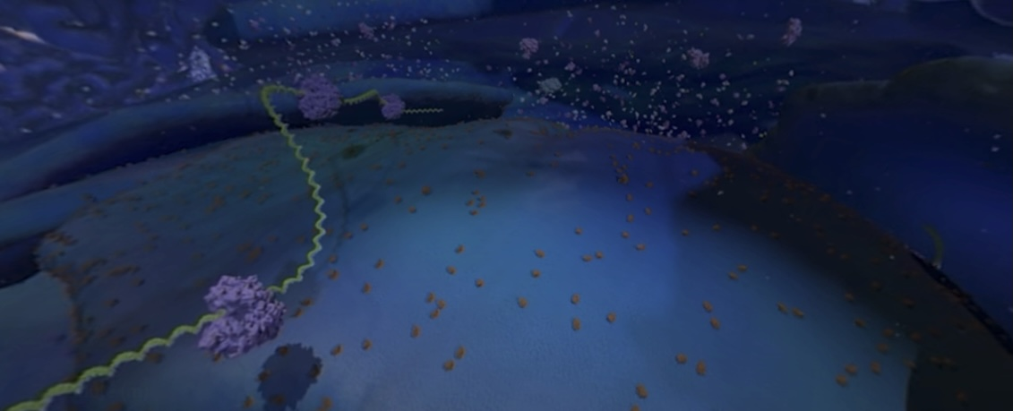
Is the cell really like a city? (factories - ribosomes)
https://www.youtube.com/watch?v=-q82IrNWbKc

Slide 7
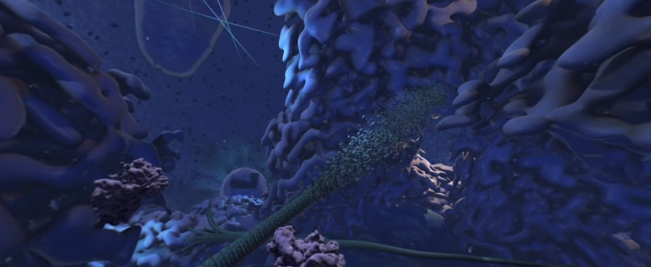
Is the cell really like a city? (roads - microtubules)
https://www.youtube.com/watch?v=-q82IrNWbKc

Slide 8
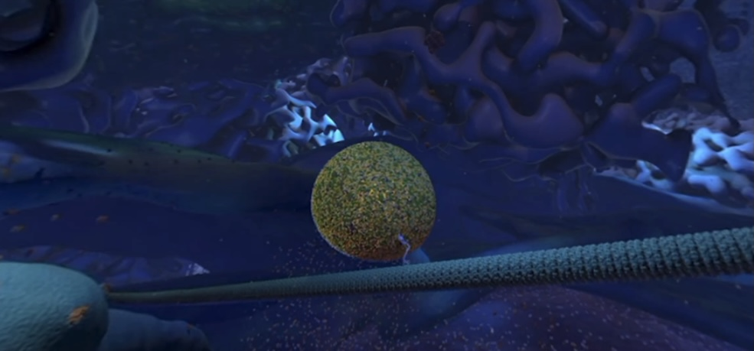
Is the cell really like a city? (transport - kinesin)
https://www.youtube.com/watch?v=-q82IrNWbKc

Slide 9
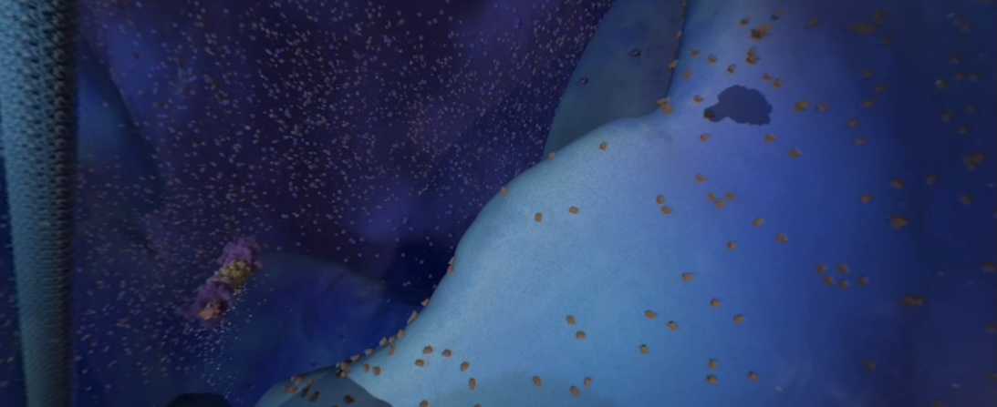
Is the cell really like a city? (waste disposal - lysosome)
https://www.youtube.com/watch?v=-q82IrNWbKc

Slide 10
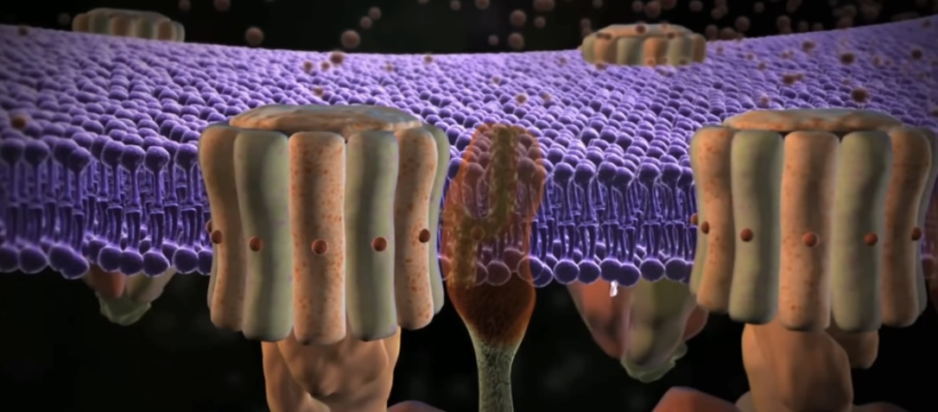
Is the cell really like a city? (energy production – ATP synthase)
https://www.youtube.com/watch?v=XI8m6o0gXDY&t=123s

Slide 11
“You are the light of the world. A city set on a hill cannot be hidden;”
- Matthew 5:14

Slide 12
How big are these cities?
Each cell has ~42 million proteins with trillions of objects!
What are the odds a city can create itself?

Slide 13
What are the odds?
1 in 10⁵⁰
100,000,000,000,000,000,000,000,000,000,000,000,000,000,000,000,000
^{Considered a statistical} ^{impossibility}

Slide 14
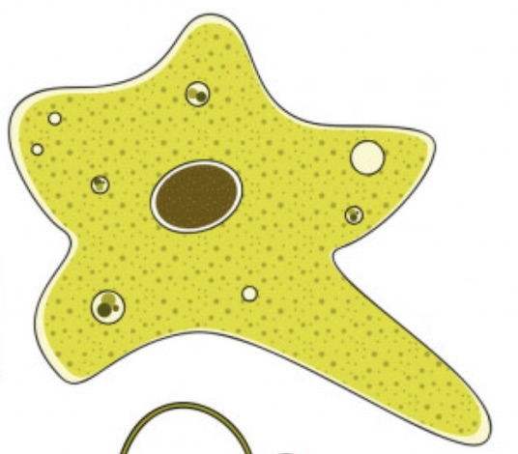
Odds of single cell-to-human evolution
Well-known evolutionist Dr Francisco Ayala, of UC Irvine,
has calculated the odds of human beings evolving from a single bacterium to be 1 in 10 to the
1 millionth power (10^{1,000,000}).

Slide 15
Odds of single cell-to-human evolution
However, three physicists, John Barrow, Brandon Carter and Frank Tipler, re-examined his data and said he overlooked several critical factors. They stated the odds at 1 in 10 to the 24 millionth power (10^{24,000,000}).
Harold Morowitz: 1 in 10^{340,000,000}!

Slide 16
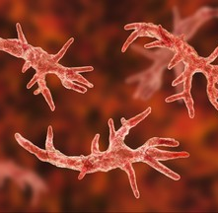
The odds that a hypothetical ‘simple cell’ could form by chance is acknowledged to be worse than: 1 in 10^{57,800}
There are 10⁸² atoms in the entire universe…

Slide 17
A Single Accidental Protein?
1 in 10¹⁶⁴ (better, right?)
Finding a single grain of sand from the entire earth filled with sand:
1 in 10³⁰
The entire universe filled with sand: 1 in 10⁹⁶

Slide 18
The notion that not only biopolymers but the operating programme of a living cell could be arrived at by chance in a primordial organic soup here on the Earth is evidently nonsense of a high order.
Fred Hoyle, The Big Bang in Astronomy, p. 527

Slide 19
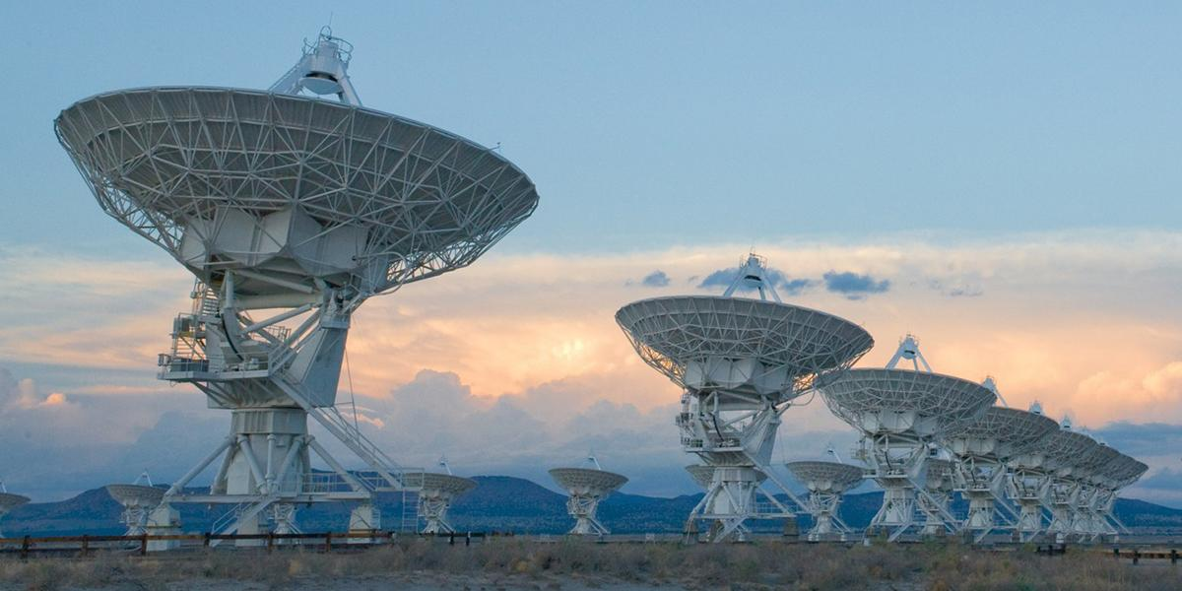
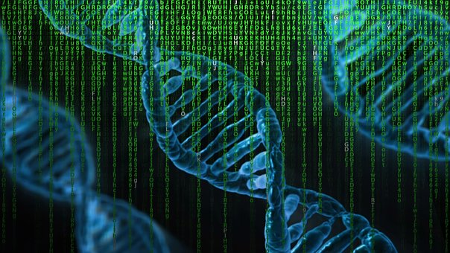
S.E.T.I.
Implications of an ordered signal?
Intelligent origin!
Credit: Alex Savello/NRAO
Non-Intelligent origin?
Implications of an ordered code?

Slide 20
“For this is what the LORD says, He who created the heavens (He is the God who formed the earth and made it, He established it and did not create it as a waste place, but formed it to be inhabited): ‘I am the LORD, and there is no one else.’”
- Isaiah 45:18

Slide 21
In the beginning….God

Slide 22
I will give thanks to You, for I am fearfully and wonderfully made;
Wonderful are Your works,
And my soul knows it very well.
- Psalm 139:14

