Slide 1
4
Evolution’s Extinction Engine
Part 2

Slide 2
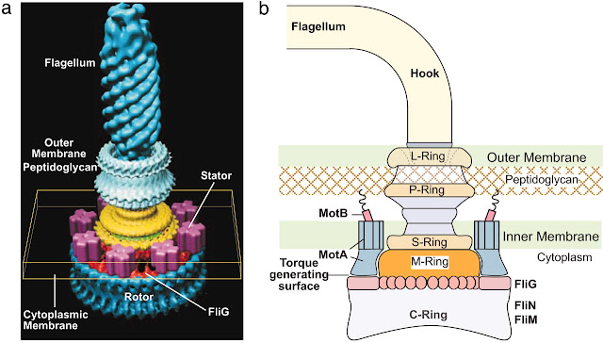
Single cell vs 747 jumbo jet
“This ‘simple’ bacterium has nearly the same number of parts as a Boeing 747 – six million – which, like the aircraft, work together perfectly.
But these parts allow the bacterium to do something the 747 can’t do – multiply itself. And it has three more motors than the Boeing!”
MO-1 flagellum - bio motor
Mark Rose, pilot and technician
Notes:
https://www.newlifepublishing.co.uk/articles/views/simplest-bacteria-more-complex-than-a-jumbo-jet/
Using electron cryotomography – an electron microscope and very cold temperatures – they found this creature’s tails are powered by seven motors, arranged in a hexagonal array, with all gears interacting with 24 smaller gears between them. To discover that such a ‘simple’ organism has a micro 24 gear planetary gear- box, synchronously driven by seven proton-powered motors complete with clutches, modulators and anti-skid sen- sors is breathtaking.
The MO-1 was found in rock claimed to be three billion years old, making it the oldest, most complete single cell known to science.

Slide 3
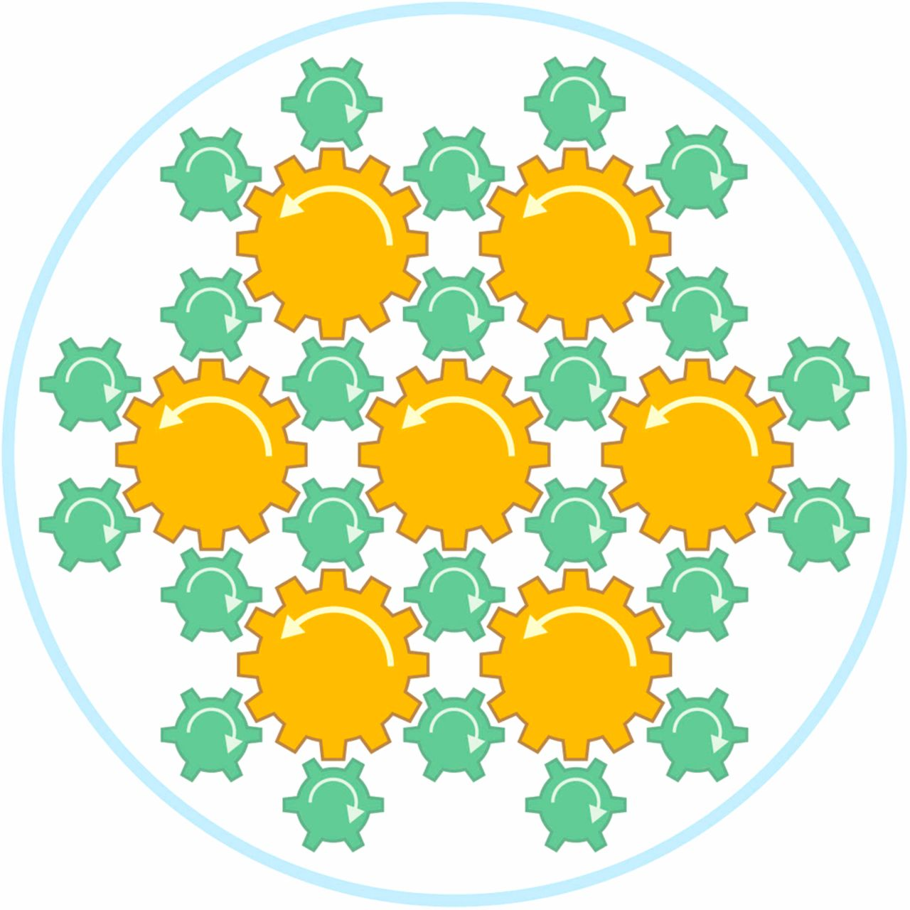
Single cell vs 747 jumbo jet
The MO-1’s tails are powered by 7 motors, arranged in a hexagonal array, with all gears interacting with 24 smaller gears between them.
The MO-1 was found in rock claimed to be 3 billion years old. The evolution of such technology is laughable.
MO-1 flagellum - bio motors
Notes:
“The motors can drive the MO-1 bacteria at relative speeds of 100 body lengths/second. A cheetah achieves a land speed of only 25 body lengths/second in comparison and that’s in air, not fluid!” he says.

Slide 4
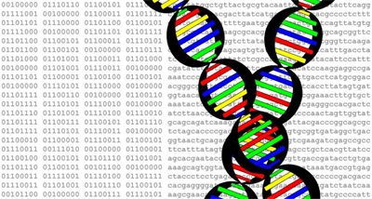
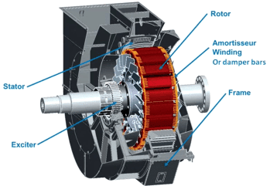
Intelligence behind design
Critical thinking: which motor can create itself…
…and the instruction manual on how to build it?
Bacterial flagellum – bio motor
Synchronous
electrical motor

Slide 5
“I will give thanks to You, because I am awesomely and wonderfully made;
Wonderful are Your works,
And my soul knows it very well.”
- Psalm 139:14

Slide 6
DNA is a set of manuals
=
How to build a human from scratch
DNA – instructions for:
Building an entire human and every living organism
Building the biological workers who can read the DNA manual
Building the raw materials to build the tools that workers use to build DNA
Building these on a massive scale – billions, trillions

Slide 7
The idea is that organisms are so complex that it is very hard to change one aspect without wrecking everything else
- Elisabeth Vrba, Yale Paleontologist

Slide 8
Evolution = change over time
+
+
+
But that change needs to be upwards.
Change over time is real and observable, but we NEVER observe upward change.
Evolution’s engine, takes living organisms in the wrong direction! Horizontal or downwards (dogs, cats, people, bacteria, etc.).
This is what we observe, the rest is fantasy.

Slide 9
During creation, it is recorded ten times that living things will reproduce after their own “kind”. This is what we find in the fossil layers and is what we observe today in all living things. (Genesis 1:11-24)

Slide 10
There’s another problem….
+
+
+
What if, after every change the 3-year-old makes, an inspection engineer changes them back to their original?
This is exactly what happens with our DNA. Error-correcting bio robots come along and corrects errors!
How does this effect the so-called evolutionary process?

Slide 11
DNA facts
How often do cells replicate?
Nearly 2 trillion every day in humans
How often do errors accumulate?
1 quintillion every day / 10¹⁸ (before error correction)
1 in 1 billion (~200 copy errors every day) after error correction
How long would we survive without DNA error correction?
Lethal mutations, disease, cancer – would happen at much younger ages

Slide 12
Critical Thinking
Why do copy mistakes happen if God said “it is all very good” at creation? Genesis 1:31
“In Him all things consist and hold together.” Colossians 1:17

Slide 13
I will give thanks to You, for I am fearfully and wonderfully made;
Wonderful are Your works,
And my soul knows it very well.
- Psalm 139:14

