Slide 1
2
At What Cost?
How disbelief in Genesis history undermines the gospel

Slide 2
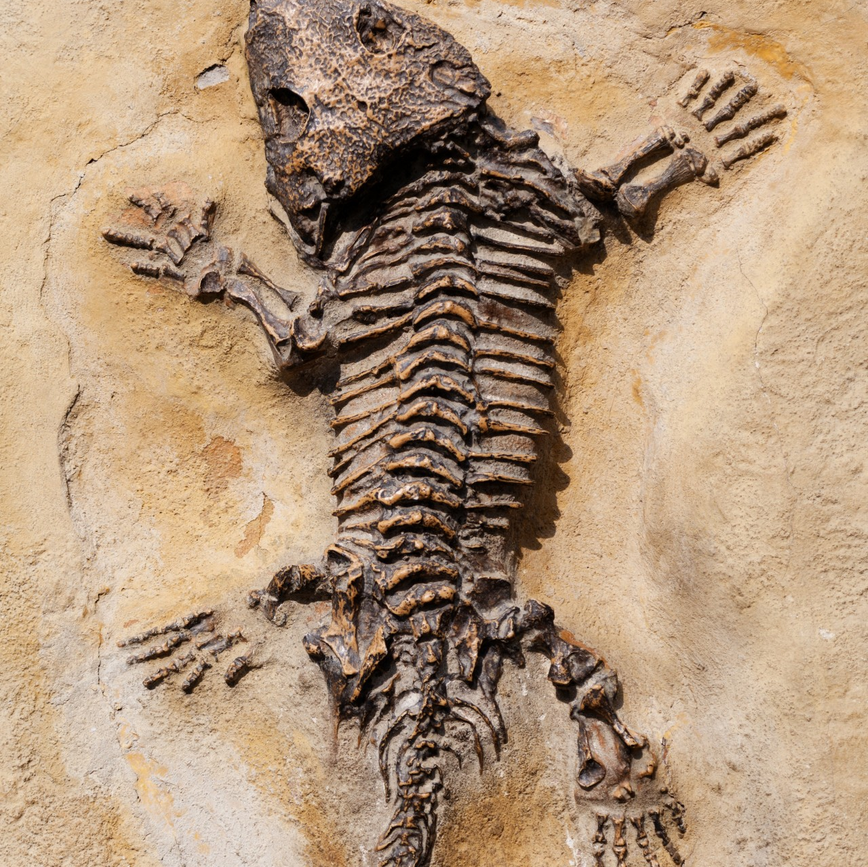
Evidence for a recent flood

Slide 3
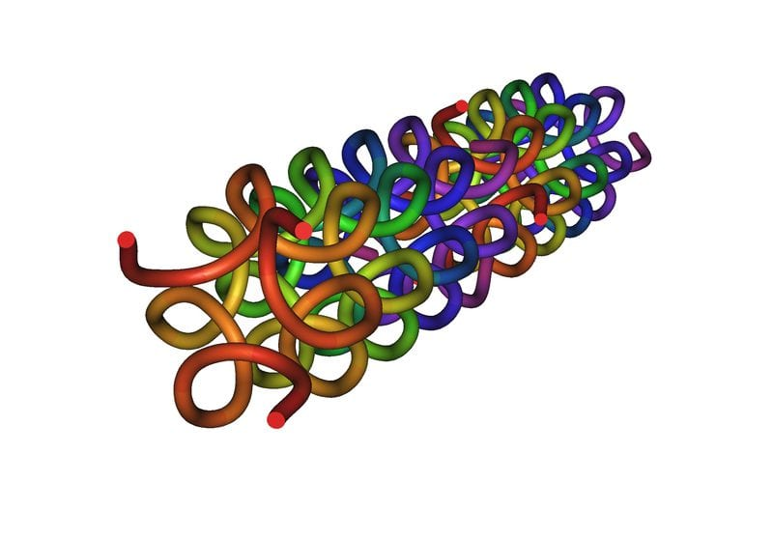
Proteins
Collagen
A protein that provides structure to much of your body, including your bones, skin, tendons, and ligaments.
Psalm 139:13
“For You created my innermost parts; You wove me in my mother’s womb”

Slide 4
Proteins
Hemoglobin
Hemoglobin is the protein molecule in red blood cells that carries oxygen from the lungs to the body's tissues and returns carbon dioxide from the tissues back to the lungs.
Leviticus 17:11
“For the life of the flesh is in the blood…”

Slide 5
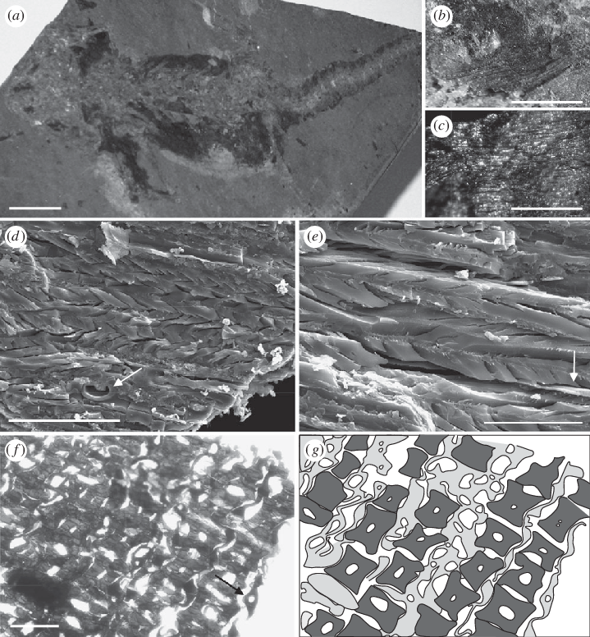
Salamander Fossil: Muscle Tissue
Fossil ‘dated’: 18 million years old!
Impossible
Consistent with Biblical time scale
No difference to modern salamanders
Zero evolution in 18 MY
Salamanders have always been salamanders (Genesis 1 “kinds”)
Nov 5, 2009 M. McNamara et al, Proc of the Royal Society B, London

Slide 6
The scientists claim that their discovery is unequivocal evidence that high-fidelity organic preservation of extremely decay prone soft tissues is more common in the fossil record - the only physical record of the history of life on earth.
- Phys Org Article – Nov 5, 2009

Slide 7
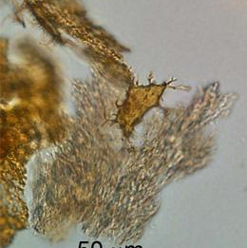
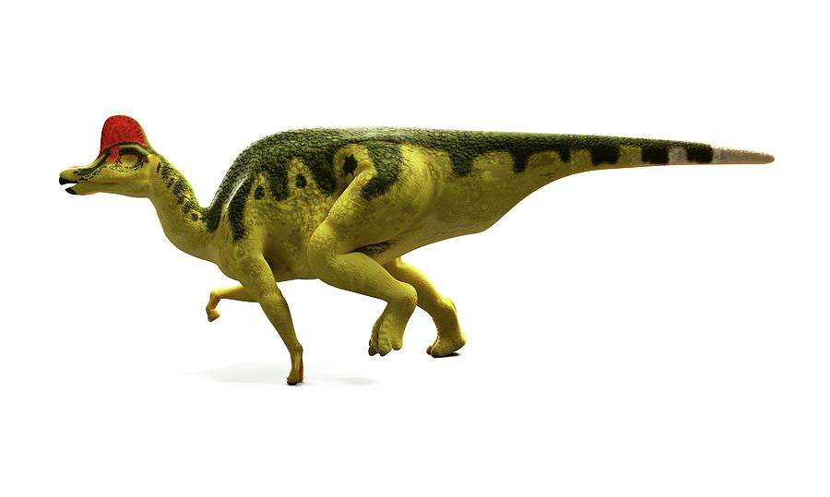
Hadrosaur Fossil: Bone Tissue
Fossil ‘dated’: 80 million years old!
Impossible
Consistent with Biblical time scale
No difference to modern collagen
Zero evolution in 80 MY
Collagen has always been collagen
Apr 30, 2009 M. Schweitzer et al, Science

Slide 8
“Three years ago, I entered this field as a complete sceptic", says Phillip Lars Manning, a bioengineer who heads paleontology at the University of Manchester and wasn't involved in the study. "Now I do think the Schweitzer group is onto something.”
- Nature – April 30, 2009

Slide 9
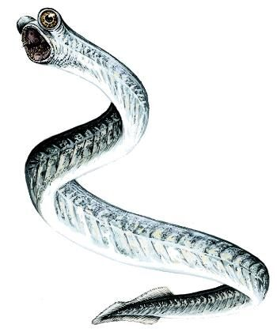
Conodont Fossil: Keratin Tissue
Fossil ‘dated’: 252 million years old!
Impossible
Consistent with Biblical time scale
Similar to modern lamprey eels
Zero evolution in 252 MY
Eels have always been eels
Genesis 1 “kinds”
Apr 18, 2018 D. Terrill et al, Analytical Spectrometry

Slide 10
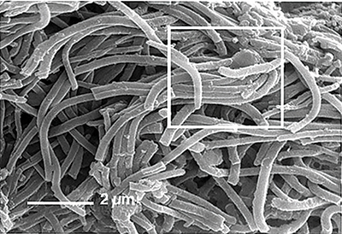
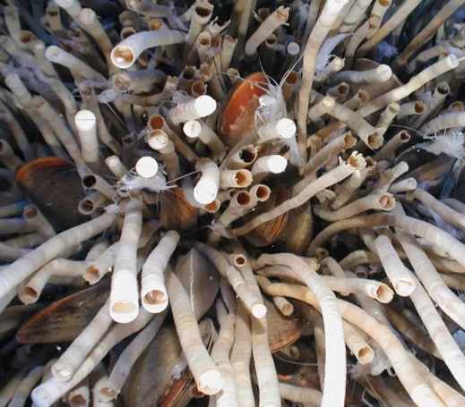
Tube Worm: Chitin Casings
‘Dated’: 551 million years old!
Impossible
Consistent with Biblical time scale
Zero difference to chitin of modern tube worms
Zero evolution in 551 MY
Tube worms have always been tube worms
Genesis 1 “kinds”
Oct 15 2015 M. Mocdyzlowska et al, Journal of Paleontology

Slide 11
Minerals have not replicated any part of the soft tissue and the carbonaceous material of the wall is primary [not replaced], preserving the original layering of the wall, its texture, and fabrics.
- Journal of Paleontology – Apr 30, 2014

Slide 12
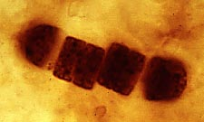
Cyanobacteria
‘Dated’: 3.5 billion years old!
Impossible
Consistent with Biblical time scale
Zero difference to modern cyanobacteria
Zero evolution in 3.5 BY
Cyanobacteria have always been cyanobacteria
Fossil Record of the Cyanobacteria (berkeley.edu)

Slide 13
God and time

Slide 14
God and Time
Reference | Time for God | Time for nature/man
John 2:7-9 Water into wine | Instant | Never
Mark 6:41-43 Loaves and fishes | Instant | Never
Matthew 15:28 Demon-possessed daughter | Instant | Never
John 11:43-44 Raise Lazarus | Instant | Never
Mark 4:39-40 Calm wind and sea | Instant | Never

Slide 15
Comprise Creates… More Compromise

Slide 16
“Then to Adam He said, “Because you have listened to the voice of your wife, and have eaten from the tree about which I commanded you, saying, ‘You shall not eat from it’; Cursed is the ground because of you; With hard labor you shall eat from it All the days of your life. Both thorns and thistles it shall grow for you; Yet you shall eat the plants of the field”
- Genesis 3:17-18

Slide 17
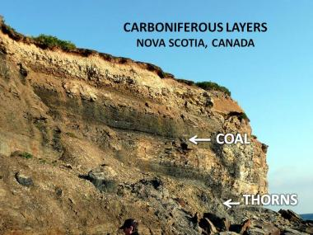
Thorns
Fossilized thorns are found in rock layers that are supposed to have been laid down 400 million years BEFORE humans.
What do we do with Genesis 3:17-18?
jurrasicark.com.au

Slide 18
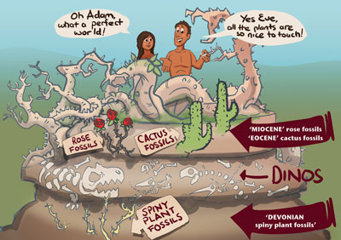
Thorns
If evolutionary theory is true, Either God did not know about thorns, or He lied about them.
creation.com

Slide 19
NT References to Genesis
1 | Matthew 1:1–3 | Ancestors of Jesus
2 | Matthew 2:18 | Rachel
3 | Matthew 3:8–9 | Abraham’s children
4 | Matthew 10:15 | Sodom and Gomorrah
5 | Matthew 11:23–24 | Sodom
6 | (1) Matthew 19:4 | Quote from Gen 1:27
7 | (2) Matthew 19:5 | Quote from Gen 2:24
8 | (3) Matthew 22:21 | Man in the image of God
9 | Matthew 22:31–2 | God of Abraham, Isaac, and Jacob
10 | (4) Matthew 23:35 | Righteous Abel
11 | (5) Matthew 24:37–39 | Days of Noah
12 | (6) Matthew 26:52 | Those who draw the sword will die by the sword
13 | (7) Mark 10:6 | Quote from Gen 1:27
14 | (8) Mark 10:7 | Quote from Gen 2:24
15 | (9) Mark 12:17 | Man in the image of God
Page
1

Slide 20
NT References to Genesis
16 | Mark 12:26 | God of Abraham, Isaac, and Jacob
17 | (10) Mark 13:19 | God created the world
18 | Luke 1:25 | Elizabeth’s reproach is taken away like Rachel’s
19 | Luke 1:48 | Mary will be called blessed like Leah
20 | Luke 1:55 | Abraham and his descendants
21 | Luke 1:73 | God’s oath to Abraham
22 | Luke 3:8 | Children of Abraham
23 | (11) Luke 3:29–37 | Jesus is descendent of Adam
24 | Luke 10:12 | Sodom
25 | (12) Luke 10:19 | Treading on serpents
26 | (13) Luke 11:51 | Abel the first slain prophet
27 | Luke 13:16 | Daughter of Abraham
28 | Luke 16:22–31 | Abraham
29 | (14) Luke 17:26–27 | Days of Noah
30 | Luke 17:28–29 | Days of Lot
Page
2

Slide 21
NT References to Genesis
31 | Luke 17:32 | Lot’s wife
32 | (15) Luke 20:25 | Man in the image of God
33 | Luke 20:37 | God of Abraham, Isaac, and Jacob
34 | (16) John 1:1–3 | God pre-existed and created
35 | John 1:51 | Reference to Jacob’s ladder
36 | John 4:5–6, 11–12 | Jacob’s well
37 | John 7:22 | Circumcision came from the patriarchs
38 | John 8:33 | Jews are Abraham’s descendents
39 | (17) John 8:44 | The devil a liar and murderer
40 | Acts 7:2–14 | History of Abraham, Isaac, Jacob, and Joseph
41 | (18) Acts 14:15 | God made heaven and earth and everything in them
42 | (19) Acts 15:20, 29 | Possible reference to Noahic covenant
43 | (20) Acts 17:24 | God made the earth and everything in it
44 | (21) Acts 17:26 | All nations descended from one man
45 | (22) Romans 1:19–20 | God’s power revealed through creation
Page
3

Slide 22
NT References to Genesis
46 | Romans 4:1–25 | Abraham justified by faith
47 | (23) Romans 5:12–21 | Death came because of Adam’s sin
48 | (24) Romans 8:20–23 | The entire creation was cursed
49 | Romans 9:7–13 | God chose Abraham, Isaac, and Jacob
50 | Romans 15:8 | Christ fulfills promises made to patriarchs
51 | (25) Romans 16:20 | Satan crushed under believers’ feet
52 | (26) 1 Corinthians 6:16 | Quote of Gen 2:24
53 | (27) 1 Corinthians 11:7–8 | Man in the image of God, and woman created after man
54 | (28) 1 Corinthians 15:21–22 | Death comes through Adam
55 | (29) 1 Corinthians 15:38 | Each kind of seed has its own body
56 | (30) 1 Corinthians 15:45 | Quote of Gen 2:7
57 | (31) 1 Corinthians 15:47 | First man made from dust
58 | (32) 2 Corinthians 4:6 | Quote of Gen 1:3
59 | (33) 2 Corinthians 11:3 | Eve was deceived
60 | Galatians 3:6 | Quote of Gen 15:6
Page
4

Slide 23
NT References to Genesis
61 | Galatians 3:8 | Gen 12:3; 18:18; 22:18
62 | Galatians 3:16 | Gen 12:7; 13:15; 24:7
63 | (34) Galatians 4:4 | Seed of the woman
64 | Galatians 4:22–30 | Abraham’s two sons
65 | (35) Ephesians 3:9 | God created all things
66 | (36) Ephesians 5:31 | Quote of Gen 2:24
67 | (37) Colossians 1:16 | All things were created by the Son
68 | (38) Colossians 3:10 | Image of the Creator
69 | (39) 1 Timothy 2:13–14 | Man created first
70 | (40) 1 Timothy 2:14 | Woman deceived
71 | (41) 1 Timothy 4:3–5 | God created everything good
72 | (42) Hebrews 1:10 | God created heaven and earth
73 | (43) Hebrews 4:3–4 | Quote of Gen 2:2
74 | (44) Hebrews 4:10 | God rested
75 | Hebrews 5:1–10 | Order of Melchizedek
Page
5

Slide 24
NT References to Genesis
76 | Hebrews 6:13–14 | Genesis 22:17
77 | Hebrews 6:20–7:17 | Order of Melchizedek
78 | (45) Hebrews 11:3 | Universe formed by God’s command
79 | (46) Hebrews 11:4 | Abel’s acceptable sacrifice
80 | (47) Hebrews 11:5 | Enoch taken away
81 | (48) Hebrews 11:7 | Noah’s ark
82 | Hebrews 11:8–12 | Abraham
83 | Hebrews 11:17–22 | Abraham’s sacrifice of Isaac and Abraham’s descendants
84 | Hebrews 12:16–17 | Godless Esau
85 | (49) Hebrews 12:24 | Blood of Abel
86 | James 2:21–23 | Abraham’s sacrifice of Isaac
87 | 1 Peter 3:6 | Sarah submitted to Abraham
88 | (50) 1 Peter 3:20 | 8 saved in the ark
89 | (51) 2 Peter 2:4–5 | God punished sinning angels and saved Noah
90 | 2 Peter 2:6–8 | Sodom and Gomorrah punished and Lot saved
Page
6

Slide 25
NT References to Genesis
91 | (52) 2 Peter 3:5–6 | Earth formed out of and destroyed by water
92 | (53) 1 John 3:11–12 | Cain killed Abel
93 | (54) Jude 6 | Disobedient angels punished (reference to “sons of God”?)
94 | Jude 7 | Sodom and Gomorrah
95 | (55) Jude 11 | Cain
96 | (56) Jude 14 | Enoch the seventh from Adam
97 | (57) Revelation 4:3 | Rainbow surrounding the throne in Heaven
98 | Revelation 5:5 | Lion of Judah
99 | (58) Revelation 6:12–14 | “Uncreation” theme-sun, moon, and stars
100 | Revelation 10:6 | God created the heaven and earth and all that is in them
101 | Revelation 20:2 | The devil is the ancient serpent
102 | (59) Revelation 21 | New Jerusalem—Edenic city
103 | (60) Revelation 22:1–6 | River of water of life and tree of life
Page
7

Slide 26
New Testament References to Genesis
Every NT author refers to Genesis as history
103 verses refer to Genesis
60 verses refer to chapters 1-11 as history
A non-historical approach to Genesis leads to theological inconsistencies

Slide 27
Genesis Conflict

Slide 28
Conflict with God’s Character
If evolution is true, it is a cruel process.
This does not make sense of God’s statement,
“And God saw all that he had made, and behold, it was very good.” - Genesis 1:31
creation.com

Slide 29
Conflict with God’s Character

Slide 30
There was no death before sin, yet if evolution is true, death had been going on for millions of years!
“The LORD God commanded the man, saying, “From any tree of the garden you may freely eat but from the tree of the knowledge of good and evil you shall not eat, for on the day that you eat from it you will certainly die.”
- Genesis 2:16-17

Slide 31
Evolutionists place humans on earth as long as 1.4M years ago. This is long before Adam.
If true, these humans died before Adam sinned.
“For since by a man death came, by a man also came the resurrection of the dead, For as in Adam all die. so also in Christ all will be made alive”
- I Corinthians 15:21-22

Slide 32
“For He must reign until He has put all His enemies under His feet. The last enemy that will be abolished is death.”
- I Corinthians 15:25-26

Slide 33
Romans 3:23
“for all have sinned and fall short of the glory of God”
Romans 6:23
“For the wages of sin is death, but the gracious gift of God is eternal life in Christ Jesus our Lord.”
John 3:16
“For God so loved the world that He gave His only Son, so that everyone who believes in Him will not perish, but have eternal life.”
The Good News

Slide 34
Summary
God does not require time to create.
Soft tissues in “millions of years” old fossils only make sense in light of a recent flood.
Compromising Genesis leads to further compromise and ultimately undermines the Gospel.

