Slide 1
13
Aaron’s Sin
Apostasy, restoration, completion and consecration

Slide 3
Aaron:
Moses’ older brother (3 years)
Moses’ right-hand man
High priest
Sons - priests
Did not enter Promised Land
People mourned him 30 days

Slide 4
Aaron’s Failure Exodus 32:1-6

Slide 5
Now when the people saw that Moses delayed to come down from the mountain, the people assembled about Aaron and said to him, “Come, make us a god who will go before us; as for this Moses, the man who brought us up from the land of Egypt, we do not know what has become of him.”
- Exodus 32:1

Slide 6
² Aaron said to them, “Tear off the gold rings which are in the ears of your wives, your sons, and your daughters, and bring them to me.” ³ Then all the people tore off the gold rings which were in their ears and brought them to Aaron.
- Exodus 32:2-3

Slide 7
⁴ He took this from their hand, and fashioned it with a graving tool and made it into a molten calf; and they said, “This is your god, O Israel, who brought you up from the land of Egypt.” ⁵ Now when Aaron saw this, he built an altar before it; and Aaron made a proclamation and said, “Tomorrow shall be a feast to the Lord.”
- Exodus 32:4-5

Slide 8
So the next day they rose early and offered burnt offerings, and brought peace offerings; and the people sat down to eat and to drink, and rose up to play.
- Exodus 32:6

Slide 9
Remember:
Aaron - Spokesman / Moses - Leader
God speaks to Moses, not Aaron
Aaron knows that he should wait

Slide 10
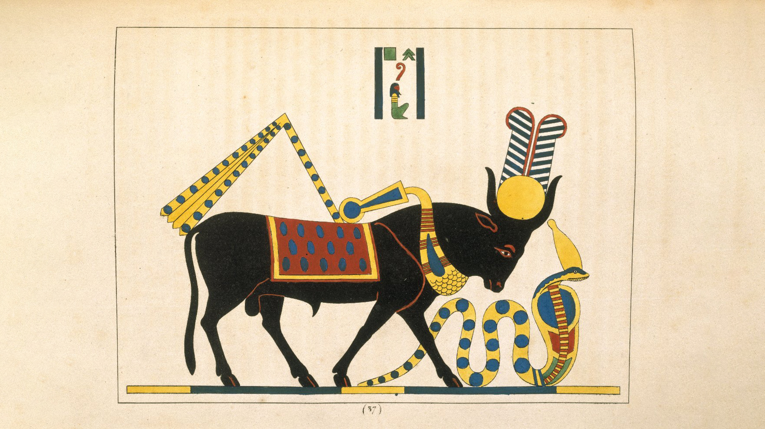

Slide 11
APIS = god who saved Israel Aaron = was preparing to offer sacrifice 2nd Commandment broken (Exodus 20:4)
“You shall not make for yourself an idol, or any likeness of what is in heaven above or on the earth beneath or in the water under the earth.”

Slide 12
⁷ Then the Lord spoke to Moses, “Go down at once, for your people, whom you brought up from the land of Egypt, have corrupted themselves. ⁸ They have quickly turned aside from the way which I commanded them. They have made for themselves a molten calf, and have worshiped it and have sacrificed to it and said, ‘This is your god, O Israel, who brought you up from the land of Egypt!’”
- Exodus 32:7-8

Slide 13
⁹ The Lord said to Moses, “I have seen this people, and behold, they are an obstinate people. ¹⁰ Now then let Me alone, that My anger may burn against them and that I may destroy them; and I will make of you a great nation.”
- Exodus 32:9-10

Slide 14
God can/has changed His mind. For example:
Hezekiah – II Kings 20:1-11
Sodom and Gomorrah – Genesis 16:18

Slide 15
¹⁹ It came about, as soon as Moses came near the camp, that he saw the calf and the dancing; and Moses’ anger burned, and he threw the tablets from his hands and shattered them at the foot of the mountain. ²⁰ He took the calf which they had made and burned it with fire, and ground it to powder, and scattered it over the surface of the water and made the sons of Israel drink it.
- Exodus 32:19-20

Slide 16
²¹ Then Moses said to Aaron, “What did this people do to you, that you have brought such great sin upon them?” ²² Aaron said, “Do not let the anger of my lord burn; you know the people yourself, that they are prone to evil.
- Exodus 32:21-22

Slide 17
²³ For they said to me, ‘Make a god for us who will go before us; for this Moses, the man who brought us up from the land of Egypt, we do not know what has become of him.’ ²⁴ I said to them, ‘Whoever has any gold, let them tear it off.’ So they gave it to me, and I threw it into the fire, and out came this calf.”
- Exodus 32:23-24

Slide 18
Aaron’s Excuses:
They forced me
Not my fault
Moses’ fault

Slide 19
Consequences:
People sinned
Lives lost
Aaron’s reputation ruined

Slide 20
Punishment:
People drink the bitter water of guilt
3000 leaders killed
Plague in the camp

Slide 21
The Journey Resumes
Moses intercedes – Exodus 33:7-23

Slide 22
The Journey Resumes
Moses intercedes – Exodus 33:7-23
Moses receives renewed instructions – Exodus 34:1-35:3

Slide 23
The Journey Resumes
Moses intercedes – Exodus 33:7-23
Moses receives renewed instructions – Exodus 34:1-35:3
The Tabernacle is built – Exodus 35:4-40:11

Slide 24
¹² Then you shall bring Aaron and his sons to the doorway of the tent of meeting and wash them with water. ¹³ You shall put the holy garments on Aaron and anoint him and consecrate him, that he may minister as a priest to Me.
- Exodus 40:12-13

Slide 25
¹⁴ You shall bring his sons and put tunics on them; ¹⁵ and you shall anoint them even as you have anointed their father, that they may minister as priests to Me; and their anointing will qualify them for a perpetual priesthood throughout their generations.” ¹⁶ Thus Moses did; according to all that the Lord had commanded him, so he did.
- Exodus 40:14-16

Slide 26
³⁴ Then the cloud covered the tent of meeting, and the glory of the Lord filled the tabernacle. ³⁵ Moses was not able to enter the tent of meeting because the cloud had settled on it, and the glory of the Lord filled the tabernacle.
- Exodus 40:34-35

Slide 27
³⁶ Throughout all their journeys whenever the cloud was taken up from over the tabernacle, the sons of Israel would set out; ³⁷ but if the cloud was not taken up, then they did not set out until the day when it was taken up. ³⁸ For throughout all their journeys, the cloud of the Lord was on the tabernacle by day, and there was fire in it by night, in the sight of all the house of Israel.
- Exodus 40:36-38

Slide 28
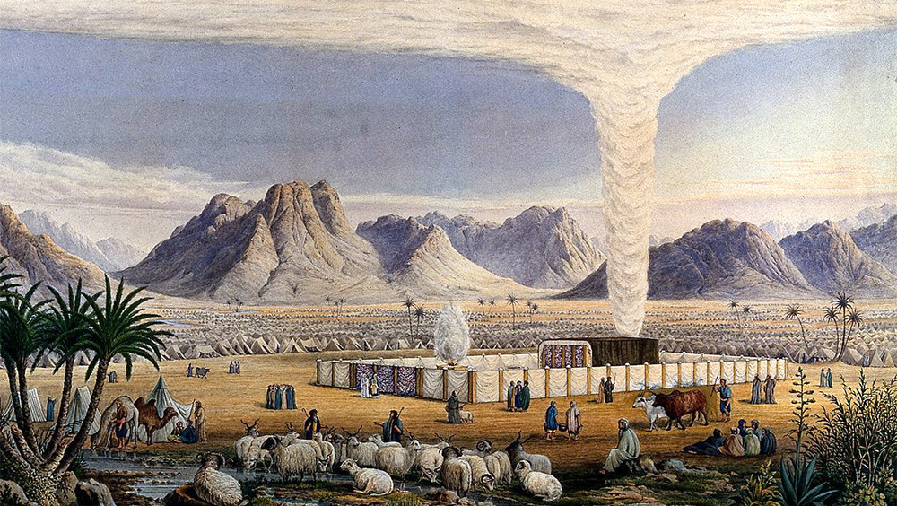

Slide 29
Lessons
Even great people fall

Slide 30
Lessons
Even great people fall
Failures are never forgotten but they are forgiven

Slide 31
Lessons
Even great people fall
Failures are never forgotten but they are forgiven
Failure lays the groundwork for improvement

Slide 32
TABERNACLE AT MT. SINAI
THE CROSS OF JESUS

Slide 33
Forgiveness and Mercy
1st Time
50th Time
Repentance and Baptism
Peter said to them, “Repent, and each of you be baptized in the name of Jesus Christ for the forgiveness of your sins; and you will receive the gift of the Holy Spirit. - Acts 2:38
Prayer
If we confess our sins, He is faithful and righteous to forgive us our sins and to cleanse us from all unrighteousness. - I John 1:9

Slide 34
THANK YOU BibleTalk.tv Mike Mazzalongo

