Slide 1
Why We Pray
MIKE MAZZALONGO

Slide 2
Many approaches to this subject:
How to pray
Study great prayers in the Bible
Study those who did the praying

Slide 3
Why We Pray
Unburden our hearts

Slide 4
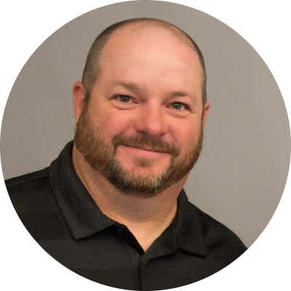
Joe Hammond
Prayer of Repentance and Confession

Slide 5
⁶ Therefore humble yourselves under the mighty hand of God, that He may exalt you at the proper time, ⁷ casting all your anxiety on Him, because He cares for you.
- I Peter 5:6-7

Slide 6
Prayer helps us detach ourselves from anxiety, fear and stress.

Slide 7
⁸ If we say that we have no sin, we are deceiving ourselves and the truth is not in us. ⁹ If we confess our sins, He is faithful and righteous to forgive us our sins and to cleanse us from all unrighteousness.
- I John 1:8-9

Slide 8
Worry
Guilt
GOD
PRAYER

Slide 9
Why We Pray
Unburden our hearts
Initiate blessings

Slide 10
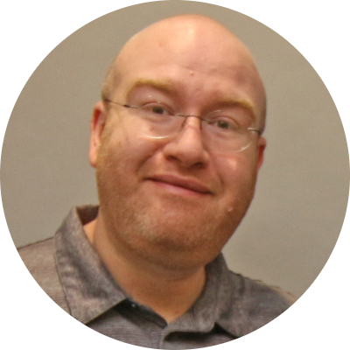
Charlie Andrews
Prayer of Supplication

Slide 11
Do not worry then, saying, ‘What will we eat?’ or ‘What will we drink?’ or ‘What will we wear for clothing?’ For the Gentiles eagerly seek all these things; for your heavenly Father knows that you need all these things.
Ask, and it will be given to you; seek, and you will find; knock, and it will be opened to you.
- Mt. 6:31-32
- Mt. 7:7

Slide 12
We are totally dependent on God
He keeps order in the universe
He gives life / rules over death
All of humanity depend on God

Slide 13
Prayer is our expression of dependance on God.

Slide 14
Prayer gives us access to the spiritual things we need to grow in the Kingdom.

Slide 15
¹⁵ For this reason I too, having heard of the faith in the Lord Jesus which exists among you and your love for all the saints, ¹⁶ do not cease giving thanks for you, while making mention of you in my prayers;
- Ephesians 1:15-16

Slide 16
¹⁷ that the God of our Lord Jesus Christ, the Father of glory, may give to you a spirit of wisdom and of revelation in the knowledge of Him. ¹⁸ I pray that the eyes of your heart may be enlightened, so that you will know what is the hope of His calling, what are the riches of the glory of His inheritance in the saints,
- Ephesians 1:17-18

Slide 17
Why We Pray
Unburden our hearts
Initiate blessings
Prayer purifies and sanctifies

Slide 18
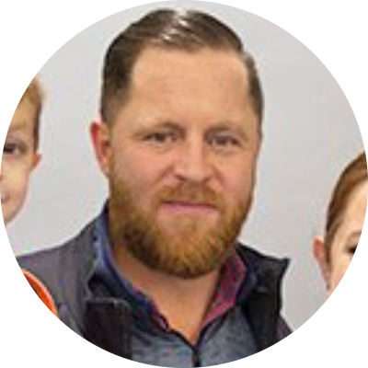
Paul Mazzalongo
Prayer of Praise to God

Slide 19
⁴ For everything created by God is good, and nothing is to be rejected if it is received with gratitude; ⁵ for it is sanctified by means of the word of God and prayer.
- I Timothy 4:4-5

Slide 20
Prayer recognizes and thanks God for His grace.

Slide 21
Jesus and Prayer
He had no sin, but he prayed

Slide 22
Jesus and Prayer
He had no sin, but he prayed
He understood the purpose of prayer

Slide 23
Jesus and Prayer
He had no sin, but he prayed
He understood the purpose of prayer
He made ordinary things holy through prayer

Slide 24
Jesus used prayer as an avenue of communication with God concerning:
Stress
Sinfulness
Needs
Pain
Guidance
Thanksgiving

Slide 25
JESUS PRAYED ON THE GO!

Slide 26
²⁵ But if we hope for what we do not see, with perseverance we wait eagerly for it. ²⁶ In the same way the Spirit also helps our weakness; for we do not know how to pray as we should, but the Spirit Himself intercedes for us with groanings too deep for words; ²⁷ and He who searches the hearts knows what the mind of the Spirit is, because He intercedes for the saints according to the will of God.
- Romans 8:25-27

Slide 27
Who needs the witness or prayers of the church today?

