Slide 1
1
Why Should I Work on My Faith?

Slide 2
Why should I increase my faith?
God wants me to grow - Matthew 17:14-20; 13:31-32

Slide 3
¹⁴ When they came to the crowd, a man came up to Jesus, falling on his knees before Him and saying, ¹⁵ “Lord, have mercy on my son, for he is a lunatic and is very ill; for he often falls into the fire and often into the water.
- Matthew 17:14-15

Slide 4
¹⁶ I brought him to Your disciples, and they could not cure him.” ¹⁷ And Jesus answered and said, “You unbelieving and perverted generation, how long shall I be with you? How long shall I put up with you? Bring him here to Me.”
- Matthew 17:16-17

Slide 5
¹⁸ And Jesus rebuked him, and the demon came out of him, and the boy was cured at once. ¹⁹ Then the disciples came to Jesus privately and said, “Why could we not drive it out?”
- Matthew 17:18-19

Slide 6
And He said to them, “Because of the littleness of your faith; for truly I say to you, if you have faith the size of a mustard seed, you will say to this mountain, ‘Move from here to there,’ and it will move; and nothing will be impossible to you.
- Matthew 17:20

Slide 7
³¹ He presented another parable to them, saying, “The kingdom of heaven is like a mustard seed, which a man took and sowed in his field; ³² and this is smaller than all other seeds, but when it is full grown, it is larger than the garden plants and becomes a tree, so that the birds of the air come and nest in its branches.”
- Matthew 13:31-32

Slide 8
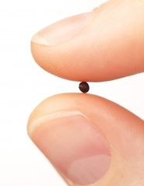

Slide 9
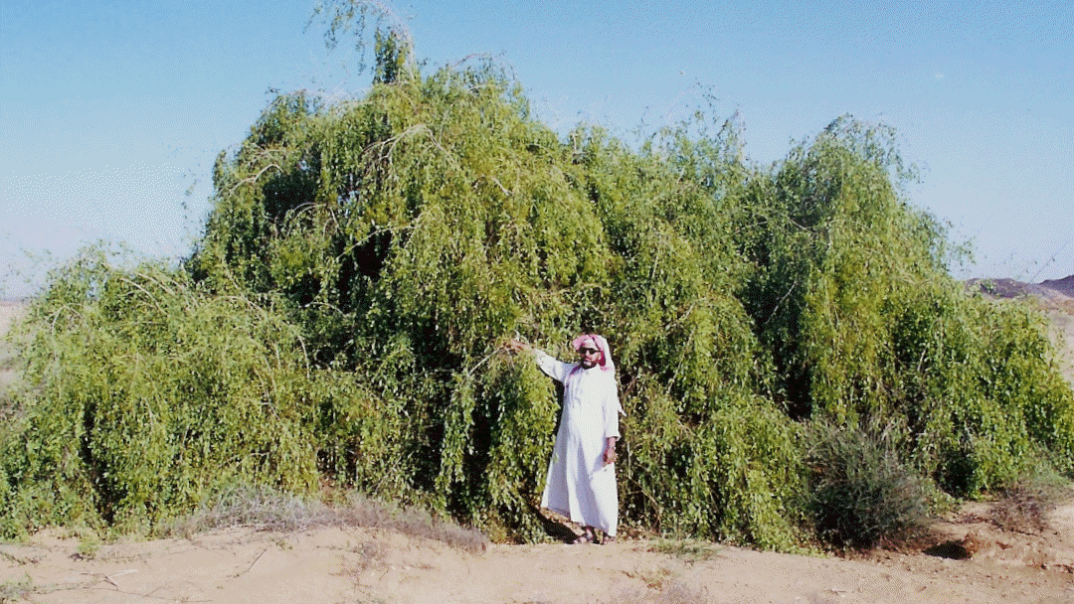

Slide 10
Why should I increase my faith?
God wants me to grow
We either move forward or backward - Hebrews 5:11-14

Slide 11
¹¹ Concerning him we have much to say, and it is hard to explain, since you have become dull of hearing. ¹² For though by this time you ought to be teachers, you have need again for someone to teach you the elementary principles of the oracles of God, and you have come to need milk and not solid food.
- Hebrews 5:11-12

Slide 12
¹³ For everyone who partakes only of milk is not accustomed to the word of righteousness, for he is an infant. ¹⁴ But solid food is for the mature, who because of practice have their senses trained to discern good and evil.
- Hebrews 5:13-14

Slide 13
Why should I increase my faith?
God wants me to grow
We either move forward or backward
Without spiritual growth we won’t have numerical growth in our congregations - Ephesians 4:14-16

Slide 14
¹⁴ As a result, we are no longer to be children, tossed here and there by waves and carried about by every wind of doctrine, by the trickery of men, by craftiness in deceitful scheming; ¹⁵ but speaking the truth in love, we are to grow up in all aspects into Him who is the head, even Christ,
- Ephesians 4:14-15

Slide 15
from whom the whole body, being fitted and held together by what every joint supplies, according to the proper working of each individual part, causes the growth of the body for the building up of itself in love.
- Ephesians 4:16

Slide 16
Why should I increase my faith?
God wants me to grow
We either move forward or backward
Without spiritual growth we won’t have numerical growth in our congregations
If God does not have you, Satan does - 1 Peter 5:6-8; 1 John 3:7-10; Matthew 12:30

Slide 17
⁶ Therefore humble yourselves under the mighty hand of God, that He may exalt you at the proper time, ⁷ casting all your anxiety on Him, because He cares for you. ⁸ Be of sober spirit, be on the alert. Your adversary, the devil, prowls around like a roaring lion, seeking someone to devour.
- 1 Peter 5:6-8

Slide 18
⁷ Little children, make sure no one deceives you; the one who practices righteousness is righteous, just as He is righteous; ⁸ the one who practices sin is of the devil; for the devil has sinned from the beginning. The Son of God appeared for this purpose, to destroy the works of the devil.
- 1 John 3:7-8

Slide 19
⁹ No one who is born of God practices sin, because His seed abides in him; and he cannot sin, because he is born of God. ¹⁰ By this the children of God and the children of the devil are obvious: anyone who does not practice righteousness is not of God, nor the one who does not love his brother.
1 John 3:9-10

Slide 20
"He who is not with Me is against Me; and he who does not gather with Me scatters.
- Matthew 12:30

Slide 21
Why should I increase my faith?
If God does not have you, Satan does
Without faith we can’t please God - Hebrews 11:6

Slide 22
And without faith it is impossible to please Him, for he who comes to God must believe that He is and that He is a rewarder of those who seek Him.
- Hebrews 11:6

Slide 23
Why should I increase my faith?
If God does not have you, Satan does
Without faith we can’t please God
Faith development fosters healthy and harmonious relationships in the family of God.

Slide 24
Why should I increase my faith?
If God does not have you, Satan does
Without faith we can’t please God
Faith development fosters healthy and harmonious relationships in the family of God. Others are struggling too - 2 Timothy 2:24-26

Slide 25
²⁴ The Lord’s bond-servant must not be quarrelsome, but be kind to all, able to teach, patient when wronged, ²⁵ with gentleness correcting those who are in opposition, if perhaps God may grant them repentance leading to the knowledge of the truth, ²⁶ and they may come to their senses and escape from the snare of the devil, having been held captive by him to do his will.
- 2 Timothy 2:24-26

Slide 26
What is your motivation?

