Slide 1
12
What's so Great about Abraham?

Slide 2
How Abraham’s Faith was so Great
By faith Abraham took God at His word.

Slide 3
How Abraham’s Faith was so Great
By faith Abraham took God at His word.
Abraham left the comfort of his native land. - Hebrews 11:8-10

Slide 4
⁸ By faith Abraham, when he was called, obeyed by going out to a place which he was to receive for an inheritance; and he went out, not knowing where he was going. ⁹ By faith he lived as an alien in the land of promise, as in a foreign land, dwelling in tents with Isaac and Jacob, fellow heirs of the same promise; ¹⁰ for he was looking for the city which has foundations, whose architect and builder is God.
- Hebrews 11:8-10

Slide 5
How Abraham’s Faith was so Great
By faith Abraham took God at His word.
Abraham left the comfort of his native land.
God said it. That settled it. - Genesis 15:6

Slide 6
Then he believed in the Lord; and He reckoned it to him as righteousness.
- Genesis 15:6

Slide 7
How Abraham’s Faith was so Great
By faith Abraham took God at His word.
Abraham left the comfort of his native land.
God said it. That settled it.
Abraham believed even though he did not know how God was going to accomplish His promise.

Slide 8
How Abraham’s Faith was so Great
By faith Abraham took God at His word.
By faith Abraham passed his beliefs on to Isaac.

Slide 9
How Abraham’s Faith was so Great
By faith Abraham passed his beliefs on to Isaac.
He invested time in Isaac teaching him the ways of Jehovah. - Genesis 18:18-19

Slide 10
¹⁸ since Abraham will surely become a great and mighty nation, and in him all the nations of the earth will be blessed? ¹⁹ For I have chosen him, so that he may command his children and his household after him to keep the way of the Lord by doing righteousness and justice, so that the Lord may bring upon Abraham what He has spoken about him.”
- Genesis 18:18-19

Slide 11
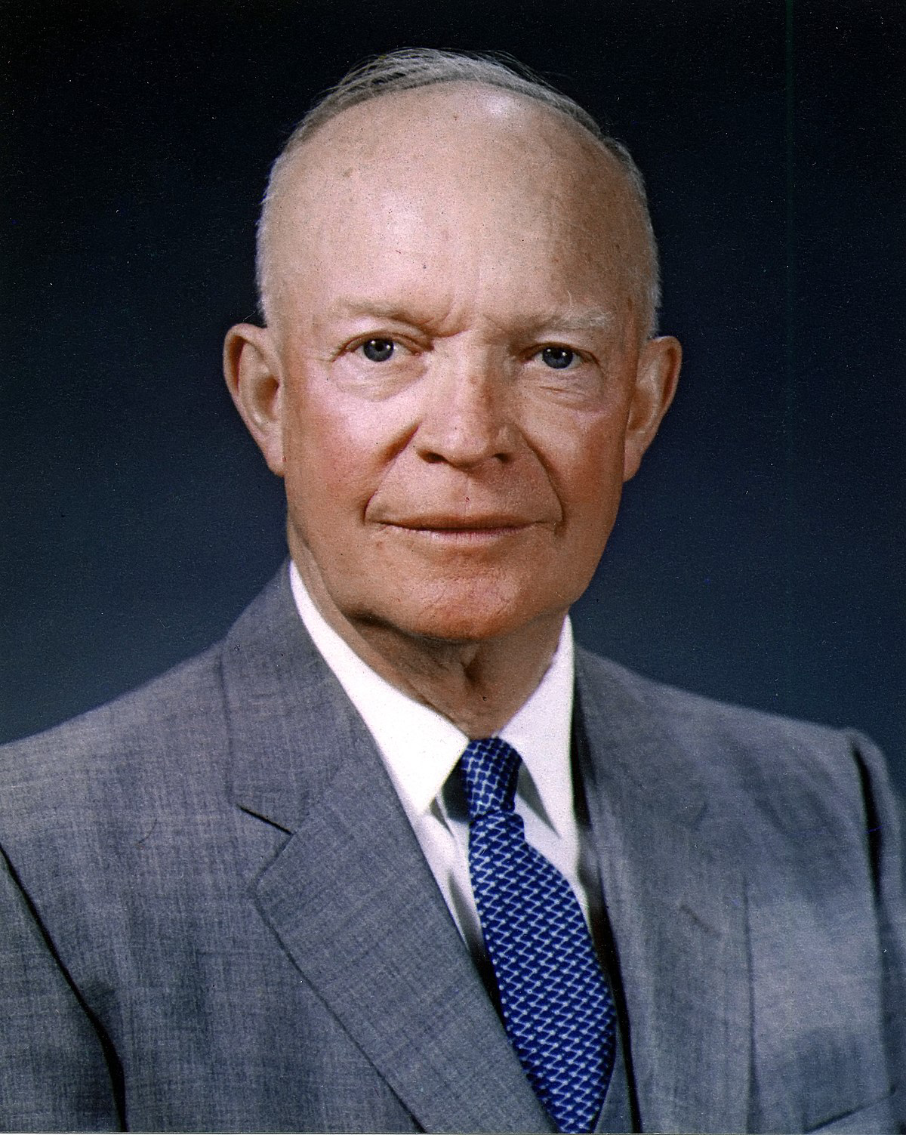
“...The best answer for too much government in Washington is better government at home...” - Dwight D. Eisenhower

Slide 12
How Abraham’s Faith was so Great
By faith Abraham passed his beliefs on to Isaac.
He invested time in Isaac teaching him the ways of Jehovah.
Any parent who teaches their child to serve God shows they love their child and their faith.

Slide 13
How Abraham’s Faith was so Great
By faith Abraham took God at His word.
By faith Abraham passed his beliefs on to Isaac.
By faith Abraham interceded on behalf of others.

Slide 14
How Abraham’s Faith was so Great
By faith Abraham interceded on behalf of others.
A man’s faith is reflected in his concern for the welfare of others. - Genesis 18:22-33

Slide 15
²² Then the men turned away from there and went toward Sodom, while Abraham was still standing before the Lord. ²³ Abraham came near and said, “Will You indeed sweep away the righteous with the wicked?
- Genesis 18:22-23

Slide 16
²⁴ Suppose there are fifty righteous within the city; will You indeed sweep it away and not spare the place for the sake of the fifty righteous who are in it? ²⁵ Far be it from You to do such a thing, to slay the righteous with the wicked, so that the righteous and the wicked are treated alike. Far be it from You! Shall not the Judge of all the earth deal justly?”
- Genesis 18:24-25

Slide 17
²⁶ So the Lord said, “If I find in Sodom fifty righteous within the city, then I will spare the whole place on their account.” ²⁷ And Abraham replied, “Now behold, I have ventured to speak to the Lord, although I am but dust and ashes.
- Genesis 18:26-27

Slide 18
²⁸ Suppose the fifty righteous are lacking five, will You destroy the whole city because of five?” And He said, “I will not destroy it if I find forty-five there.” ²⁹ He spoke to Him yet again and said, “Suppose forty are found there?” And He said, “I will not do it on account of the forty.”
- Genesis 18:28-29

Slide 19
³⁰ Then he said, “Oh may the Lord not be angry, and I shall speak; suppose thirty are found there?” And He said, “I will not do it if I find thirty there.” ³¹ And he said, “Now behold, I have ventured to speak to the Lord; suppose twenty are found there?” And He said, “I will not destroy it on account of the twenty.”
- Genesis 18:30-31

Slide 20
³² Then he said, “Oh may the Lord not be angry, and I shall speak only this once; suppose ten are found there?” And He said, “I will not destroy it on account of the ten.” ³³ As soon as He had finished speaking to Abraham the Lord departed, and Abraham returned to his place.
- Genesis 18:32-33

Slide 21
²⁸ One of the scribes came and heard them arguing, and recognizing that He had answered them well, asked Him, “What commandment is the foremost of all?” ²⁹ Jesus answered, “The foremost is, ‘Hear, O Israel! The Lord our God is one Lord; ³⁰ and you shall love the Lord your God with all your heart, and with all your soul, and with all your mind, and with all your strength.’
- Mark 12:28-30

Slide 22
and the second [is] like [it], this, You will love your neighbor as yourself—there is no other command greater than these.”
- Mark 12:31 LSV

Slide 23
How Abraham’s Faith was so Great
By faith Abraham interceded on behalf of others.
A man’s faith is reflected in his concern for the welfare of others.
Abraham wanted protection for the innocent.

Slide 24
How Abraham’s Faith was so Great
By faith Abraham interceded on behalf of others.
A man’s faith is reflected in his concern for the welfare of others.
Abraham wanted protection for the innocent.
Could you carry on so bold a conversation with the Almighty?

Slide 25
How Abraham’s Faith was so Great
By faith Abraham took God at His word.
By faith Abraham passed his beliefs on to Isaac.
By faith Abraham interceded on behalf of others.
By faith Abraham witnessed the miraculous birth of his son.

Slide 26
How Abraham’s Faith was so Great
By faith Abraham witnessed the miraculous birth of his son.
This happened because of his faith according to Hebrews 11:11-12.

Slide 27
¹¹ By faith even Sarah herself received ability to conceive, even beyond the proper time of life, since she considered Him faithful who had promised. ¹² Therefore there was born even of one man, and him as good as dead at that, as many descendants as the stars of heaven in number, and innumerable as the sand which is by the seashore.
- Hebrews 11:11-12

Slide 28
How Abraham’s Faith was so Great
By faith Abraham witnessed the miraculous birth of his son.
This happened because of his faith according to Hebrews 11:11-12.
The ultimate tests of Abraham’s faith was when God told him to offer up Isaac, Genesis 22:2.

Slide 29
He said, “Take now your son, your only son, whom you love, Isaac, and go to the land of Moriah, and offer him there as a burnt offering on one of the mountains of which I will tell you.”
- Genesis 22:2

Slide 30
How Abraham’s Faith was so Great
By faith Abraham witnessed the miraculous birth of his son.
This happened because of his faith according to Hebrews 11:11-12.
The ultimate tests of Abraham’s faith was when God told him to offer up Isaac, Genesis 22:2.
Abraham was not a perfect man, but he trusted God.

