Slide 1
The Demands of Discipleship
MIKE MAZZALONGO

Slide 2
¹⁸ And Jesus came up and spoke to them, saying, “All authority has been given to Me in heaven and on earth. ¹⁹ Go therefore and make disciples of all the nations, baptizing them in the name of the Father and the Son and the Holy Spirit, ²⁰ teaching them to observe all that I commanded you; and lo, I am with you always, even to the end of the age.”
- Matthew 28:18-20

Slide 3
⁹ “Then they will deliver you to tribulation, and will kill you, and you will be hated by all nations because of My name. ¹⁰ At that time many will fall away and will betray one another and hate one another. ¹¹ Many false prophets will arise and will mislead many. ¹² Because lawlessness is increased, most people’s love will grow cold. ¹³ But the one who endures to the end, he will be saved.
- Matthew 24:9-13

Slide 4
⁵⁷ As they were going along the road, someone said to Him, “I will follow You wherever You go.” ⁵⁸ And Jesus said to him, “The foxes have holes and the birds of the air have nests, but the Son of Man has nowhere to lay His head.”
- Luke 9:57-58

Slide 5
⁵⁹ And He said to another, “Follow Me.” But he said, “Lord, permit me first to go and bury my father.” ⁶⁰ But He said to him, “Allow the dead to bury their own dead; but as for you, go and proclaim everywhere the kingdom of God.”
- Luke 9:59-60

Slide 6
⁶¹ Another also said, “I will follow You, Lord; but first permit me to say good-bye to those at home.” ⁶² But Jesus said to him, “No one, after putting his hand to the plow and looking back, is fit for the kingdom of God.”
- Luke 9:61-62

Slide 7
Demands of Discipleship
Discipleship demands that we be pilgrims – vs. 57-58

Slide 8
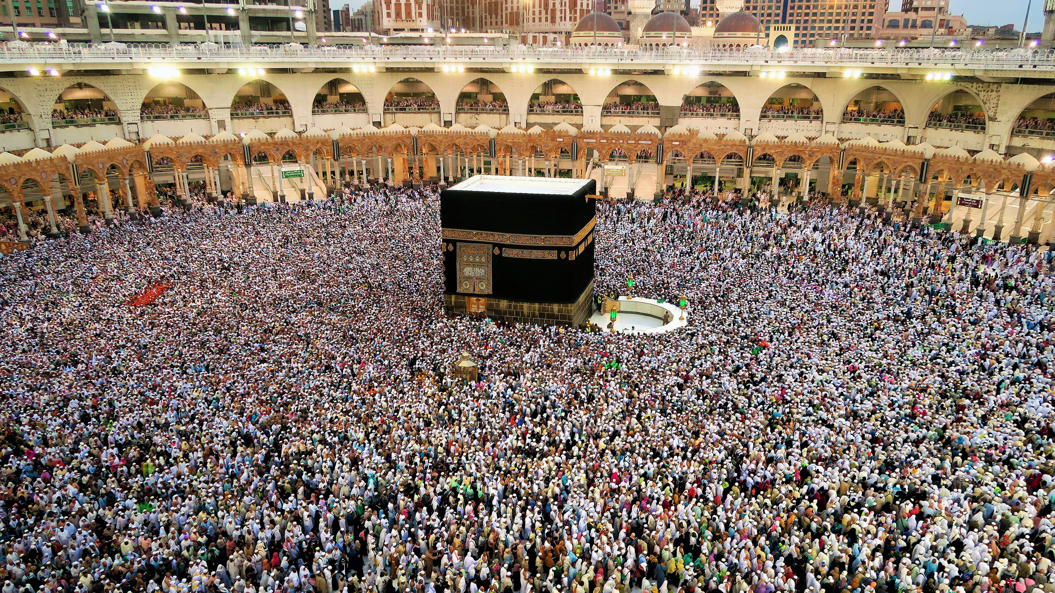

Slide 9
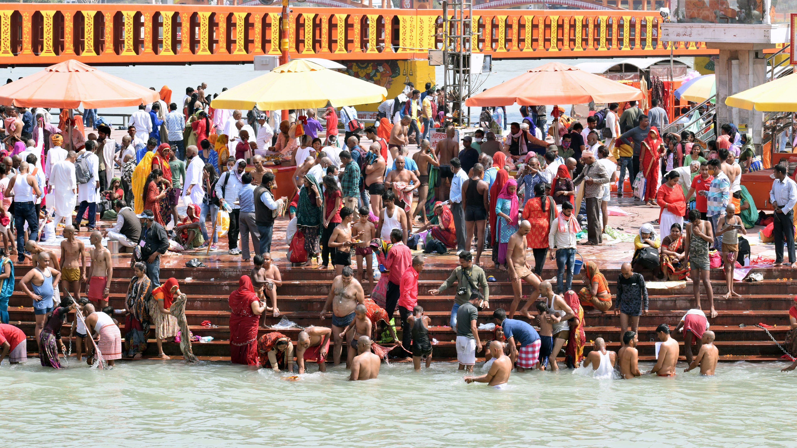

Slide 10
A Christian’s pilgrimage is passing through this world on their journey to heaven.

Slide 11
“If you’ve found your place in the world, it may mean that the world has found its place in you.”

Slide 12
Demands of Discipleship
Discipleship demands that we be pilgrims – vs. 57-58
Discipleship demands that we follow Jesus – vs. 59-60

Slide 13
{
Loyalty
Sentiment
Culture
CHRISTIANITY IS NOT ABOUT

Slide 17
Disciples follow only Jesus because only Jesus is alive and gives life.

Slide 18
Demands of Discipleship
Discipleship demands that we be pilgrims – vs. 57-58
Discipleship demands that we follow Jesus – vs. 59-60
Discipleship demands that we don’t look back – vs. 61-62

Slide 19
Discipleship doesn’t mean going to church on Sundays, it means being the church every day!

Slide 20
Discipleship is a privilege
Give up sin – gain salvation
Abandon darkness – live in light
Trade lust – pursue love

Slide 21
THE CHRISTIAN PILGRIMAGE
Jesus & Disciples
God
New Jerusalem
Eternity
}
»

Slide 22
Same Demands on Today’s Disciples
Success is measured by spiritual gains

Slide 23
Same Demands on Today’s Disciples
Success is measured by spiritual gains
Today’s disciples are always in fellowship with Christ

Slide 24
Same Demands on Today’s Disciples
Success is measured by spiritual gains
Today’s disciples are always in fellowship with Christ
Disciples desire the return of Jesus

Slide 25
THE INVITATION
Become a disciple today. Acts 2:38
Come back to being a disciple today. I John 1:7-9

