Slide 1
4
Stillness and Solitude

Slide 2
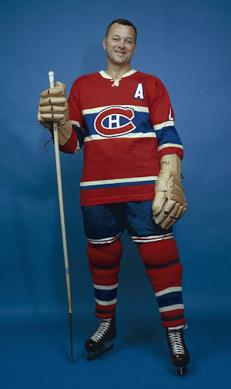
Doug Harvey
Montreal Canadiens

Slide 3
What’s your Rhythm Rate?
1
10
2
3
4
5
6
7
8
9

Slide 4
Selah Pause, Cease, Stop

Slide 5
¹ God is our refuge and strength, A very present help in trouble. ² Therefore we will not fear, though the earth should change And though the mountains slip into the heart of the sea; ³ Though its waters roar and foam, Though the mountains quake at its swelling pride. Selah.
- Psalm 46:1-3

Slide 6
⁴ There is a river whose streams make glad the city of God,
The holy dwelling places of the Most High.
⁵ God is in the midst of her, she will not be moved;
God will help her when morning dawns.
- Psalm 46:4-5

Slide 7
⁶ The nations made an uproar, the kingdoms tottered; He raised His voice, the earth melted. ⁷ The Lord of hosts is with us; The God of Jacob is our stronghold. Selah.
- Psalm 46:6-7

Slide 8
⁸ Come, behold the works of the Lord, Who has wrought desolations in the earth. ⁹ He makes wars to cease to the end of the earth; He breaks the bow and cuts the spear in two; He burns the chariots with fire.
- Psalm 46:8-9

Slide 9
¹⁰ "Cease striving and know that I am God; I will be exalted among the nations, I will be exalted in the earth." ¹¹ The Lord of hosts is with us; The God of Jacob is our stronghold. Selah.
- Psalm 46:10-11

Slide 10
SIMPLIFY Draws us near STILLNESS Enables us to know

Slide 11
Knowing Him begins the transformation of being like Him.

Slide 12
And the Word became flesh, and dwelt among us, and we saw His glory, glory as of the only begotten from the Father, full of grace and truth.
- John 1:14

Slide 13
Stillness is not:
Talking to God
Worrying
Reviewing our needs
Figuring out the answers
Improving ourselves

Slide 14
Goal → Stillness of the Heart

Slide 15
Be still and know that I am God.
- Psalm 46:10

Slide 16
Cultivating stillness requires solitude

Slide 17
"People rarely learn something while in a crowd.” - Chuck Swindoll

Slide 18
Stillness Through Solitude
Pick a place and time

Slide 19
Stillness Through Solitude
Pick a place and time
Let your mind run to empty

Slide 20
Stillness Through Solitude
Pick a place and time
Let your mind run to empty
Write down your thoughts

Slide 21
#1 On a scale of 1 (very slow) to 10 (super fast), how would you rate the pace of your life? Are you satisfied with the pace and why?

Slide 22
#2 In your opinion what is the number one factor that determines the pace of your life? What/who should be the primary factor?

Slide 23
#3 With all the encouragements and proofs of God's care, why do you think so many believers do not turn to Him in time of need? Why is this so?

Slide 24
#4 What stops you from being alone with God?

Slide 25
#5 Have the group stop all discussion and movement for 10 minutes and let each write down any thoughts that occur during that time. Share with the group when time is up.

Slide 26
Note: This silent exercise needs to be done by all groups at the same time. Leave 10 minutes at the end of the session for feedback.

