Slide 1
1
Jewish Historical Timeline

Slide 2
JEWISH HISTORY
1500 BC - MOSES
1020 BC – KING SAUL

Slide 3
TIMELINE – HEADINGS
DATE
EVENTS
PROPHETS/BOOKS
WORLD

Slide 4
DATE
EVENTS
PROPHETS/BOOKS
WORLD
1020 BC
Beginning of United Kingdom
Israel ruled by one king
- Saul (1020-1000)
- David (1000-961)
- Solomon (961-922)
I & II Samuel
I Kings 1-11
I Chronicles
II Chronicles 1-9
Psalms
Proverbs
Song of Solomon
Ecclesiastes

Slide 5
DATE
EVENTS
PROPHETS/BOOKS
WORLD
1020 BC
Beginning of United Kingdom
Israel ruled by one king
- Saul (1020-1000)
- David (1000-961)
- Solomon (961-922)
I & II Samuel
I Kings 1-11
I Chronicles
II Chronicles 1-9
Psalms
Proverbs
Song of Solomon
Ecclesiastes
922 BC
Beginning of Divided Kingdom
I Kings 12-22
II Kings
II Chronicles
Rise of
Assyrian Empire

Slide 7
DATE
EVENTS
PROPHETS/BOOKS
WORLD
722 BC
Succession of rulers
North (Israel)
20 kings
South (Judah)
20 kings
Jonah
Joel
Isaiah
Amos
Hosea
Micah
Nineveh, capital of Assyria is spared
by Jonah’s preaching

Slide 8
DATE
EVENTS
PROPHETS/BOOKS
WORLD
722 BC
Succession of rulers
North (Israel)
20 kings
South (Judah)
20 kings
Jonah
Joel
Isaiah
Amos
Hosea
Micah
Nineveh, capital of Assyria is spared
by Jonah’s preaching
721 BC
Fall of Northern Kingdom to Assyria
Obadiah
Zephaniah
Nahum
Habakkuk
Israel carried off into diff. foreign lands by Assyria
Assyria destroyed by Babylonians
Babylonian Empire established

Slide 9
DATE
EVENTS
PROPHETS/BOOKS
WORLD
587 BC
Fall of Jerusalem and Southern Kingdom to Nebuchadnezzar Il of Babylon
70 years of captivity
Jeremiah
Lamentations
Ezekiel
Daniel
Judah in Babylonian captivity
Rise of Daniel to prominence
Babylon defeated by Medes and Persians

Slide 10
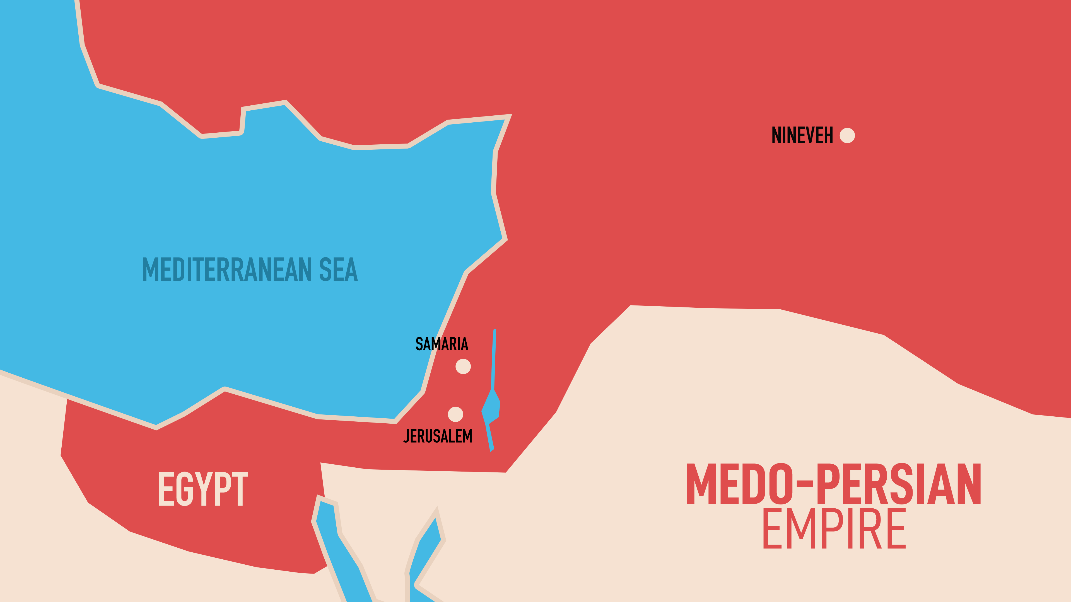

Slide 11
DATE
EVENTS
PROPHETS/BOOKS
WORLD
587 BC
Fall of Jerusalem and Southern Kingdom to Nebuchadnezzar Il of Babylon
70 years of captivity
Jeremiah
Lamentations
Ezekiel
Daniel
Judah in Babylonian captivity
Rise of Daniel to prominence
Babylon defeated by Medes and Persians
538 BC
First group of Jewish exiles returns to Jerusalem under leadership of Sheshbazzar
Haggai
Edict of Cyrus Persian king

Slide 12
DATE
EVENTS
PROPHETS/BOOKS
WORLD
516 BC
Second temple begins reconstruction and completed by Zerubbabel and Jeshua
Zechariah
Esther
Period of Persian Empire
Darius I
Xerxes (Ahasuerus)
Artaxerxes I
Artaxerxes Il

Slide 13
ZERUBBABEL Grandson of King Jehoiachin JESHUA Head of household of priests

Slide 14
DATE
EVENTS
PROPHETS/BOOKS
WORLD
457 BC
Ezra reinstates the teaching of the Law
Ezra

Slide 15
DATE
EVENTS
PROPHETS/BOOKS
WORLD
457 BC
Ezra reinstates the teaching of the Law
Ezra
445 BC
Nehemiah returns to rebuild the wall around Jerusalem
Ezra and Nehemiah dedicate the finished work
Nehemiah
Malachi
Close of the Old Testament period

Slide 16
NEHEMIAH Cup bearer to the king EZRA Priest/secretary of state for Jewish affairs

Slide 17
DATE
EVENTS
PROPHETS/BOOKS
WORLD
400 BC
CHRIST
Greek domination of Judea
Ruled by Ptolemy of Egypt
Maccabean revolt
Jesus Christ born
Apocryphal (hidden) books
Esdras
Judith
Maccabees
Alexander conquers Persia
Ascendance of the Roman Empire

Slide 18
600 YEARS – COMMON THEME God ministers to His people.

Slide 19
God never let them go!

Slide 20
LESSON #2 “God stirs up the builders’ hearts”

