Slide 1
10
How do I Start Solidifying my Faith?

Slide 2
Mature Faith Solidifying Faith Searching Faith Affiliating Faith Imitating Faith

Slide 3
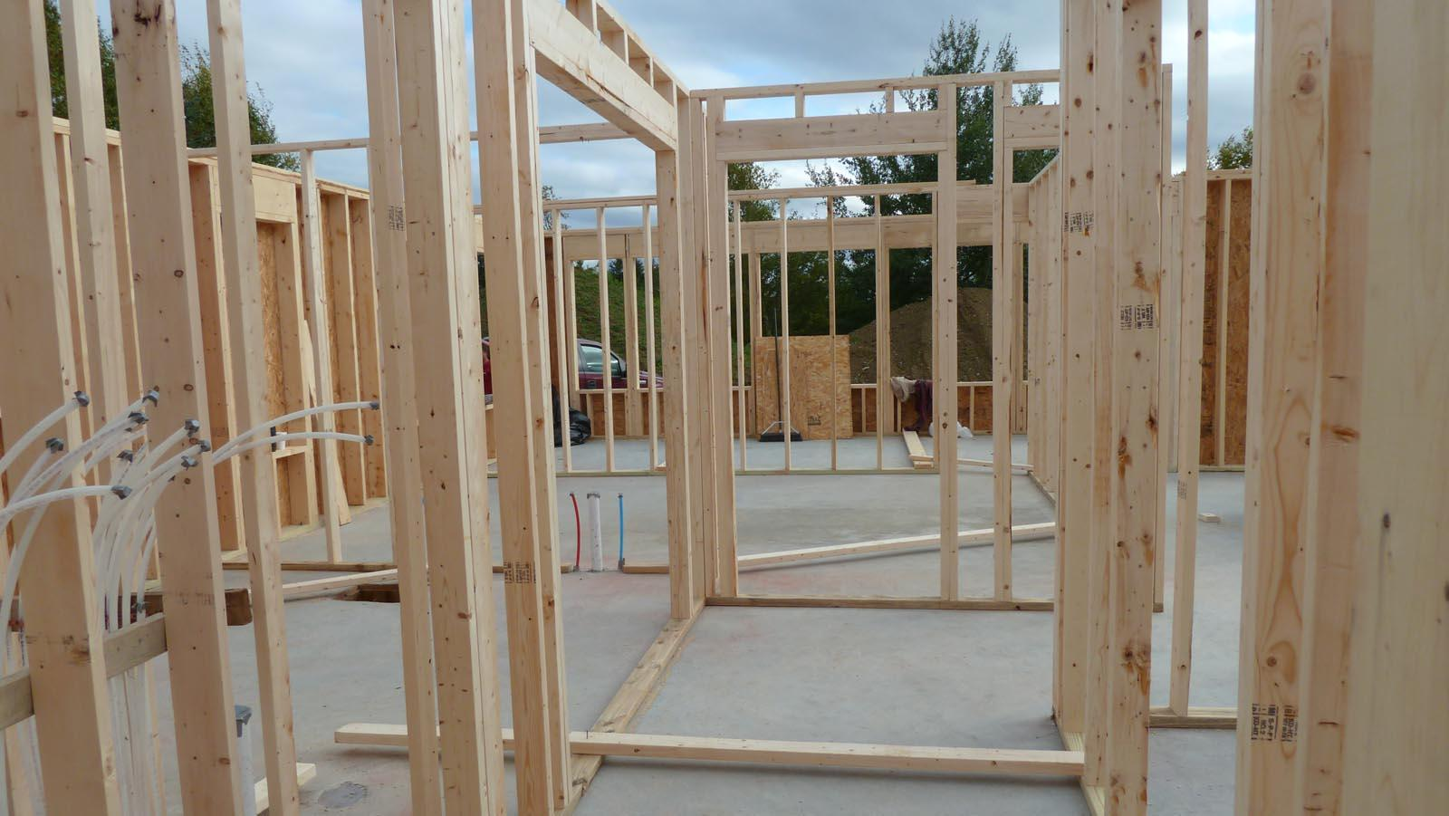

Slide 4
You will always be searching but at some point you need to come down solid on what you believe. - John 4:46-54

Slide 5
⁴⁶ Therefore He came again to Cana of Galilee where He had made the water wine. And there was a royal official whose son was sick at Capernaum. ⁴⁷ When he heard that Jesus had come out of Judea into Galilee, he went to Him and was imploring Him to come down and heal his son; for he was at the point of death.
- John 4:46-47

Slide 6
⁴⁸ So Jesus said to him, “Unless you people see signs and wonders, you simply will not believe.” ⁴⁹ The royal official said to Him, “Sir, come down before my child dies.” ⁵⁰ Jesus said to him, “Go; your son lives.” The man believed the word that Jesus spoke to him and started off.
- John 4:48-50

Slide 7
⁵¹ As he was now going down, his slaves met him, saying that his son was living. ⁵² So he inquired of them the hour when he began to get better. Then they said to him, “Yesterday at the seventh hour the fever left him.”
- John 4:51-52

Slide 8
⁵³ So the father knew that it was at that hour in which Jesus said to him, “Your son lives”; and he himself believed and his whole household. ⁵⁴ This is again a second sign that Jesus performed when He had come out of Judea into Galilee.
- John 4:53-54

Slide 9
For your belief (faith) to grow you must overcome your unbelief. - Mark 9:14-25

Slide 10
¹⁴ When they came back to the disciples, they saw a large crowd around them, and some scribes arguing with them. ¹⁵ Immediately, when the entire crowd saw Him, they were amazed and began running up to greet Him.
- Mark 9:14-25

Slide 11
¹⁶ And He asked them, “What are you discussing with them?” ¹⁷ And one of the crowd answered Him, “Teacher, I brought You my son, possessed with a spirit which makes him mute;
- Mark 9:16-17

Slide 12
and whenever it seizes him, it slams him to the ground and he foams at the mouth, and grinds his teeth and stiffens out. I told Your disciples to cast it out, and they could not do it.”
- Mark 9:18

Slide 13
¹⁹ And He answered them and said, “O unbelieving generation, how long shall I be with you? How long shall I put up with you? Bring him to Me!” ²⁰ They brought the boy to Him. When he saw Him, immediately the spirit threw him into a convulsion, and falling to the ground, he began rolling around and foaming at the mouth.
- Mark 9:19-20

Slide 14
²¹ And He asked his father, “How long has this been happening to him?” And he said, “From childhood. ²² It has often thrown him both into the fire and into the water to destroy him. But if You can do anything, take pity on us and help us!”
- Mark 9:21-22

Slide 15
²³ And Jesus said to him, “‘If You can?’ All things are possible to him who believes.” ²⁴ Immediately the boy’s father cried out and said, “I do believe; help my unbelief.”
- Mark 9:23-24

Slide 16
When Jesus saw that a crowd was rapidly gathering, He rebuked the unclean spirit, saying to it, “You deaf and mute spirit, I command you, come out of him and do not enter him again.”
- Mark 9:25

Slide 17
How do I Start Solidifying my Faith?
Come to some conclusions

Slide 18
How do I Start Solidifying my Faith?
Come to some conclusions
I either believe it, or I do not.

Slide 19
How do I Start Solidifying my Faith?
Come to some conclusions
I either believe it, or I do not.
Do I accept God’s will for my life? 2 Corinthians 12:7-10.

Slide 20
⁷ Because of the surpassing greatness of the revelations, for this reason, to keep me from exalting myself, there was given me a thorn in the flesh, a messenger of Satan to torment me—to keep me from exalting myself! ⁸ Concerning this I implored the Lord three times that it might leave me.
- 2 Corinthians 12:7-8

Slide 21
⁹ And He has said to me, “My grace is sufficient for you, for power is perfected in weakness.” Most gladly, therefore, I will rather boast about my weaknesses, so that the power of Christ may dwell in me. ¹⁰ Therefore I am well content with weaknesses, with insults, with distresses, with persecutions, with difficulties, for Christ’s sake; for when I am weak, then I am strong.
- 2 Corinthians 12:9-10

Slide 22
Two Warnings
DO NOT set time limits for spiritual growth.

Slide 23
Two Warnings
DO NOT set time limits for spiritual growth.
DO recognize when it is time to move forward.

Slide 24
How do I Start Solidifying my Faith?
Come to some conclusions
Accept the fact that some questions have to go unanswered for now.

Slide 25
How do I Start Solidifying my Faith?
Accept the fact that some questions have to go unanswered for now.
We need sufficient evidence for a conclusion; not exhaustive evidence. - Job 42:1-3

Slide 26
¹ Then Job answered the Lord and said,
² “I know that You can do all things, And that no purpose of Yours can be thwarted.
- Job 42:1-2

Slide 27
‘Who is this that hides counsel without knowledge?’
Therefore I have declared that which I did not understand,
Things too wonderful for me, which I did not know.”
- Job 42:3

Slide 28
How do I Start Solidifying my Faith?
Accept the fact that some questions have to go unanswered for now.
We need sufficient evidence for a conclusion; not exhaustive evidence.
An infinite God is hard for the finite mind to grasp. - 1 Corinthians 1:18-25

Slide 29
¹⁸ For the word of the cross is foolishness to those who are perishing, but to us who are being saved it is the power of God. ¹⁹ For it is written, “I will destroy the wisdom of the wise, And the cleverness of the clever I will set aside.”
- 1 Corinthians 1:18-19

Slide 30
²⁰ Where is the wise man? Where is the scribe? Where is the debater of this age? Has not God made foolish the wisdom of the world? ²¹ For since in the wisdom of God the world through its wisdom did not come to know God, God was well-pleased through the foolishness of the message preached to save those who believe.
- 1 Corinthians 1:20-21

Slide 31
²² For indeed Jews ask for signs and Greeks search for wisdom; ²³ but we preach Christ crucified, to Jews a stumbling block and to Gentiles foolishness,
- 1 Corinthians 1:22-23

Slide 32
²⁴ but to those who are the called, both Jews and Greeks, Christ the power of God and the wisdom of God. ²⁵ Because the foolishness of God is wiser than men, and the weakness of God is stronger than men.
- 1 Corinthians 1:24-25

Slide 33
How do I Start Solidifying my Faith?
Accept the fact that some questions have to go unanswered for now.
We need sufficient evidence for a conclusion; not exhaustive evidence.
An infinite God is hard for the finite mind to grasp.
There are secret things we do not need to know. - Job 42:3; Deuteronomy 29:29; Matthew 10:16.

Slide 34
'Who is this that hides counsel without knowledge?' "Therefore I have declared that which I did not understand, Things too wonderful for me, which I did not know.“
- Job 42:3

Slide 35
"The secret things belong to the LORD our God, but the things revealed belong to us and to our sons forever, that we may observe all the words of this law.
- Deuteronomy 29:29

Slide 36
"Behold, I send you out as sheep in the midst of wolves; so be shrewd as serpents and innocent as doves.
- Matthew 10:16

Slide 37
How do I Start Solidifying my Faith?
Come to some conclusions
Accept the fact that some questions have to go unanswered for now.
Pray for a spirit of conviction.

Slide 38
How do I Start Solidifying my Faith?
Pray for a spirit of conviction.
Half-hearted Christianity is a waste of time. - Mark 12:28-30

Slide 39
²⁸ One of the scribes came and heard them arguing, and recognizing that He had answered them well, asked Him, “What commandment is the foremost of all?” ²⁹ Jesus answered, “The foremost is, ‘Hear, O Israel! The Lord our God is one Lord;
- Mark 12:28-29

Slide 40
and you shall love the Lord your God with all your heart, and with all your soul, and with all your mind, and with all your strength.’
- Mark 12:30

Slide 41
How do I Start Solidifying my Faith?
Pray for a spirit of conviction.
Half-hearted Christianity is a waste of time.
Those who live for nothing will die for nothing. - Colossians 3:1-4

Slide 42
¹ Therefore if you have been raised up with Christ, keep seeking the things above, where Christ is, seated at the right hand of God. ² Set your mind on the things above, not on the things that are on earth.
- Colossians 3:1-2

Slide 43
³ For you have died and your life is hidden with Christ in God. ⁴ When Christ, who is our life, is revealed, then you also will be revealed with Him in glory.
- Colossians 3:3-4

Slide 44
How do I Start Solidifying my Faith?
Pray for a spirit of conviction.
Half-hearted Christianity is a waste of time.
Those who live for nothing will die for nothing.
Write your prayers down so you can see how they are being answered.

