Slide 1
14
How do I Reach Mature Faith?

Slide 2
How do I Reach Mature Faith?
Be a teacher of God’s Word, as you ought to be.
Hebrews 5:11-14

Slide 3
¹¹ Concerning him we have much to say, and it is hard to explain, since you have become dull of hearing. ¹² For though by this time you ought to be teachers, you have need again for someone to teach you the elementary principles of the oracles of God, and you have come to need milk and not solid food.
- Hebrews 5:11-12

Slide 4
¹³ For everyone who partakes only of milk is not accustomed to the word of righteousness, for he is an infant. ¹⁴ But solid food is for the mature, who because of practice have their senses trained to discern good and evil.
- Hebrews 5:13-14

Slide 5
How do I Reach Mature Faith?
Train yourself to discern the difference between good and evil, 5:14.

Slide 6
But solid food is for the mature, who because of practice have their senses trained to discern good and evil.
- Hebrews 5:14

Slide 7
How do I Reach Mature Faith?
If you still have love for this world, re-focus your life.
1 John 2:15-17

Slide 8
¹⁵ Do not love the world nor the things in the world. If anyone loves the world, the love of the Father is not in him. ¹⁶ For all that is in the world, the lust of the flesh and the lust of the eyes and the boastful pride of life, is not from the Father, but is from the world.
- 1 John 2:15-16

Slide 9
The world is passing away, and also its lusts; but the one who does the will of God lives forever.
- 1 John 2:17

Slide 10
How do I Reach Mature Faith?
Put childish ways behind you.
1 Corinthians 13:9-12

Slide 11
⁹ For we know in part and we prophesy in part; ¹⁰ but when the perfect comes, the partial will be done away. ¹¹ When I was a child, I used to speak like a child, think like a child, reason like a child; when I became a man, I did away with childish things.
- 1 Corinthians 13:9-11

Slide 12
For now we see in a mirror dimly, but then face to face; now I know in part, but then I will know fully just as I also have been fully known.
- 1 Corinthians 13:12

Slide 13
How do I Reach Mature Faith?
At the same time, your faith needs child-like qualities.
Matthew 18:1-4

Slide 14
¹ At that time the disciples came to Jesus and said, “Who then is greatest in the kingdom of heaven?” ² And He called a child to Himself and set him before them,
- Matthew 18:1-2

Slide 15
³ and said, “Truly I say to you, unless you are converted and become like children, you will not enter the kingdom of heaven. ⁴ Whoever then humbles himself as this child, he is the greatest in the kingdom of heaven.
- Matthew 18:3-4

Slide 16
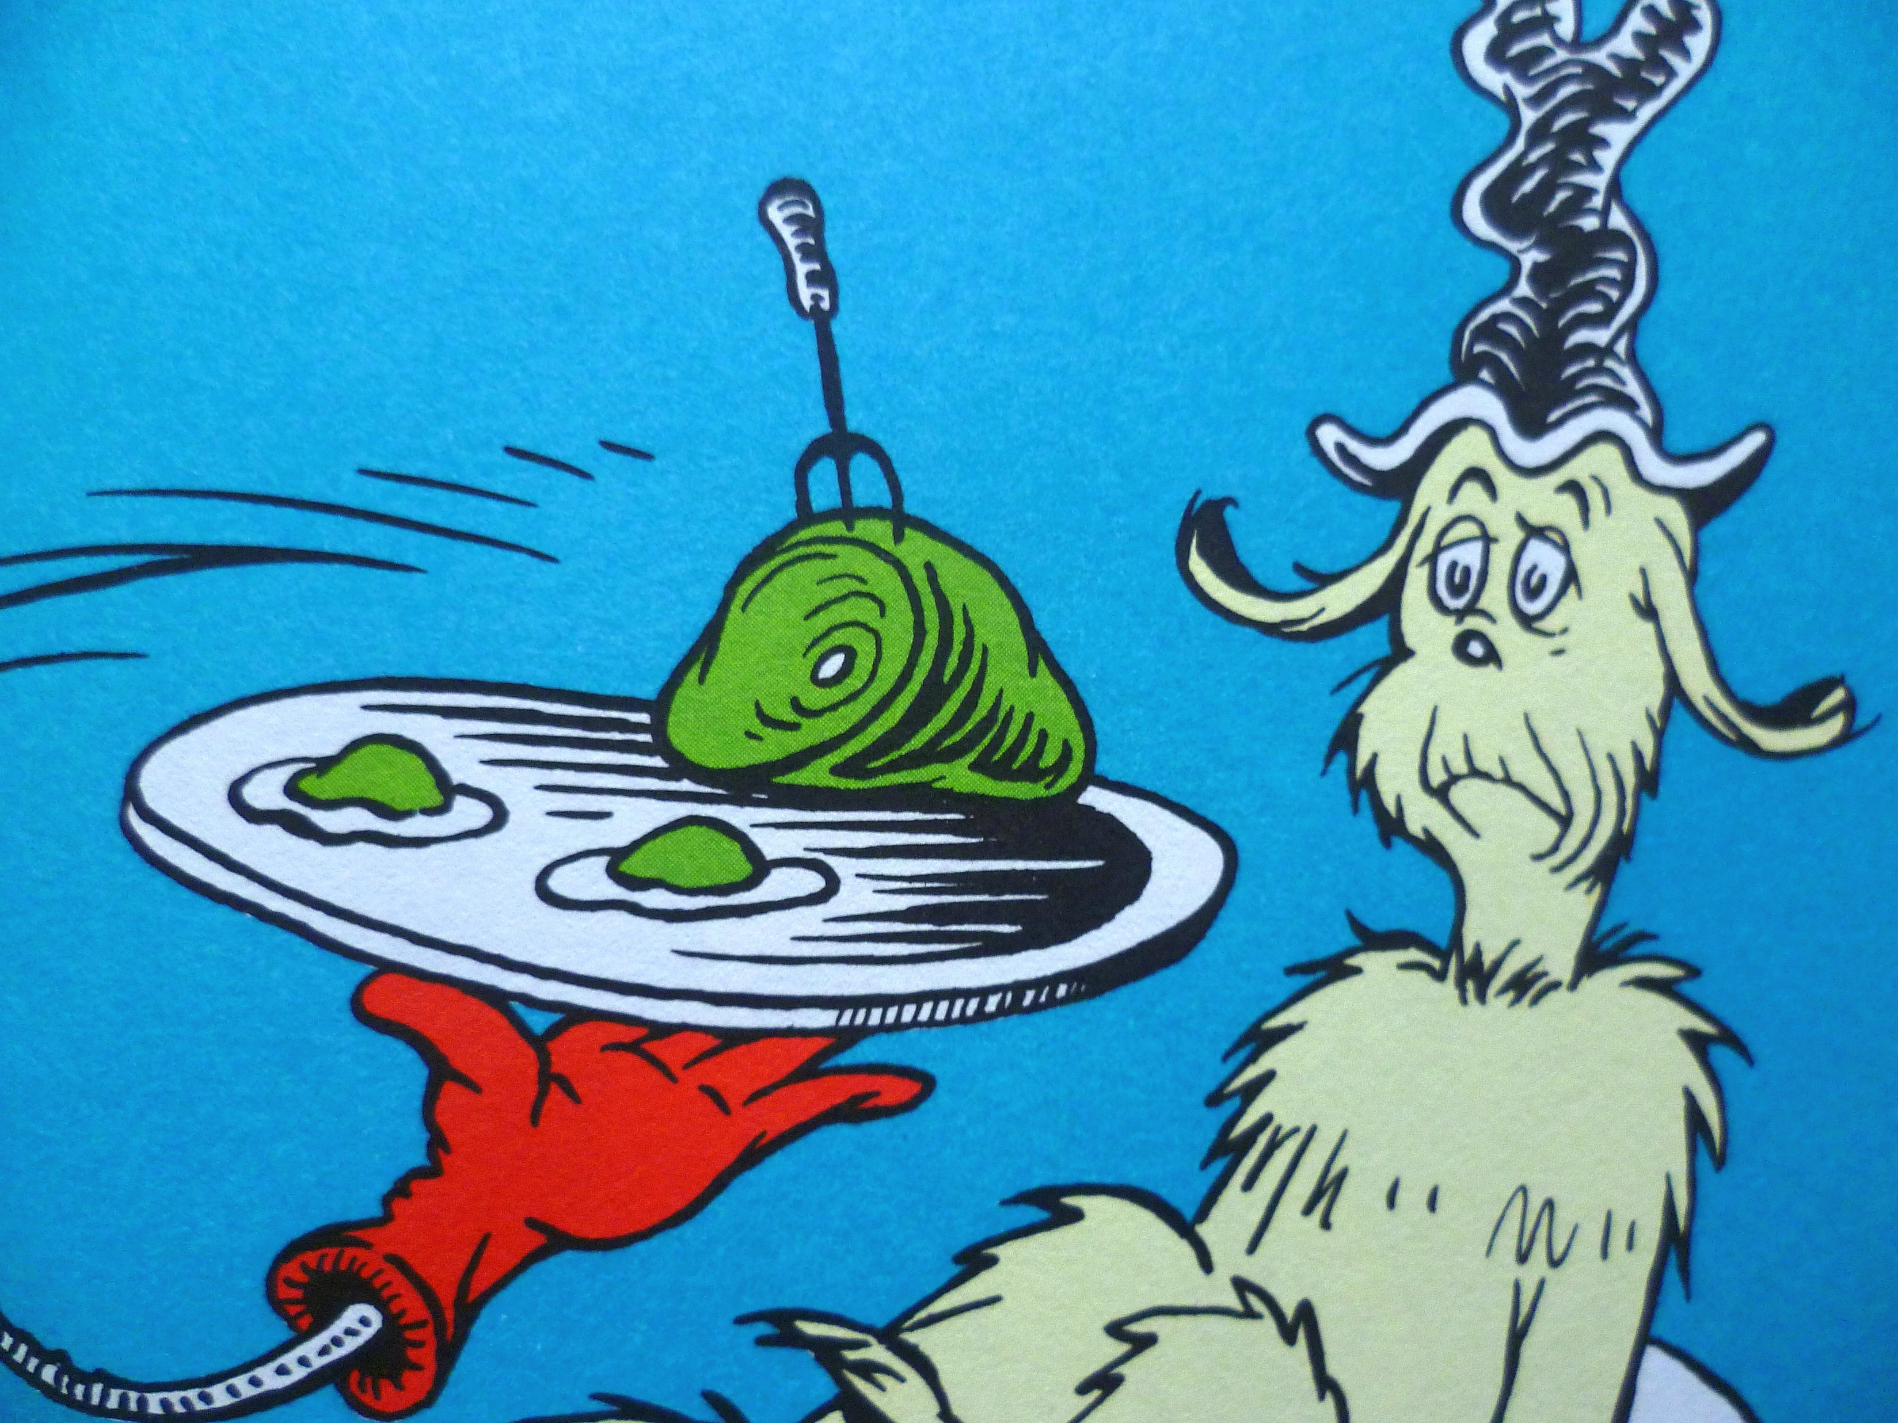
I do not like green eggs and ham.
I do not like them, Sam-I-am.
I could not, would not, on a boat.
I will not, will not, with a goat.
I will not eat them in the rain.
Not in the dark! Not in a tree!
Not in a car! You let me be!
I do not like them in a box.
I do not like them with a fox.
I will not eat them in a house.
I do not like them with a mouse.
I do not like them here or there.
I do not like them anywhere!
I do not like green eggs and ham!
I do not like them, Sam-I-am.

Slide 17
Implicitly trust the wisdom of your Heavenly Father.

Slide 18
How do I Reach Mature Faith?
Forget the past and press on.
Philippians 3:12-15

Slide 19
¹² Not that I have already obtained it or have already become perfect, but I press on so that I may lay hold of that for which also I was laid hold of by Christ Jesus. ¹³ Brethren, I do not regard myself as having laid hold of it yet; but one thing I do: forgetting what lies behind and reaching forward to what lies ahead,
- Philippians 3:12-13

Slide 20
¹⁴ I press on toward the goal for the prize of the upward call of God in Christ Jesus. ¹⁵ Let us therefore, as many as are perfect, have this attitude; and if in anything you have a different attitude, God will reveal that also to you;
- Philippians 3:14-15

Slide 21
How do I Reach Mature Faith?
Make “winning as many as possible” your lifestyle.
1 Corinthians 9:19-23

Slide 22
¹⁹ For though I am free from all men, I have made myself a slave to all, so that I may win more. ²⁰ To the Jews I became as a Jew, so that I might win Jews; to those who are under the Law, as under the Law though not being myself under the Law, so that I might win those who are under the Law;
- 1 Corinthians 9:19-20

Slide 23
²¹ to those who are without law, as without law, though not being without the law of God but under the law of Christ, so that I might win those who are without law. ²² To the weak I became weak, that I might win the weak; I have become all things to all men, so that I may by all means save some.
- 1 Corinthians 9:21-22

Slide 24
I do all things for the sake of the gospel, so that I may become a fellow partaker of it.
- 1 Corinthians 9:23

