Slide 1
3
Evolution’s Extinction Engine
Part 1

Slide 2
DNA

Slide 3
“I will give thanks to You, because I am awesomely and wonderfully made;
Wonderful are Your works,
And my soul knows it very well.”
- Psalm 139:14

Slide 4
How to build an airplane
Landing gear
Wings
Fuel system (fuselage)
Aerodynamic body
Engines
Cabin pressure system

Slide 5
How to build an airplane
Cockpit
Tail assembly
Flaps, ailerons
Weight ratio
Instrument panel
Computers
Rudder pedals

Slide 6
How to build an airplane – from scratch!
Mining all required metal
Drilling the oil to produce the rubber for the tires etc.
Extracting the silicon from sand for circuit boards
Oil to plastic process

Slide 7
How to build an airplane – from scratch!
Building the rivets, nuts and bolts from scratch
Oil to jet fuel conversion process (refinery)
Building the scales to measure the weight of parts

Slide 8
How to build an airplane – the tools!
How to build the tools used in assembly
How build the mining / drilling equipment
How to build the refineries to convert oil to byproducts

Slide 9
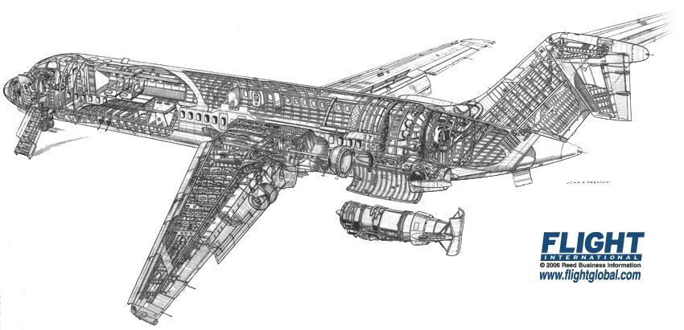
How to build an airplane – the whole manual!
There’s more:
Skilled engineers to understand/decode the manuals
Skilled workers who can build piece by piece
Know when to build a part and use it (order)
Know which manual has the instructions you need at the precise time you need it
Know how to use it once it is built

Slide 10
How to build an airplane – the whole manual!
There’s more!
How to build/make/create the engineers to read the manuals
How to build/make/create the workers to carry parts when needed
How to build/make/create the crew to fly the airplane after construction
How to build/make/create the inspectors to make sure it remains safe

Slide 11
Now, lets apply “evolution’s engine”
+
+
+
Lead to a better / improved airplane?
Lead to new features (ability to travel to space/under water)?
How long before it doesn’t fly at all?
Evolution’s “change” engine is blind, based on chance, has no intelligence, has no forward thinking.

Slide 12
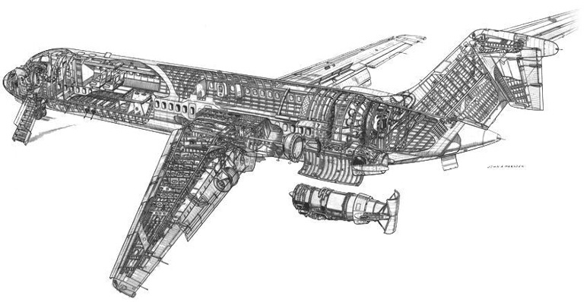
Manuals, codes, and languages
=
How to build an airplane from scratch
Critical thinking:
Could these manuals write themselves?
Could they write themselves if they had 13.8 billion years to do it?
Does it make it easier to believe if the manual is DNA?
Languages, codes, and manuals always come from a mind. Can you think of any exceptions?

