Slide 1
7
When Ordinary Men and Women Do Extraordinary Work Part 2

Slide 2
God called and the exiles were ready!

Slide 3
What to Expect
Resources
His resources, not yours

Slide 4
What to Expect
Resources
His resources, not yours
He provides at His pace

Slide 5
What to Expect
Resources
His resources, not yours
He provides at His pace
He provides the full amount

Slide 6
What to Expect
Resources
Opposition

Slide 7
What to Expect
Resources
Opposition
Victory

Slide 8
Summary I
Ezra/Neh. → Jesus – 400 years.
(Preparing for the Coming of the Savior)
Today → ?
(Preparing for the Return of the Savior)

Slide 10
Let us Build Because He Will Provide:
Resources
Power
Victory

Slide 11
THE ART OF FINISHING

Slide 12
The Art of Finishing
Finishing is always harder than starting.

Slide 17
Nehemiah:
Reorganize society
Establish religious calendar
Organize temple service
Organize National Dedication Day
Return to Maintain

Slide 18
It’s always harder to finish than start.

Slide 19
The Art of Finishing
Finishing is always harder than starting.
You must resolve that nothing will stop you from finishing.

Slide 20
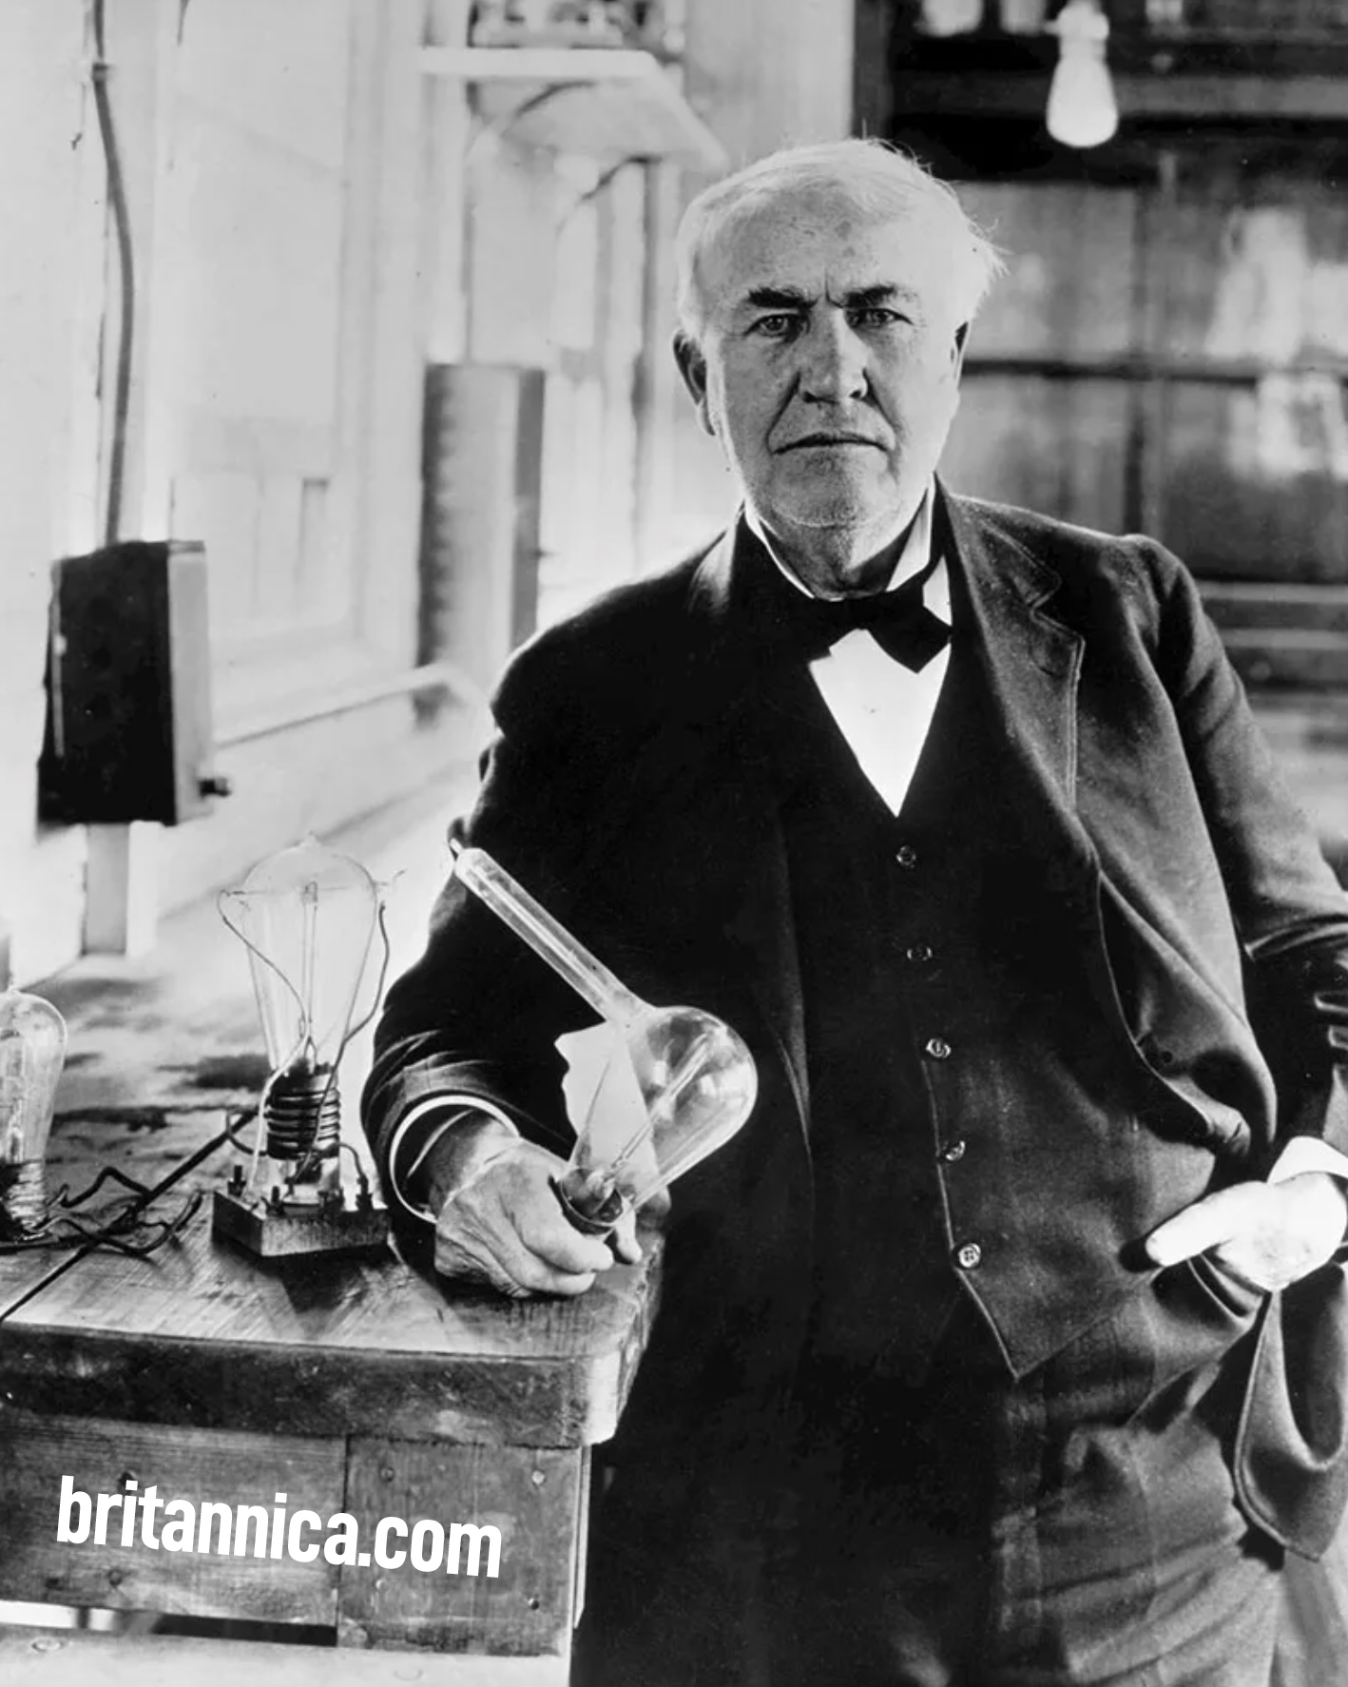
THOMAS EDISON

Slide 21
BEGIN
OBSTACLES
I WANT TO QUIT
VICTORY
(VICTORY)

Slide 22
The Art of Finishing
Finishing is always harder than starting.
You must resolve that nothing will stop you from finishing.
Remember that rewards are only given to finishers, not starters.

Slide 23
“IT IS FINISHED” JOHN 19:30

Slide 24
HIS REWARD WAS OUR RESURRECTION. (I PETER 1:3)

Slide 25
²⁴ Do you not know that those who run in a race all run, but only one receives the prize? Run in such a way that you may win. ²⁵ Everyone who competes in the games exercises self-control in all things. They then do it to receive a perishable wreath, but we an imperishable.
- I Corinthians 9:24-25

Slide 26
GOD BLESS YOU IN WHATEVER YOU BUILD FOR HIM.

