Slide 1
The Lord of Hurting

Slide 2
After the initial impact of tragedy, all that is left is pain – usually accompanied by loneliness.

Slide 3
Jesus Christ is the Lord of Hurting

Slide 4
The Lord of Hurting Provides:
An avenue of prayer

Slide 5
God Listens, Cares and Answers:
Abraham
Samson
Hezekiah
Dorcas

Slide 6
“Come to Me, all who are weary and heavy-laden, and I will give you rest.
- Matthew 11:28

Slide 7
²⁶ In the same way the Spirit also helps our weakness; for we do not know how to pray as we should, but the Spirit Himself intercedes for us with groanings too deep for words; ²⁷ and He who searches the hearts knows what the mind of the Spirit is, because He intercedes for the saints according to the will of God.
- Romans 8:26-27

Slide 8
Don’t suffer more than you need to – pray!

Slide 9
The Lord of Hurting Provides:
An avenue of prayer
An avenue of teaching

Slide 10
Pain by itself teaches us nothing.

Slide 11
Through His Word God provides us with a mirror of ourselves.

Slide 12
God does not leave us to suffer in the darkness.

Slide 13
The Lord of Hurting Provides:
An avenue of prayer
An avenue of teaching
An avenue of help

Slide 14
No temptation has overtaken you but such as is common to man; and God is faithful, who will not allow you to be tempted beyond what you are able, but with the temptation will provide the way of escape also, so that you will be able to endure it.
- I Corinthians 10:13

Slide 15
“Temptation” has 2 meanings:
Seduction to do evil
God helps:
Guidance – II Timothy 3:16
Holy Spirit – Romans 8:13
The Church – I Timothy 3:15
Biblical Examples – I Corinthians 10:11

Slide 16
“Temptation” has 2 meanings:
Seduction to do evil
A trial or test
A brother to lean on
A thing to do
Resources
Insight

Slide 17
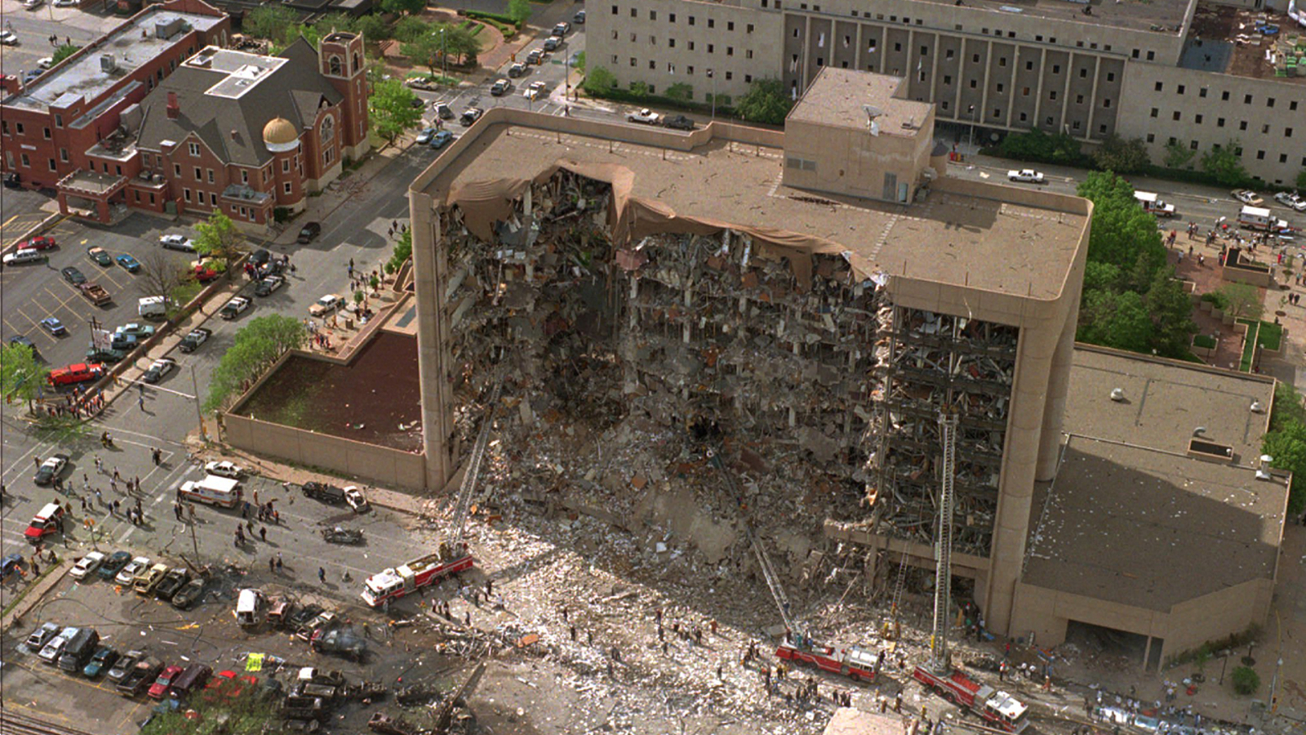

Slide 19
What is your hurt? What is your avenue of escape?

