Slide 1
Being Rich in a World of Poverty

Slide 2
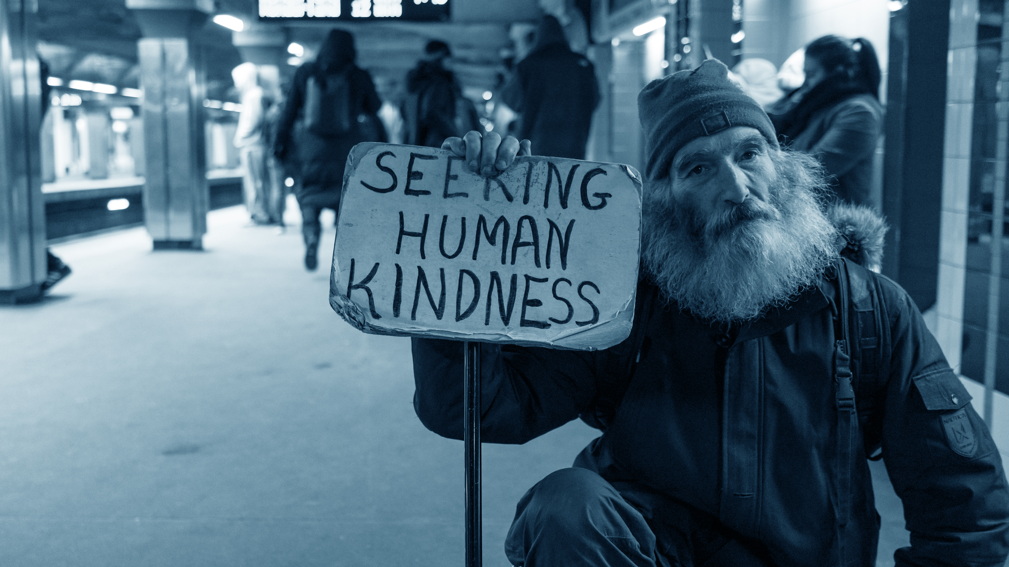

Slide 3
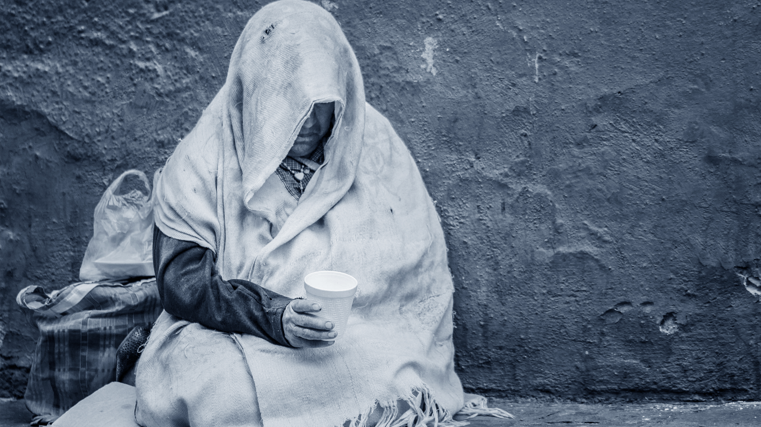

Slide 4
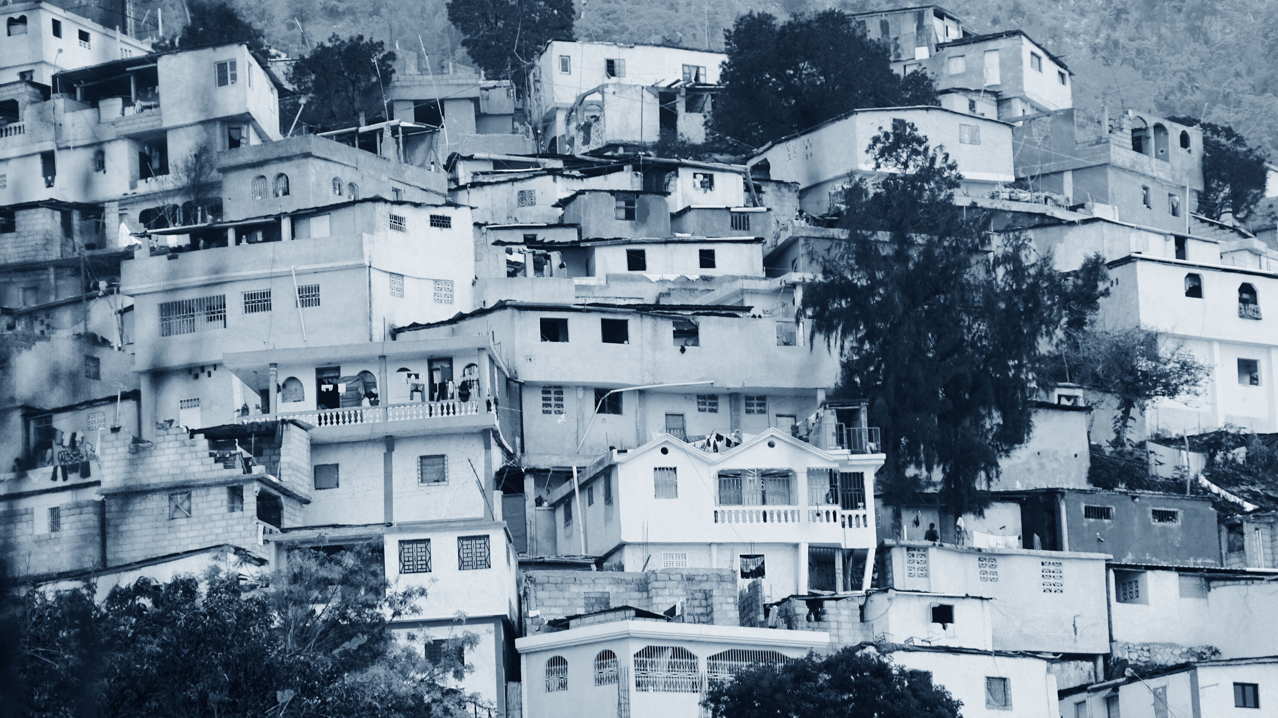

Slide 5
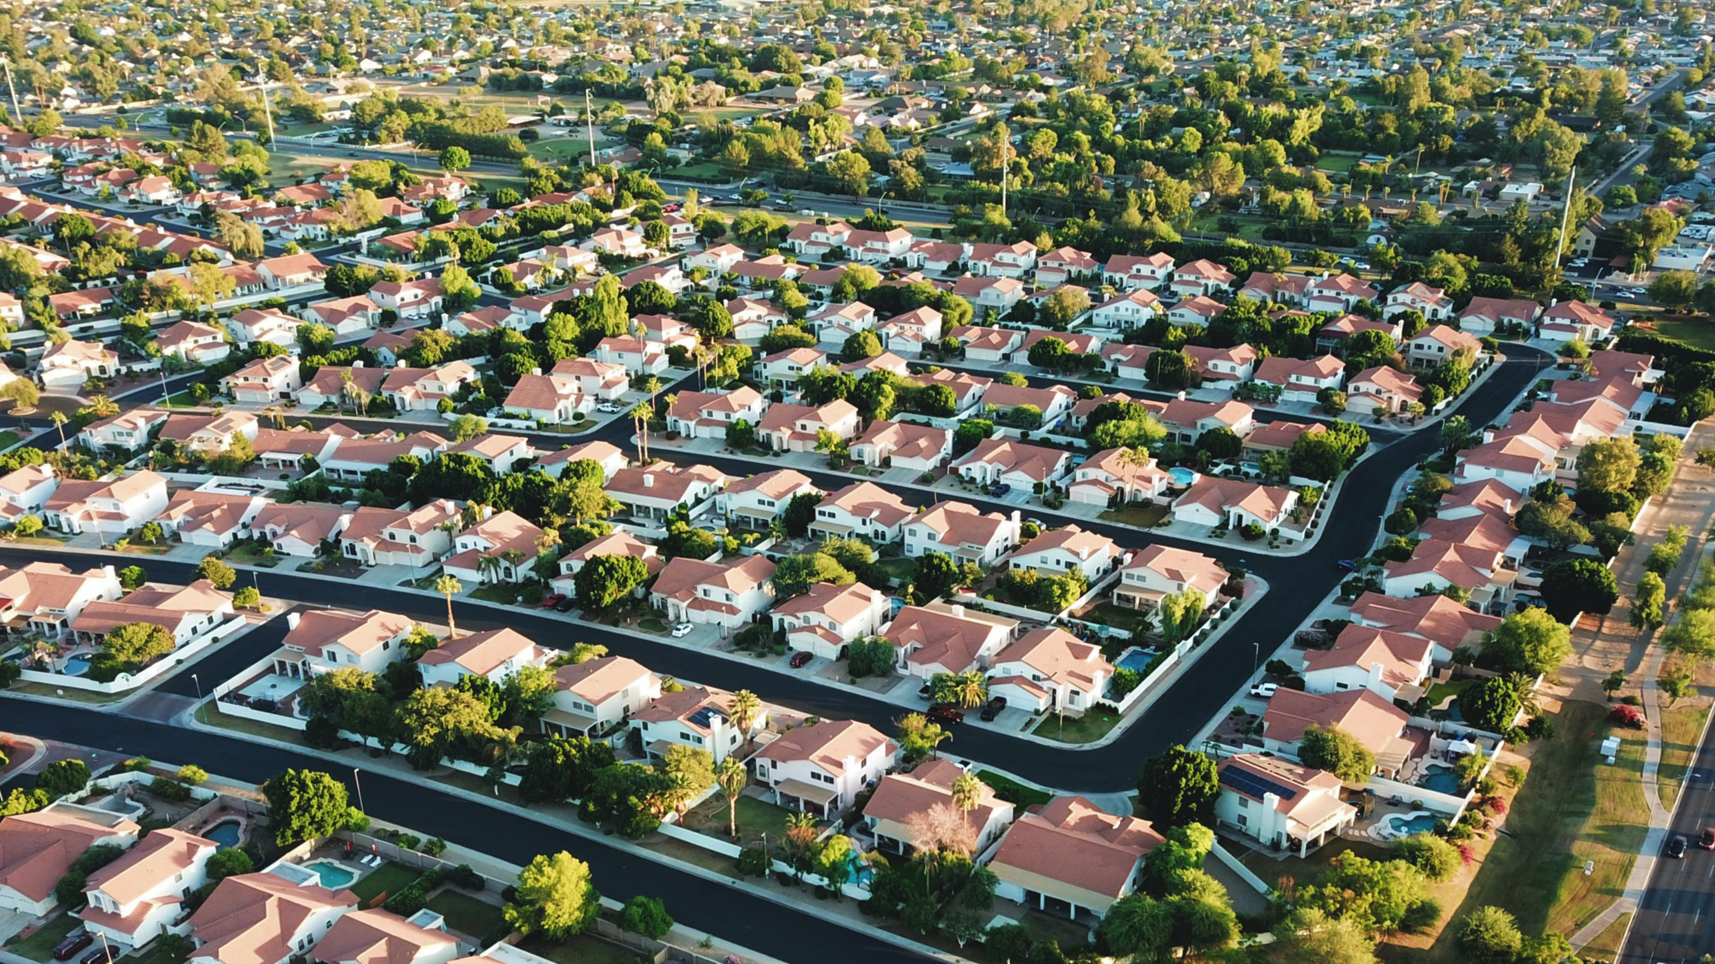

Slide 6
We are the Rich!

Slide 7
Being Rich in a Poor World
There is a saturation point beyond which the accumulation of wealth becomes uncomfortable for the body and soul.

Slide 8
Have you found honey? Eat only what you need, That you not have it in excess and vomit it.
- Proverbs 25:16

Slide 9
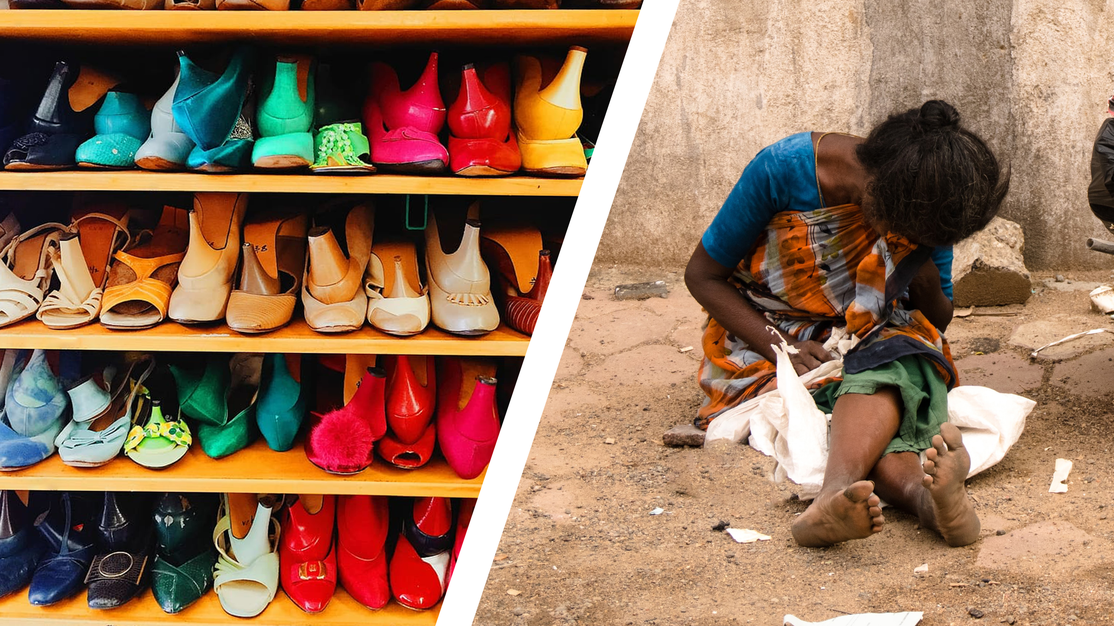

Slide 10
Being Rich in a Poor World
Being rich requires much more discipline

Slide 11
¹¹ When good things increase, those who consume them increase. So what is the advantage to their owners except to look on? ¹² The sleep of the working man is pleasant, whether he eats little or much; but the full stomach of the rich man does not allow him to sleep.
- Ecclesiastes 5:11-12

Slide 12
BEING RICH WARS AGAINST MY SPIRITUALITY

Slide 13
Being Rich in a Poor World
Being rich has made it easier for me to be insensitive to the needs of others.

Slide 14
¹⁹ “Now there was a rich man, and he habitually dressed in purple and fine linen, joyously living in splendor every day. ²⁰ And a poor man named Lazarus was laid at his gate, covered with sores, ²¹ and longing to be fed with the crumbs which were falling from the rich man’s table; besides, even the dogs were coming and licking his sores.
- Luke 16:19-21

Slide 15
²² Now the poor man died and was carried away by the angels to Abraham’s bosom; and the rich man also died and was buried. ²³ In Hades he lifted up his eyes, being in torment, and saw Abraham far away and Lazarus in his bosom.
- Luke 16:22-23

Slide 16
²⁴ And he cried out and said, ‘Father Abraham, have mercy on me, and send Lazarus so that he may dip the tip of his finger in water and cool off my tongue, for I am in agony in this flame.’ ²⁵ But Abraham said, ‘Child, remember that during your life you received your good things, and likewise Lazarus bad things; but now he is being comforted here, and you are in agony.
- Luke 16:24-25

Slide 17
Being rich makes me forget what needing is like and needing is what the heart sees and hears.

Slide 18
Wealth:
False sense of security
False sense of independence
Rejection of other’s needs

Slide 19
These are matters which have, to be sure, the appearance of wisdom in self-made religion and self-abasement and severe treatment of the body, but are of no value against fleshly indulgence.
- Colossians 2:23

Slide 20
Spiritual Balance (Rich or Poor)
Give a minimum of 10% to God

Slide 21
10% = Sacrifice

Slide 22
I’m encouraging sacrifice in giving.

Slide 23
Spiritual Balance (Rich or Poor)
Give a minimum of 10% to God
Compare the time and energy invested in gaining wealth to time and energy serving others

Slide 24
Spiritual Balance (Rich or Poor)
Give a minimum of 10% to God
Compare the time and energy invested in gaining wealth to time and energy serving others
Be continually thankful

Slide 25
Gratitude:
Enables enjoyment of what we have without guilt
Moves us to share with others
Helps us to keep our blessings (great or small) in perspective

Slide 26
True wealth is salvation.

