Slide 1
A State of Readiness

Slide 2
A State of Readiness
Prepare through service

Slide 3
³⁵ “Be dressed in readiness, and keep your lamps lit. ³⁶ Be like men who are waiting for their master when he returns from the wedding feast, so that they may immediately open the door to him when he comes and knocks.
- Luke 12:35-36

Slide 4
Blessed are those slaves whom the master will find on the alert when he comes; truly I say to you, that he will gird himself to serve, and have them recline at the table, and will come up and wait on them.
- Luke 12:37

Slide 5
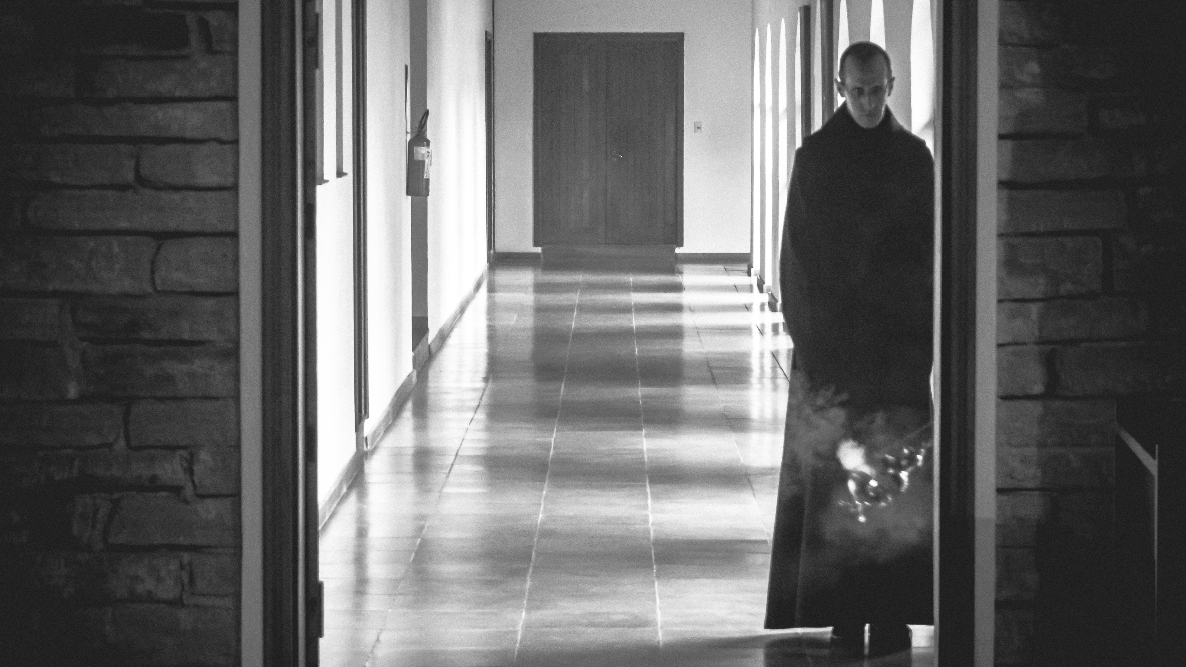

Slide 6
Readiness requires that we be serving others in His name.

Slide 7
When He comes He will bless the doers not the watchers.

Slide 8
A State of Readiness
Prepare through service
We are ready at all times

Slide 9
³⁸ Whether he comes in the second watch, or even in the third, and finds them so, blessed are those slaves. ³⁹ “But be sure of this, that if the head of the house had known at what hour the thief was coming, he would not have allowed his house to be broken into. ⁴⁰ You too, be ready; for the Son of Man is coming at an hour that you do not expect.”
- Luke 12:38-40

Slide 11
We have to be ready for the Lord’s coming at any time.

Slide 12
Not Ready if:
Putting off baptism
Secret sins
Serving conveniently or comfortably
Jesus is second

Slide 13
He will come when you least expect it.

Slide 14
Christian Training
Daily prayer
Bible reading/study
Faithful attendance
Service
Sharing faith
Ministry to the lost
Growing in purity and love

Slide 15
We’re ready at any time because He can come at any time.

Slide 16
Three States of Readiness
The Faithful Steward

Slide 17
⁴¹ Peter said, “Lord, are You addressing this parable to us, or to everyone else as well?” ⁴² And the Lord said, “Who then is the faithful and sensible steward, whom his master will put in charge of his servants, to give them their rations at the proper time?
- Luke 12:41-42

Slide 18
⁴³ Blessed is that slave whom his master finds so doing when he comes. ⁴⁴ Truly I say to you that he will put him in charge of all his possessions.
- Luke 12:43-44

Slide 19
Reward:
Resurrection – I Thessalonians 4:16
Glorified Body – I Corinthians 15:42-49
Seated with the Godhead – II Timothy 2:12

Slide 20
Three States of Readiness
The Faithful Steward
Unfaithful Steward

Slide 21
⁴⁵ But if that slave says in his heart, ‘My master will be a long time in coming,’ and begins to beat the slaves, both men and women, and to eat and drink and get drunk; ⁴⁶ the master of that slave will come on a day when he does not expect him and at an hour he does not know, and will cut him in pieces, and assign him a place with the unbelievers.
- Luke 12:45-46

Slide 22
And that slave who knew his master’s will and did not get ready or act in accord with his will, will receive many lashes,
- Luke 12:47

Slide 23
Three States of Readiness
The Faithful Steward
Unfaithful Steward
The Lost Servant

Slide 24
but the one who did not know it, and committed deeds worthy of a flogging, will receive but few.
- Luke 12:48a

Slide 25
ROMANS 1:20 “… without excuse.”

Slide 26
DIFFERENT INTENSITIES OF PUNISHMENT

Slide 27
From everyone who has been given much, much will be required; and to whom they entrusted much, of him they will ask all the more.
- Luke 12:48b

Slide 28
GREAT GIFT = GREAT RESPONSIBILITY

Slide 29
What Kind of Steward Are You? ~ CHECK ONE BOX ONLY ~
Ignorant Slave
Unfaithful Steward
Faithful and Sensible Steward

Slide 30
WHAT DO YOU NEED TO DO OR CHANGE TO BE READY?

